Slide 1



DOING BUSINESS WITH LAWA WORKSHOP
LOS ANGELES WORLD AIRPORTS
Rev. 03/2023

Slide 2

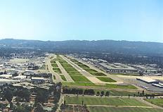
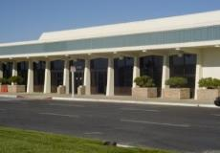
Los Angeles World Airports
 | In 2022, airlines served 65.9 million passengers In 2021, airlines served 48 million passengers In 2020, airlines served 28 million passengers (#5 in US) In 2019, airlines served 88 million passengers (#2 in US)
 | Van Nuys Airport – one of the world’s busiest General Aviation airports Dedicated to non-commercial air travel
 | LA/Palmdale - LAWA owns and maintains the Palmdale Land Holdings, previously an FAA-certified airport

Slide 3
Workshop Overview
    Business Opportunities
    Competitive Processes
    Concessions
    Registering on RAMP
    Business Assistance Programs
    Certification
    Administrative Requirements
    Next Steps

Slide 4

Business Opportunities
LAWA procures almost $400
million annually in Request
for Bids (RFBs):
    Goods and Equipment
    Materials and Supplies
    Non-professional services.
LAWA has administered over $14 Billion in Request for Proposals (RFPs):
    Construction Projects (Planning & Development Group)
    Professional Services including On-Call contracts.

Slide 5
Request For Proposals (RFP)
A Request for Proposal is used for the competitive procurement of the following:
  Capital Projects (Terminals, Runways, Railroads, etc.)
  Professional Services (Engineering, Architectural, &/or Environmental Services, etc.
The award is based on the winning score according to the selection criteria which may include:
    Concept
    Experience
    Cost
    Etc.
RFP’s can be for individual items, services, or contracts.

Slide 6
Important RFP Information to Note
DUE DATE (COVID-19 info)
  There are no exceptions to the stated Due Date and Time
  RFP proposal submittal must be uploaded through Box
  Upload instructions are located on RAMP RFP page.
QUESTIONS & CLARIFICATIONS
  Must contact the designated LAWA Project Manager for RFPs.
AUTHORIZATION
  RFP must be signed by someone authorized to encumber the bidding/proposing company.
PRE-PROPOSAL MEETINGS
  Non-mandatory.

Slide 7
Additional RFP Requirements
COMPLETION OF DOCUMENTS
  Any Worksheets and Administrative Requirements must be filled out as directed and returned complete, in the order received. Failure to do so may invalidate RFP.
BE CAREFUL
  Be sure to read and complete the RFP documents accurately. Failure to do so may invalidate your RFP.

Slide 8
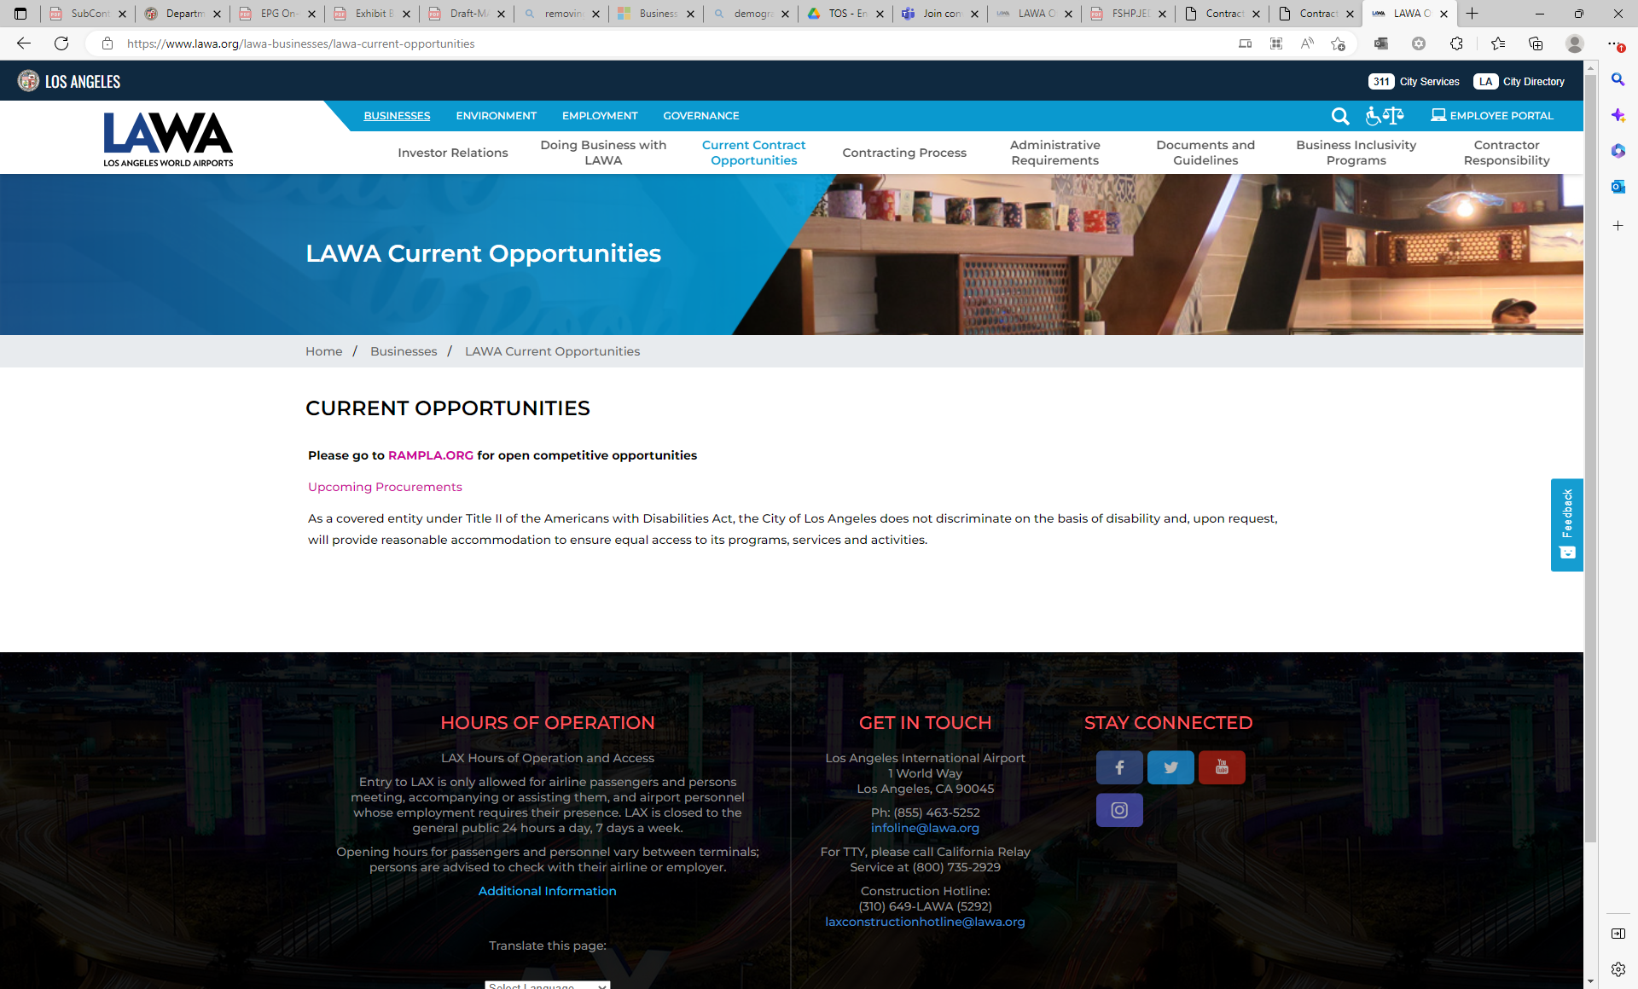
Construction Forecast Report
(LAWA Development Group)
See Contracts and Procurements Document:
  https://www.lawa.org/lawa-businesses/lawa-current-opportunities
For questions, contact PDGprocurement@lawa.org

Slide 9
Request For Bids (RFB)
A Request for Bid is used for the competitive purchase of the following:
  Goods
  Equipment
  Non-professional services.
The contract award is made to the lowest priced bid that is deemed to be:
  Responsive – accurate completion of the bid
  Responsible – determined to be capable of meeting the specifications.
Bids can be for individual items, services, or contracts from 1 to 5 years in duration.

Slide 10
Important RFB Information to Note
DUE DATE (COVID-19 Info)
  There are no exceptions to the stated Due Date and Time
  RFB bid submittal must be uploaded through Box
  Upload instructions are located on RAMP RFB page.
QUESTIONS & CLARIFICATIONS
  Must contact the designated LAWA Procurement Analyst via email for RFBs.
AUTHORIZATION
  RFB must be signed by someone authorized to encumber the bidding/proposing company.
PRE-BID MEETINGS
  Mandatory vs. Non-mandatory.

Slide 11
Additional RFB Requirements
COMPLETION OF DOCUMENTS
  Bid, Worksheets and Administrative Requirements must be filled out as directed and returned complete, in the order received. Failure to do so may invalidate RFB.
PAYMENT TERMS
  Discount terms of 25 days or more can impact your RFB evaluation.
DEVIATION FROM SPECIFICATIONS
  When allowed, bidders desiring to quote on any other comparable make/brand must indicate make/brand and model name/number.
BE CAREFUL
  Be sure to read and complete the bid documents accurately. Failure to do so may invalidate your RFB.

Slide 12
Soliciting Bids and Proposals
All City of Los Angeles RFB/RFPs are available on:
  The Los Angeles Regional Alliance Marketplace for Procurement (RAMP) web site:
    https://www.rampla.org

Slide 13
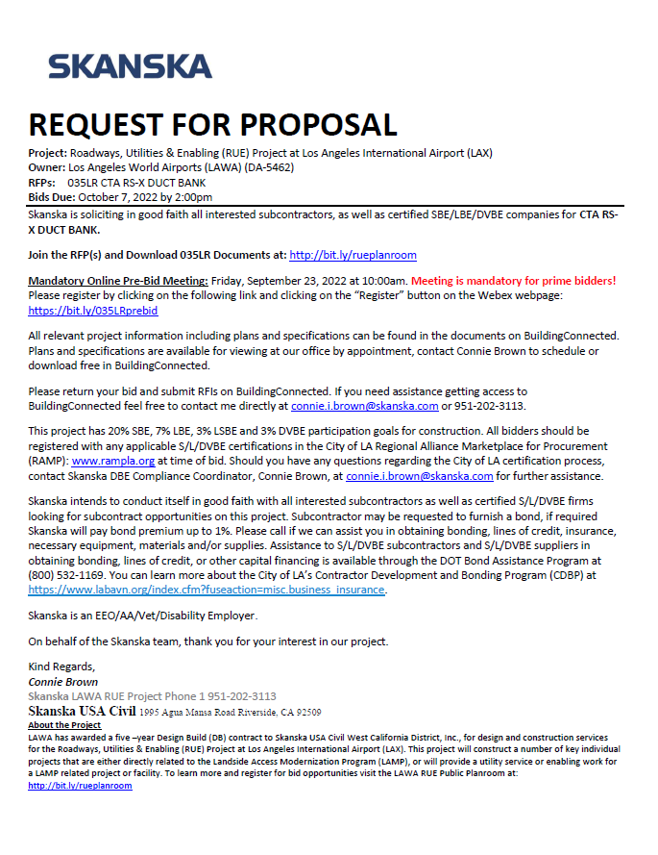
Current/Future Construction Opportunities
Keep an eye out for sub-contracting opportunities under Skanska USA Civil for work on Roadways, Utilities & Enabling (RUE) Project at LAX
http://bit.ly/rueplanroom

Slide 14
LAWA Concessions Overview
What is a concession?
An Airport Concession is defined as:
  Business located at the Airport engaged in the sale of consumer goods or services to the public under an agreement w/ 1) the Airport, or 2) another Concessionaire
  Business conducting one or more of the following activities (even if it does not maintain an office or store at the Airport, as long as activities take place at the Airport):
    Managing contracts and subcontracts (e.g. Terminal Commercial Manager / URW)
    Web-based or other electronic business where passengers can access in the terminals (e.g. WiFi)
    Advertising business providing displays or messages to the public at the Airport (e.g. JCD)
Does LAWA manage all concessions at LAX?
Yes, using two (2) concession management models –
  Direct management for airport-wide concession services (currency exchange, luggage carts, etc.), and for Food & Beverage and Retail concessions in Terminals 4, 5, 7, and 8.
  Via Terminal Commercial Manager (TCM) for Terminals 1, 2, 3, 6, and TBIT.

Slide 15
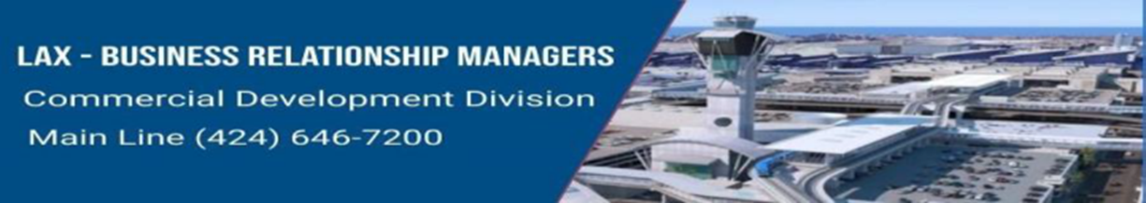
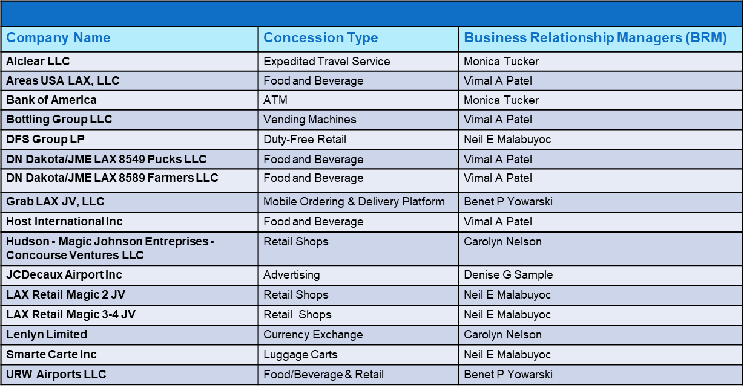
LAWA’s Current Concession Operators

Slide 16
LAWA Concession Opportunities
How do I get my business at the airport?
Concessions are selected via an open competitive solicitation basis (aka Bid/Award process, e.g. RFB, RFP, etc.). To be notified of any opportunities, interested parties may:
  Register with the LA City website (rampla.org)
  Reach out to LAWA’s Terminal Commercial Manager, URW, to learn more about opportunities available in terminals managed by the TCM (Terminals 1, 2, 3, 6, and TBIT).
Other than an RFP issued by LAWA, how can I get my business at the airport?
  Educate yourself on partnership opportunities. Airport Concessions Disadvantaged Business Enterprise (ACDBE) is a certification your business may qualify for.
  Educate yourself on concession companies and research their ACDBE opportunities.
  Competitive Evaluation Process (CEP) through TCM.

Slide 17
LAWA Concession Timelines
When do LAWA concession agreements expire?
  LAWA direct F&B and retail concession agreements expire on 6/30/25
  Service agreements have various expiration dates (e.g. ATM, luggage carts)
  Depending on the agreement, there may be an opportunity to extend the agreement (case by case basis).
  Unit Concession Agreements (UCAs) managed by TCM have various expiration dates.
How long are LAWA concession agreements?
The average term for a concession agreement is up to 10 years.

Slide 18
Concessions Contact
Concessions Questions:
LAWA Commercial Development
(424) 646-7200
CDGopportunities@lawa.org
Terminal Commercial Manager (URW)
(310) 646-1770

Slide 19
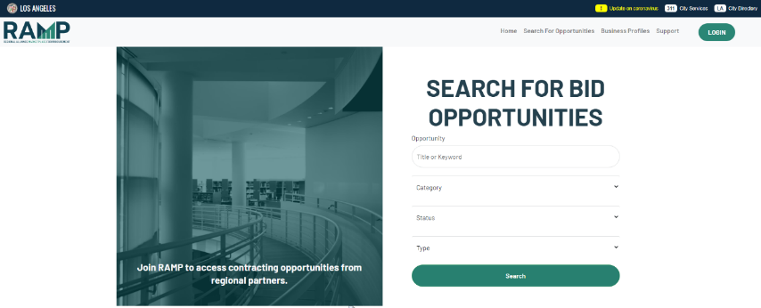
Registering w/RAMP…

Slide 20
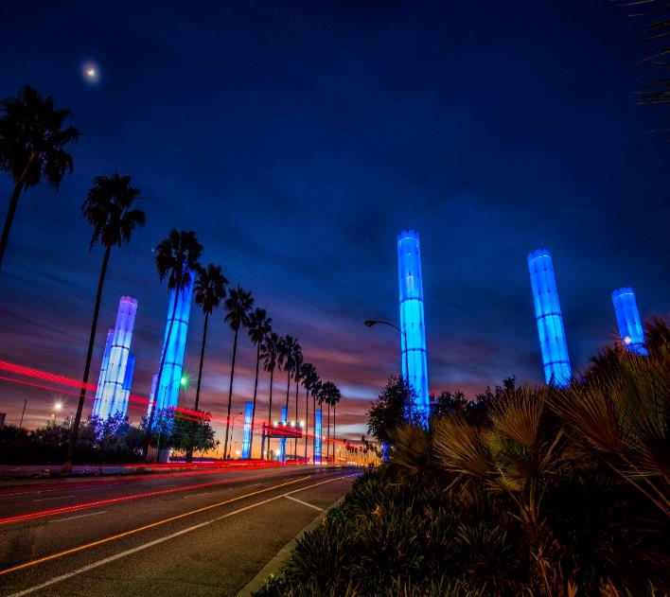

BUSINESS, JOBS
& SOCIAL RESPONSIBILITY
OUR MISSION
Maximize access to business and job opportunities
Ensure that local, diverse communities benefit from LAWA’S investments
Set the global airport standard for public corporate social responsibility
THE FUTURE IS NOW

Slide 21
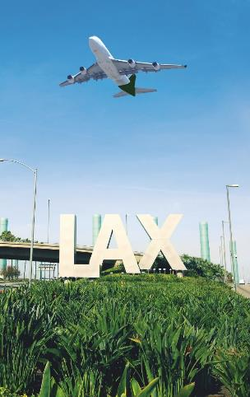
LAWA BUSINESS, JOBS &
SOCIAL RESPONSIBILTITY DIVISION
BUSINESS OPPORTUNITY & SUPPORT
Develop Policies and Programs to Advance Diversity, Equity, and Inclusion at LAWA
Business Inclusion Contract Language
Contractor Development
Bonding Assistance Program
Contract Finance Assistance Program
Workforce Recruitment & Sourcing
Economic Impact/Disparity Studies
Targeted Outreach & Engagement
businessandjobs@lawa.org
424-646-7300
Notes:
We need to re-word or take out the above highlighted bullets. – Why?
Is the email and website still current?- Email is current/ website is under construction

Slide 22
BUSINESS, JOBS & SOCIAL RESPONSIBILITY
For general inquires, contact the Business, Jobs &
Social Responsibility Division at BusinessandJobs@lawa.org or (424) 646 -7300
Notes:
Info updated?

Slide 23


First Source Hiring Program
(FSHP)
Business, Jobs & Social Responsibility Division’s
JobsatLAX.org
Business, Jobs & Social Responsibility (BJSR)

Slide 24
First Source Hiring Program- Overview
The First Source Hiring Program (FSHP) is a valuable resource to connect LAX employers with job seekers.
The program requires employers and their sub-contractors to participate by posting and promoting their jobs on www.jobsatlax.org.
Applicants can apply directly on the company’s website or directly on the www.jobsatlax.org website.
Contractors can post their jobs manually and communicate with job seekers directly.
Currently the website has 100,000+ active job seeker accounts and 50,000+ searchable resumes.
JobsatLAX.org
Business, Jobs & Social Responsibility (BJSR)
Notes:
Need to update information highlighted in yellow – sent email to Matt on 01/04- UPDATED

Slide 25
Next Steps for Selected Contractors
Contact FSHP to register once a LAX contract has started by reaching BJSR at BusinessandJobs@lawa.org for guidance and technical assistance needs.
Complete the “FSHP Company Profile Form” located under the “Employment” tab on www.JobsatLAX.org
Designate a liaison to work with FSHP (i.e. Manager, Human Resources personnel, etc.).
Work with the FSHP team to post jobs online and utilize the features of the system to hire prospective employees.
JobsatLAX.org
Business, Jobs & Social Responsibility (BJSR)

Slide 26
LAWA FIRST SOURCE HIRING PROGRAM
For more information, please contact:
Business, Jobs & Social Responsibility Division
First Source Hiring Program
6053 W. Century Blvd., Suite 300
Los Angeles, CA 90045
Phone: (424) 646-7300
Website: www.jobsatlax.org
Email: BusinessandJobs@lawa.org
JobsatLAX.org
Business, Jobs & Social Responsibility (BJSR)

Slide 27
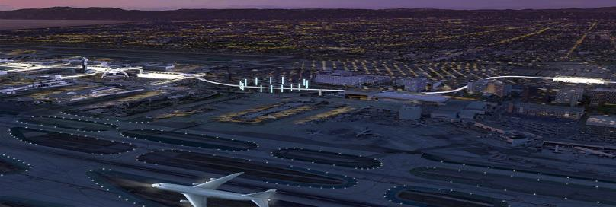


LAWA Contractor Development & Bonding Program
“Doing Business with Los Angeles World Airports”
Rosa Osorio
Senior Account Manager
550 S Hope Street, Suite 1835
Los Angeles, CA 90071
Cell: 213-327-5259
rosa@imwis.com

Slide 28

LAWA Contractor Development Program Services
  To reduce the barriers of bonding/capacity, enabling greater and successful participation of small, local, minority, women and disabled veteran owned businesses in public contract opportunities.

Slide 29

LAWA Contractor Development Program Services
Obtaining or Increasing Bonding Capacity
Contractor Development, Capacity Building and Technical Services
Dedicated Account Manager (Business Development)
Agency Collateral Support
  Bid, Performance & Payment Bonds for Qualified Contractors
Third Party Funds Administration
Accounting Cost Subsidy
  $3,200 for CPA Prepared Financial Statements
Weekly Bid, Project and Event Email Alerts

Slide 30
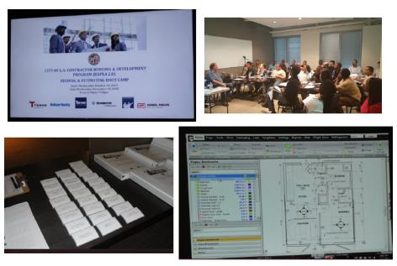
LAWA Contractor Development Technical Assistance
Assessment & Work Plan
Contractor Profile
Certifications
Capacity Building
Bid Document Review
Contract Monitoring
Monthly Workshops & Coaching
Construction Training Academy
    Bidding & Estimating
    Contract Award Management

Slide 31
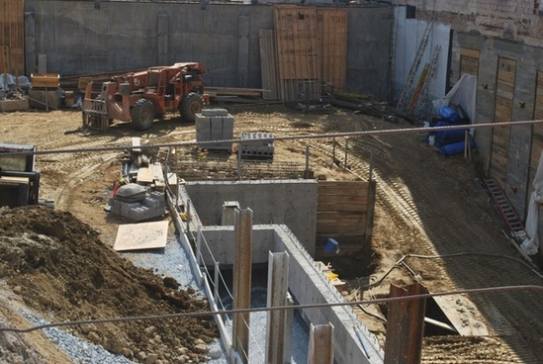
LAWA Contractor Development Bid Document Review
Bid Review Disclaimer: Bid Review is a courtesy for contractors enrolled in the Contractor Development and Bonding Program and who meet the minimum requirements. Neither Merriwether & Williams Insurance Services nor Metro Agency is responsible for errors, oversights, omissions or misstatements made in the preparation of the Bid Review.
Attend Pre-Bid
Review Plans & Specs
Assist with Identifying Risks
Assist with Identifying Required Bid Documents
Schedule Additional Meetings Prior to Bid Submission
Follow Up After Bidding Process

Slide 32
LAWA Contractor Development Contract Monitoring
Contract Review with Contractor
Project Kick-off
Monthly Site Visits (If Applicable)
Status Reports
Construction Schedule
Cost Management
Closeout

Slide 33
LAWA Contractor Development & Bonding Program
“Doing Business with Los Angeles World Airports”
Rosa Osorio
Senior Account Manager
550 S Hope Street, Suite 1835
Los Angeles, CA 90071
Cell: 213-327-5259
rosa@imwis.com

Slide 34
GETTING CERTIFIED
Small Business Enterprise (SBE-Proprietary)
Local Business Enterprise (LBE)
Local Small Business (LSB (formerly Small Local-now online)
Disabled Veterans Business Enterprise
DVBE (LAWA)
Certification Recognition
Local Small Business Enterprise (LSBE) (LAWA)
Federal Programs
Disadvantaged Business Enterprise (DBE)
Airport Concessions DBE (ACDBE)

Slide 35
SBE (Proprietary) Certification
Requirements:
  Firm is independently owned and operated
  Firm meets small business criteria set forth by the Small Business Administration (8a) Business Development Program or State DGS Small Business Program, whichever standard is higher
Advantage:
  Certification provides additional opportunities in competing against non-certified subcontractors for procurement opportunities calling for SBE (Proprietary)-certified firms
Process:
  If certified by one of the agencies on the chart in the following slide, provide copy of the certification or approval letter; OR if not, submit SBE (Proprietary) Application for processing.
  Certification is good for two years.
Applying:
  Go to https://bca.lacity.org/Uploads/cca/SBE%20%28Proprietary%29%20Application.pdf
Types of Projects: Construction, professional and non-professional projects valued over $150,000.

Slide 36
SBE (Proprietary) Certification
If your firm is currently certified with one of the following agencies you do NOT need to go through the Certification process, simply submit a copy of your certification to a Certification analyst or with your bid/proposal.
City of Los Angeles
City of Los Angeles
CERTIFYING AGENCY | CERTIFICATION | ACCEPTED BY LAWA FOR SBE (PROPRIETARY)?
Federal Small Business Administration (SBA) | SBA 8(a) Business Devpt. Program | Yes
State of California Department of General Services (DGS) | SB, SB-Public Works, SB (micro) | Yes
California Department of Transportation (CALTRANS) | SMBE, SWBE, DBE | Yes
L.A. County Metropolitan Transportation Authority (METRO) | SBE, DBE | Yes
California Unified Certification Program (CUCP) Agencies: • California Department of Transportation (CALTRANS) City of Fresno • City of Los Angeles L.A. County Metropolitan Transportation Authority (METRO) • San Diego County Regional Airport Authority (SAN) • San Francisco Bay Area Rapid Transit District (BART) • San Francisco International Airport (SFO) • San Francisco Municipal Transportation Agency (SFMTA) • San Mateo County Transit District (SAMTRANS) • Santa Clara Valley Transportation Authority (VTA) | DBE | Yes
US Women’s Chamber of Commerce (USWCC) | WOSB, EDWOSB | Yes
Women’s Business Enterprise Council West (WBEC-WEST) | WOSB | Yes
National Women Business Owners Corporation (NWBOC) | WOSB, EDWOSB | Yes
City of Los Angeles | SBE, SLB | Yes
County of Los Angeles | LSBE | Yes

Slide 37
LBE Certification
Requirements:
  Must have business workspace within County of Los Angeles boundaries:
    Headquartered (physically conducts and manages all operations) in the County; OR
    at least 50 of its full-time employees perform work within the boundaries of the County at least 60 percent of their total hours worked on annual basis; OR
    at least half of its full-time employees work within the boundaries of the County at a minimum of 60 percent of their total regular hours worked on annual basis.
  City of Los Angeles Business Tax Registration Certificate
  Current on all City & County taxes
  Licenses, permits, etc. to provide goods and/or services
Advantage:
  Certified LBEs on procurement contracts over $150,000 are given an 8% deduction on the bid amount or 8 points toward the proposal score
Process (on-line in RAMP):
  LBPP Application Form completed by Local Business
  Application posted by firm on RAMP (Mayor’s website) & verified by BCA/LAWA
  Certification valid for five years.

Slide 38
LBE Certification
Example: Any type of business, the major eligibility criteria is business workspace/headquarters located within LA County boundaries
NOTE: LAWA does not accept Harbor’s LBE or LA County LSBE certification. LBE
Certification does not apply to contracts that involve the expenditure of funds that are not entirely within LAWA’s control; i.e., grants, federal funds, etc.
Also, virtual business offices, PO Box centers, mail centers, or other
temporary business locations are not eligible for LBE certification.

Slide 39
Local Small Business (LSB) Certification (formerly Small Local; changed as of 8/7/2021, now online)
Requirements:
  Principal office located in the County of Los Angeles (must be eligible or qualified for LBE Certification first)
  Gross receipts (including affiliates) for the previous fiscal year must be less than $5 million (formerly $3 million)
  City of Los Angeles Business Tax Registration Certificate
Advantage:
  Certified LSB responsible bidders on procurement contracts under $100,000 given a 10% deduction on their bid amount
Process (on-line in RAMP (fka BAVN) as part of LBPP (LBE) Application Form):
  Apply on-line, application is reviewed, if qualified or eligible for LBE, then a copy of current taxes, and BTRC will be requested as part of required documents
  Certification process is simple and good for 30 months or two and a half years
Applying:
  Go to https://www.rampla.org
Type of Contracts: Mostly goods and commodities.

Slide 40
DVBE (LAWA) Certification
Requirements:
Must be certified by one of two agencies, one Federal, one State of
California (see following slide)
  Must also have business workspace within the State of California:
    Headquartered (physically conducts and manages all operations) in the State; OR
    at least 50 of its full-time employees perform work within the boundaries of the State at least 60 percent of their total hours worked on annual basis; OR
    at least half of its full-time employees work within the boundaries of the State at a minimum of 60 percent of their total regular hours worked on annual basis.
  City of Los Angeles Business Tax Registration Certificate
  Current on all City, County, & State taxes
Advantage:
  Certified DVBE(LAWA)s on procurement contracts over $150,000 are given an 8% deduction on the bid amount or 8 points toward the proposal score

Slide 41
Recognized for DVBE (LAWA) Certification
CERTIFYING AGENCY | CERTIFICATION | ACCEPTED BY LAWA AS DVBE (LAWA)?
U.S. Department of Veterans Affairs* (now U.S. SBA) | Service-Disabled Veteran-Owned Small Business (SDVOSB) | Yes
U.S. Small Business Administration* | Service-Disabled Veteran-Owned Small Business (SDVOSB) | Yes
State of California | Disabled Veteran Business Enterprise (DVBE) | Yes
*The Federal SDVOSB must be headquartered or have employees working at a business workspace in California in
order to be certified as a DVBE (LAWA)
If a firm, after uploading a completed DVBE(LAWA) Affidavit in RAMP, is verified as being certified by one of the Federal agencies as an SDVOSB and is also verified as certified as a City of Los Angeles LBE, that firm may be granted DVBE (LAWA) certification..

Slide 42
DVBE (LAWA) Certification
Process (on-line in RAMP):
  Affidavit of Eligibility downloaded and completed by firm requesting DVBE(LAWA) Certification
  Affidavit posted by applicant firm on RAMP (Mayor’s website) & verified by LAWA
  Analyst reviews Affidavit and sends email to firm requesting required documents (if applicable)
  Certification valid for five years.
  An optional site visit may be conducted to verify State of California location.
  Applying:
  After registering on RAMP, download a DVBE(LAWA) Affidavit and apply online by completing and uploading the Affidavit.
Example: Any type of business
NOTE: DVBE (LAWA)Certification does not apply to contracts that involve the
expenditure of funds that are not entirely within LAWA’s control; i.e., grants,
federal funds, etc.

Slide 43
LAWA’s Local Small Business Enterprise (LSBE) Certification Recognition
There is no separate LSBE certification process with the City of Los Angeles or with LAWA. In order to qualify as a LAWA LSBE, a firm must be certified as an SBE(Proprietary) and LBE
What happens if I have LSBE certification from the County of Los Angeles?
  Your firm will be recognized as an SBE (Proprietary) by LAWA.
  However, you must submit a LBPP Application with the City of Los Angeles in RAMP.
    If your firm meets the City of Los Angeles’ LBE criteria and consequently obtains LBE certification, your firm will then be recognized as both an LBE and LSBE (LAWA) for contract credit by LAWA.

Slide 44
LAWA’s Local Small Business Enterprise (LSBE) Certification Recognition
Advantage: LSBE(LAWA) recognition provides additional opportunities in competing against non-recognized subcontractors for procurement opportunities calling for LSBE (LAWA)-recognized firms
Example: Any type of business
NOTE: As mentioned previously, LAWA does not accept LA County LSBE Certification for Local Business Enterprise Certification Recognition.

Slide 45
DBE/ACDBE Certification Requirements
 | DBE | ACDBE
Ownership & Control Requirements | For-profit, independent business that is at least 51% owned and controlled by socially and economically disadvantaged individuals (Asian-Pacific, Black, Hispanic, Native American, Subcontinent Asian, Women)
Qualifying Owner’s Personal Financial Limit | Less than $1,320,000 (excluding equity in primary residence and applicant business)
Business Gross Receipts Limit, (Including Affiliates) | Small Business Administration Industry Size Standards up to $30.40* million (averaged over 3 years) |  | $56.42 million (averaged over 3 years)
Type of Business | Any |  | A business that is: (a) located on the airport selling consumer goods or services to the public (excludes taxi, custodial & security services, and aeronautical activities) OR (b) Suppliers of goods and services to concessionaires (includes management, advertising, & web-based contractors)
*Increased from $28.48 million, effective March 1, 2023

Slide 46
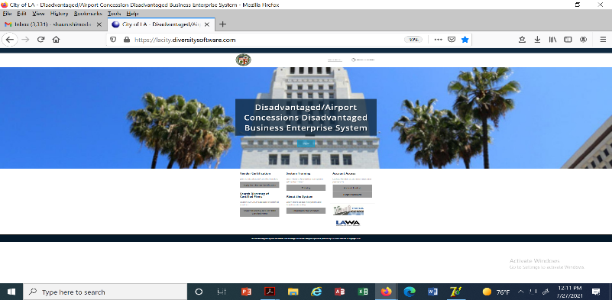
DBE / ACDBE Certification
Applying for DBE or ACDBE Certification:
  For potential new DBE/ACDBE applicant firms, please use the weblink below to register and apply.
Click here to access the https://lacity.diversitysoftware.com/

Slide 47
DBE / ACDBE Certification
Advantage:
  Certification provides additional opportunities in competing against non-certified subcontractors
  Marketing exposure through nationwide, statewide, and citywide databases
  One stop shop – the City’s DBE/ACDBE certifications are honored throughout CA (CUCP includes CALTRANS, Metro, etc.)
  DBE/ACDBE certification is good until or unless removed for cause; e.g., change in ownership or control, exceeds size standards or personal net worth or failure to cooperate.
ACDBE Examples:
  On-line and hard copy airport magazine publisher
  On-line digital advertising vendor
  Vehicle Service and Maintenance Provider off the LAWA campus who performs CHP-standard vehicle inspections and services. Staff also repairs, services, and maintains tour buses and shuttle vans that transport travelers to and from LAX.
  Vending machine operator providing baby products
  Dark Chocolate Manufacturer, candy and other products

Slide 48
DBE/ACDBE Certification Process
1. Preliminary Intake Review:
Submitted documents are checked for completeness. Any missing documents will be requested.
2. Desk Audit:
Supporting documents are reviewed to determine eligibility for certification, additional information may be requested
3. Mandatory Site Visit (Due to COVID-19, virtual or telephonic):
Interview applicant at the business location; physical verification that business exists, additional information may also be requested
4. Final Review for Approval/Denial
Start the Certification Process Today!

Slide 49
Getting Certified
For more information:
http://bca.lacity.org
Certification Helpline
(213) 847-2684
bca.certifications@lacity.org
Shaun Shimoda-Kobayashi, LAWA Certification Manager
(213) 847-2650
shaun.shimoda-kobayashi@lacity.org
Elaine Luong-Huynh, LAWA Certification Analyst
(213) 847-2436
elaine.luong@lacity.org
Directories of Certified Firms:
CUCP: https://californiaucp.dbesystem.com/ Directory City of LA go to http://bca.lacity.org -> Certification Listings -> go to https://bca.lacity.org/CertificationListings/DBETable.php

Slide 50
ADMINISTRATIVE REQUIREMENTS

Slide 51
Administrative Requirements
Due with bid/proposal
Affidavit of Non-Collusion (Form: Notary signature)
Bid Bond (Form, project specific)*
Bidder Contribution Limits (Form CEC 55, >$100,000)
Contractor Responsibility Program (Form, Board approval)
Equal Benefits Ordinance (Form, project specific)*
Municipal Lobbying Ordinance (Form CEC 50, > $25,000)
Vendor Identification Form
Subcontractor Participation Plan
Iran Contracting Act of 2010
Insurance (pricing only), if greater than $1 million…requirements…

Slide 52
Administrative Requirements
Selected Bidder/ Proposer Requirements
Affirmative Action Plan (Language)
Assignment of Anti-Trust Claims (Language)
Child Support Obligations (Language)
First Source Hiring Program (LAX only)
Labor Peace Agreement (Language, concessions only)
Living Wage Ordinance/Service Contractor Worker Retention Ordinance (Language; if applicable, complete the Correct Exemption Form)*
Insurance (Form)

Slide 53
Administrative Requirements
Administrative Requirements Website:
http://www.lawa.org - > About LAWA - >
Business Opportunities - > Administrative Requirements

Slide 54
Next Steps…
1. Check the products and services that LAWA needs on www.lawa.org -> Business
Opportunities -> What LAWA Buys as well as the LAWA Construction
Forecast Report. Additionally, reach out to Prime Contractor and
potential business partners.
2. Research applicable CERTIFICATION Programs and APPLY.
3. Register on Los Angeles Regional Alliance Marketplace for Procurement—
RAMP— at https://www.rampla.org
4. Check the Expiring Contracts Report at https://www.lawa.org/en/lawa-businesses/lawa-current-opportunities for contracts that are about to expire.

Slide 55
Next Steps…
5. Contact Business Jobs & Social Responsibility Division for upcoming Outreach
Events.
6. Attend any relevant pre-bid/proposal meetings (refer to RFB/P)
7. Research LAWA’s Contractor Development & Bonding Program for technical
assistance.
8. Research LAWA’s First Source Hiring Program for any employee needs.
9. If applying, contact the Contract Administrators of the RFB/P regarding
questions on the scope of work.

Slide 56
Next Steps… (cont.)
10. Contact LAWA’s Strategic Sourcing Division (Contract Services Unit) regarding
Administrative Requirements at (424) 646-5380 or go to www.lawa.org
- > About LAWA - > Business Opportunities - >
Administrative Requirements

Slide 57
Contact Information
LAWA Business, Jobs & Social Responsibility | Main Line: (424) 646-7300 | businessandjobs@lawa.org | https://www.lawa.org/groups-and-divisions/business-jobs-and-social-responsibility
LAWA Strategic Sourcing Division | SSD Main Line: (424) 646-5380 | Purchasing: (424) 646-7392 | https://www.lawa.org/en/groups-and-divisions/procurement
City of Los Angeles Contractor Development and Bonding Program (Rosa Osorio, Sr. Account Manager) | (213) 327-5259 |  | rosa@imwis.com
First Source Hiring Program | (424) 646-7300 |  | businessandjobs@lawa.org
LAWA Risk Management Insurance Compliance Section | (424) 646-5480
Department of Public Works, Bureau of Contract Admin. | bca.certifications@lacity.org
Los Angeles Regional Alliance Marketplace for Procurement (RAMP) | https://www.rampla.org
The Development Group (TDG) | pdgprocurement@lawa.org
Commercial Development Division | (424) 646-7200

Slide 58
DOING BUSINESS WITH LAWA WORKSHOP
LOS ANGELES WORLD AIRPORTS

