Slide 2
Agenda
LAMP Project Overview
Draft EIR Findings
FEIR & Responses to Comments
Proposed Entitlement Requests
Next Steps and Timeline

Slide 3
LAX LAMP PROJECT OVERVIEW

Slide 4
Project Objectives
Improve access to LAX and relieve congestion on Airport and surrounding roadways.
Enhance passenger experience by providing new options for pick-up and drop-off at the airport.
Provide easier and more efficient access to rental cars and non-CTA parking facilities.
Promote sustainability of LAX by improving the efficiency and operation of the surface transportation system.
Enhance and integrate the overall design of proposed facilities with existing CTA structures.
Maintain airport operations during construction.

Slide 5
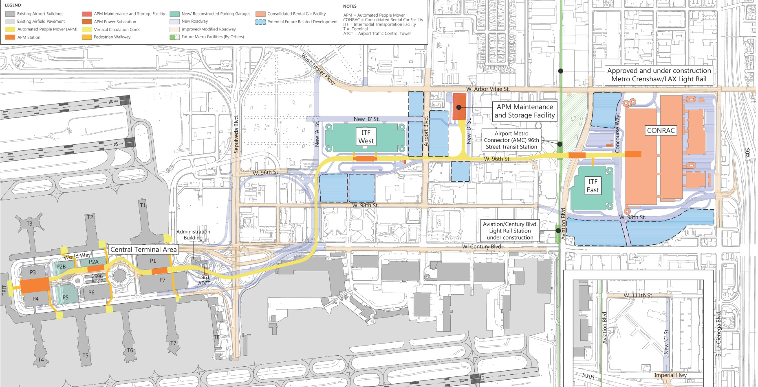
Ultimate LAMP Project
5

Slide 6
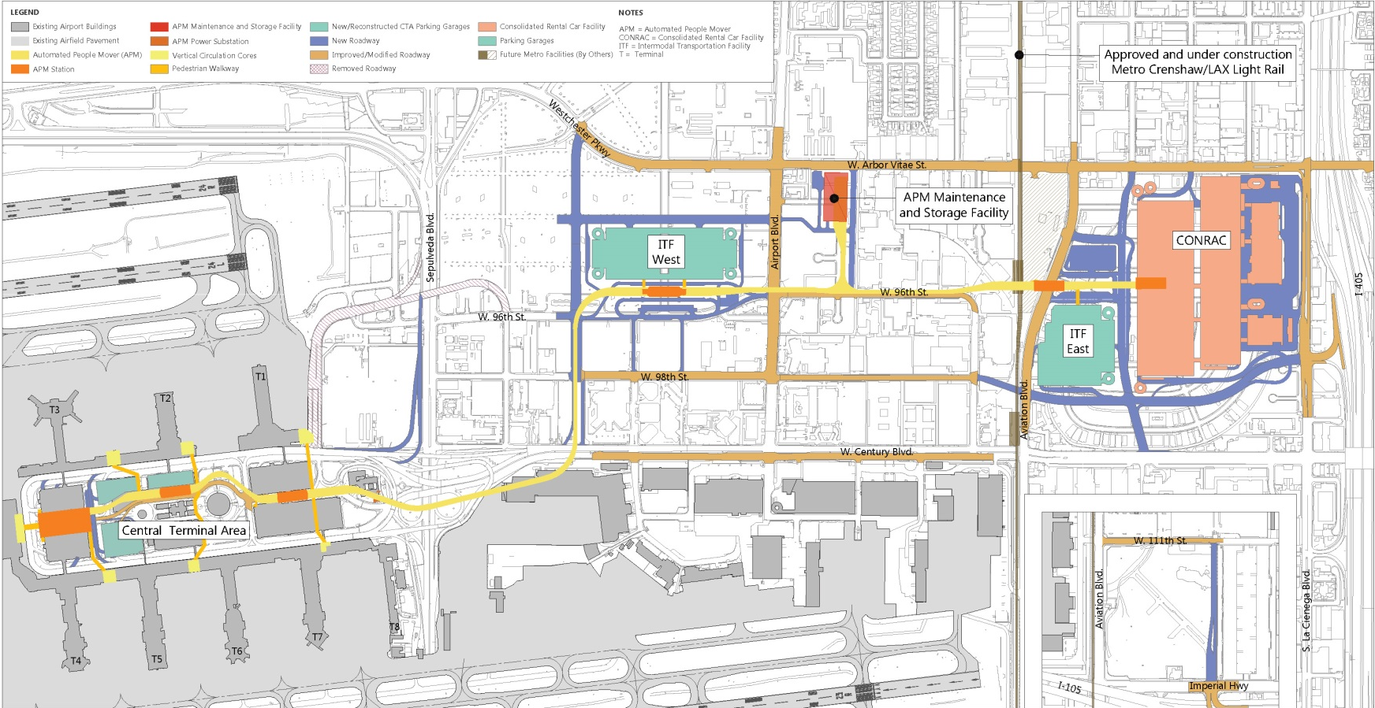
LAMP Project – Phase 1
Proposed Project - Phase 1
Construction from 2017-2023
APM operational in late 2023 / early 2024
6

Slide 7
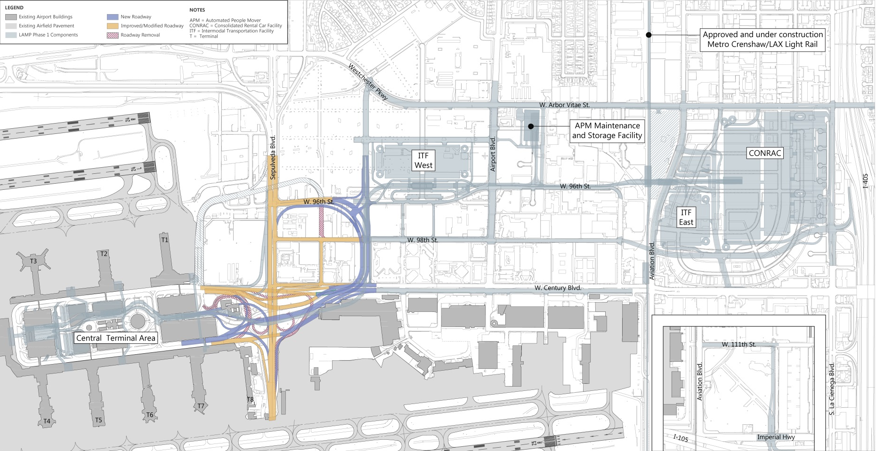
LAMP Project – Phase 2
Proposed Project - Phase 2
Construction from 2025-2030
Operational out year 2035
7

Slide 8
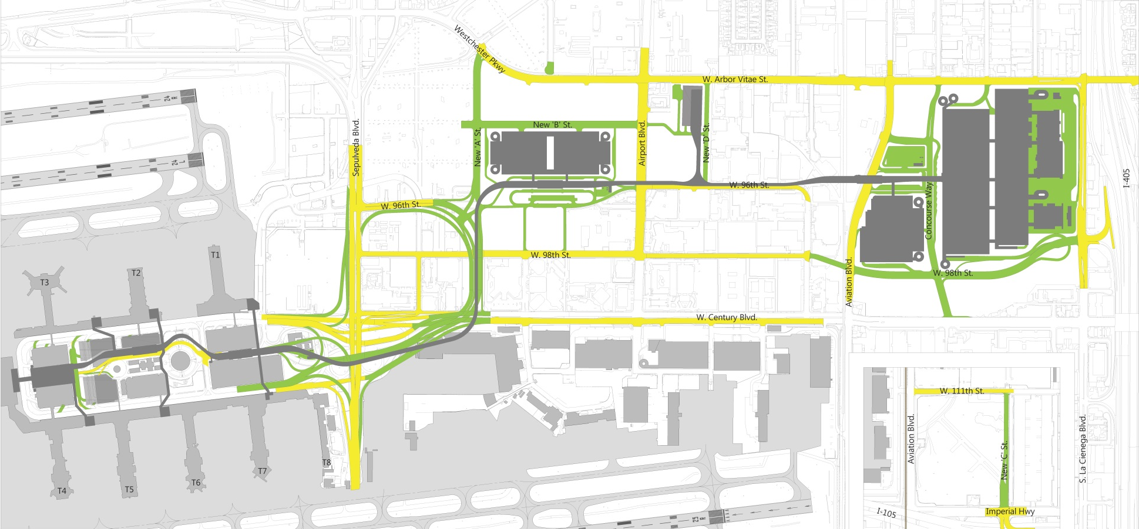
LAMP Roadway Improvements
Additional lane (WB)
Additional lane (EB & WB)
Roads
2 miles of new roadways
4.5 miles of improved roadways
Additional lane (SB & NB)
New Roads
Additional lane (SB)
Additional lane (NB)
98th Street extended to I-405
Additional lane (EB)
Improved I-405/ I-105 access
Improved Century/ Sepulveda interchange

Slide 9
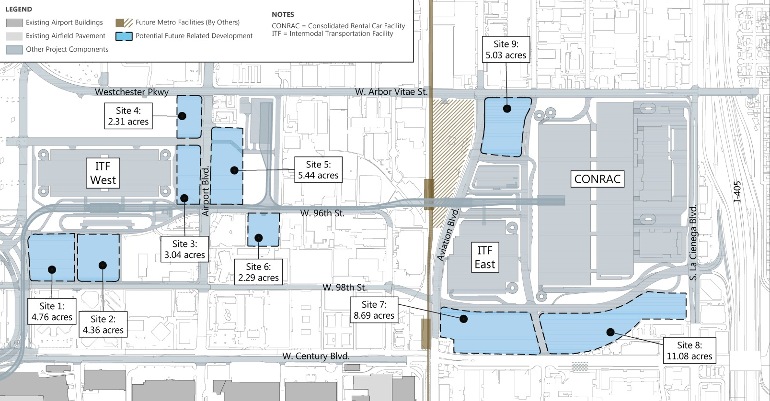
Phase 2 Program - Potential Future Related Development
Goals
Downzone parcels
Minimize regional trips
Capture internal trips/ pedestrians
Revitalize BID
Enhance airport visitor experience
LAWA has no definitive plans today; but we are studying at a program level in the EIR.
9

Slide 10
DRAFT EIR FINDINGS

Slide 11
Draft EIR Findings
Resource Categories Analyzed
Aesthetics | Land Use and Planning
Air Quality | Noise and Vibration
Biological Resources | Population and Housing
Cultural (Historic) Resources | Public Services
Greenhouse Gas Emissions | Transportation/Traffic
Hazards and Hazardous Materials | Utilities and Service Systems
Hydrology and Water Quality
11

Slide 12
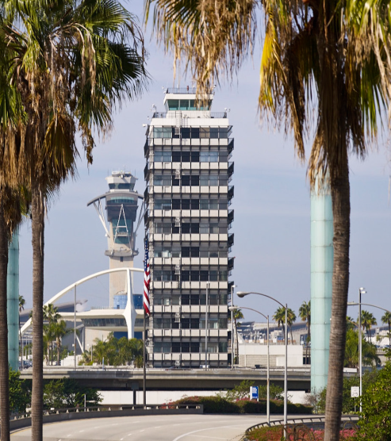
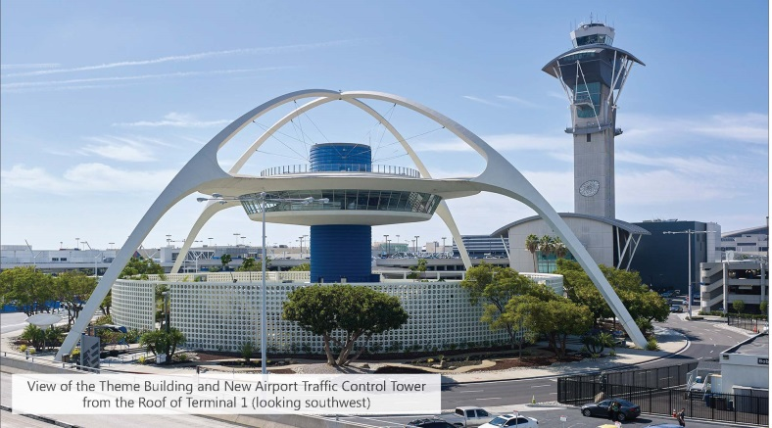
Aesthetics & Cultural Resources
Resource | Construction | Project | Program | Cumulative
Aesthetics - Visual Character | Less than Significant | Significant | Less than Significant | Significant
Cultural - Historic Resources | Less than Significant | Significant | Less than Significant | Significant
Mitigation Measures
Preservation of Historic Resources: Theme Building and 1961 Air Traffic Control Tower
Design Guidelines to Protect the Historic Integrity of the Theme Building
12

Slide 13
Traffic Study Area
8 Jurisdictions
183 Intersections Studied
23 Freeway Segments
26 Ramp Terminals
2024: No Significant Impacts
2035: Only 1 Significant and Unavoidable Impact at Manchester and La Cienega
13

Slide 14
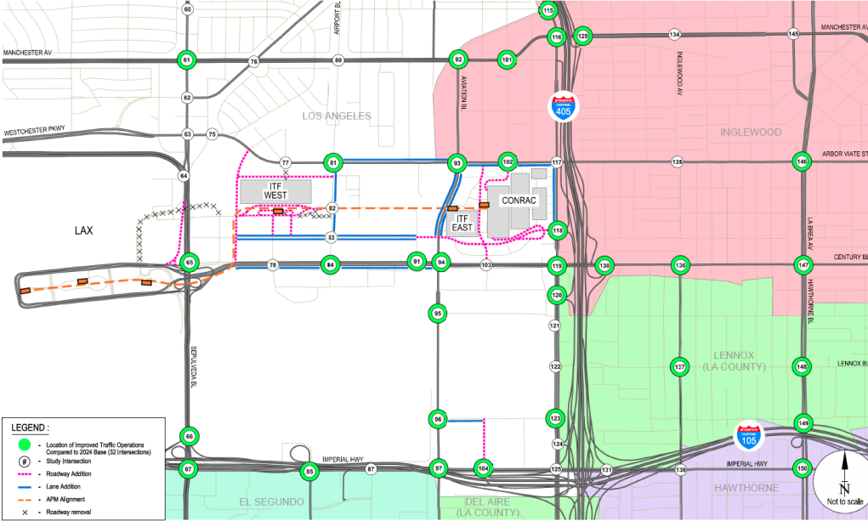
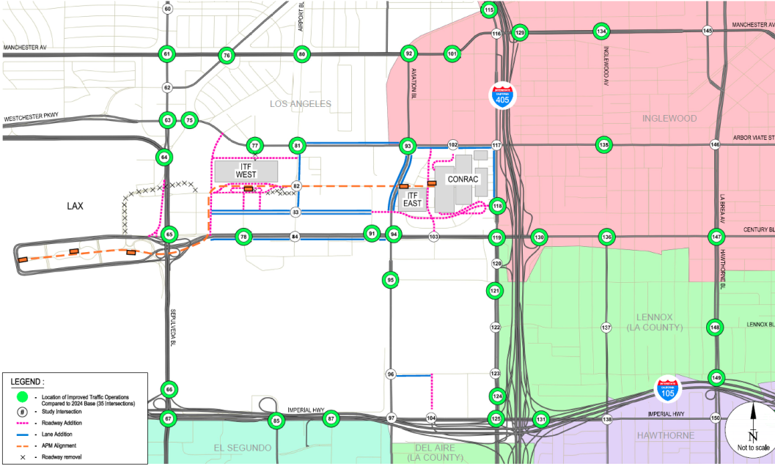
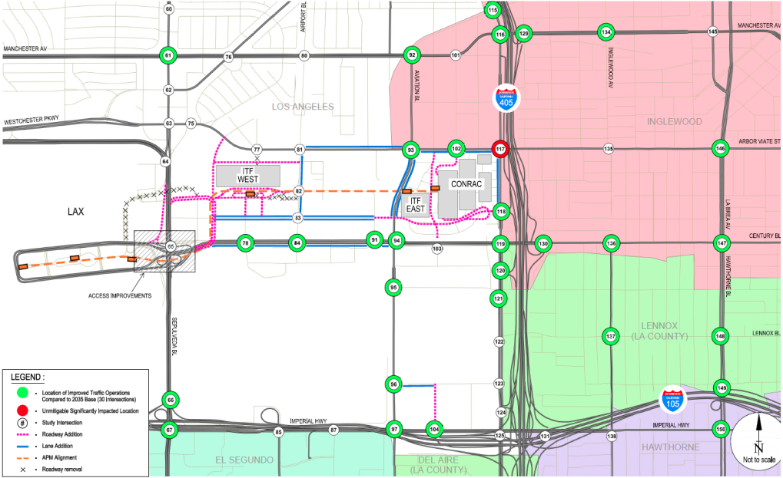
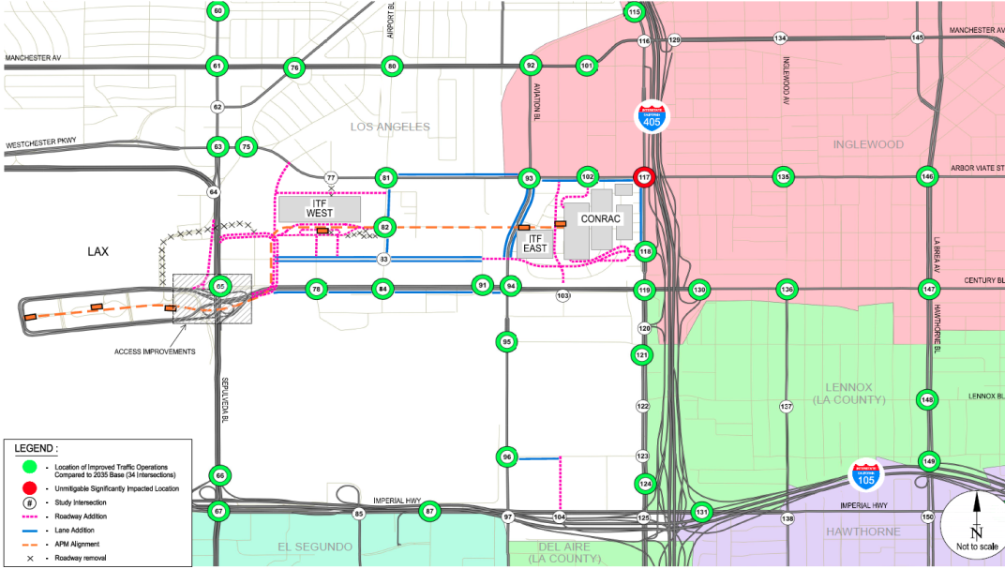
2
0
2
4
A
M
P
M
2
0
3
5
A
M
P
M

Slide 15
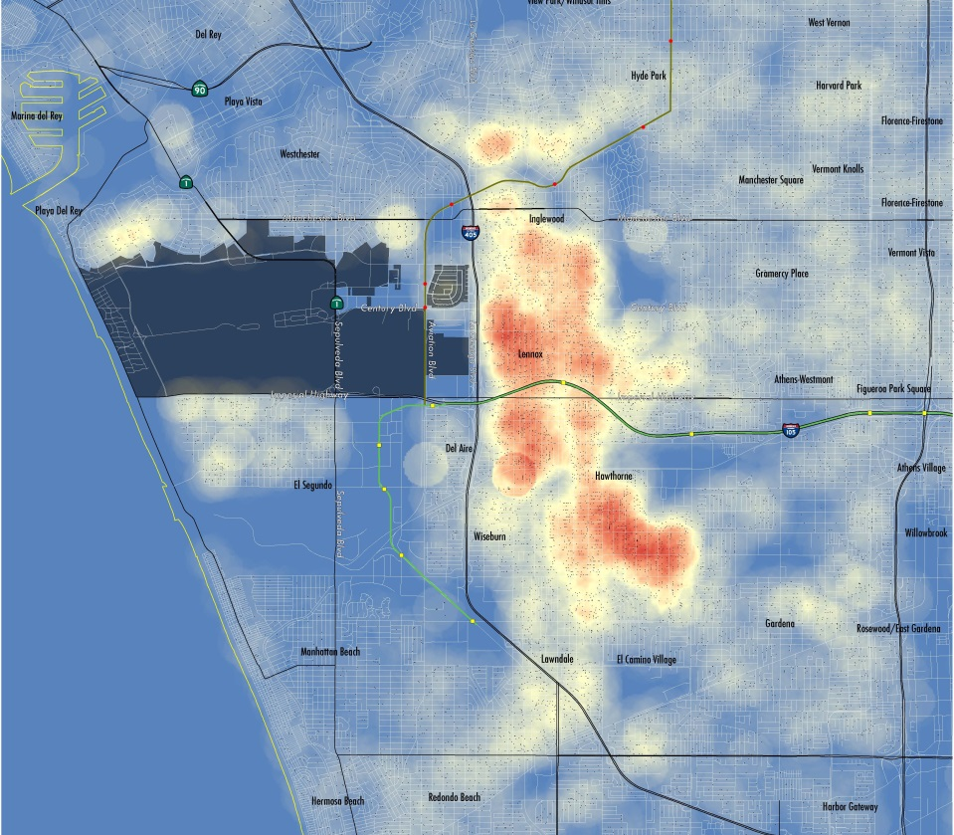
Travel Demand Management Program at LAX
LAX Employees
43,498 validated badged employees
31% live within 5 miles/53% within 10 miles of LAX
High concentration within 1 to 3 miles, located within SB 535 Disadvantaged Communities
LAX Transportation Management Association
Home-to-work transportation alternatives
Enhanced rideshare/carpool/vanpool program
Incentives transit pass program
Bicycle access program
Coordination with adjacent TMAs
15

Slide 16
FEIR & RESPONSE TO COMMENTS

Slide 17
CEQA DEIR Summary - Comment Period 60 Days; Closed November 15, 2016
Total Comments Received | 75
Federal Agencies | 1 (FEMA)
State Agencies | 2 (Clearinghouse, Caltrans)
Regional Agencies | 1 (AQMD)
Local Agencies | 12 (Bureau of Sanitation, City of Lawndale, ALUC, LA Community College District (2), Culver City, Metro, El Segundo (2), LADWP, City of Inglewood, CD11)
Individuals/Businesses/Community Groups | 59 (Businesses along Century - 3 Parking Operators, 4 Hotels, 1 Taxi Company, 1 Property Owner, and Gateway BID)

Slide 18
Key Issues Raised in Comment Letters
Capacity/Induced Growth
Plan Amendments
Homeless
Transportation Policies
Construction Phasing/Impacts
Project elements
Police/Fire Protection
TDM Program
CTA Pedestrian Plan/Crossing

Slide 19
Key Issues Raised in DEIR Comment Letters
 | Issue | Final EIR Response
1 | El Segundo argues LAMP induces growth in passengers; EIR underestimates impacts. | LAMP does not induce growth. Natural growth accounted for as a background condition.
2 | ARSAC & El Segundo opposed the LAX Plan/Specific Plan amendments (removal of 153 gate cap, regionalization goals, FlyAway program, new study when 78.9 MAP anticipated). | Plans need to be updated to reflect goals and program, and be consistent with other City Plans. BOAC approves EDR and appeals go to City Council.
3 | El Segundo asserts another SPAS study required that includes CEQA analysis with environmental impacts of MAP growth. | LAMP includes the Plan amendments which technically satisfies this requirement per the previous Specific Plan.
4 | Westchester Neighborhood Council and Airport Advisory Committee contend that displacement of homeless in Manchester Square is a significant impact. | No Significant Impact identified in EIR; LAWA is working with the CD 11 / Mayor / County Task Force to permanently house homeless individuals.
5 | General concerns over lack of specificity on impacts and mitigations. Request that LAWA agree to maintain and fund reconstruction of haul routes along Imperil Hwy/Aviation Blvd. | Stress proactive stakeholder engagement and creation of Construction Traffic Project Task Force; and coordination with jurisdictions on haul route maintenance.
6 | Request for performance metrics for TDM Program and early implementation. | LAWA evaluating ways to implement TDM Program early in project stages; and coordinate with CD 11.

Slide 20
Key Issues Raised in DEIR Comment Letters
 | Issue | Final EIR Response
7 | Gateway BID / Hotel’s concern about hotel shuttles being restricted from the CTA. | Operational assumptions in DEIR assumed 48% of traffic is shifted outside of the CTA; LAWA will implement strategies to affect this shift in coordination with affected Parties and BOAC.
8 | Request relocation of Commercial Vehicle Lot and Taxi Holding Lot. | Relocation of Commercial Vehicle Lot is being examined and will require environmental review after FEIR; no relocation anticipated for Taxi Holding Lot via LAMP.
9 | Assertion that LAMP does not include sufficient Police / Fire Protection. | Satellite office for LAWA PD may be added after coordination with LAWA PD; LAFD indicated they have sufficient equipment and stations.
10 | Request for CTA Pedestrian Plan and improvements to crosswalk at Sepulveda/Century. | LAWA committed to preserving pedestrian crossing at Sepulveda/Century, and examining whether pedestrian bridge can be incorporated in Phase 2 roadway improvements.

Slide 21
LAX Design Guidelines
Appendix to LAX Specific Plan
Site Design
Site Access and Circulation
Building Orientation
Surface Parking/Driveways
Service Areas
Architecture
Massing/Form
Parking Structures
LAWA Facilities
Building Lighting
Streetscape
Pedestrian Connections
Bicycle Network
Street Cross Sections
Street Trees
Landscape/Urban Design for LAWA Facilities and Future Development
Planting zones
Buffer/Setback zones
Open Space
Sustainability
Planning and Design
Energy Efficiency
Water Efficiency and Conservation
Material Conservation and Resource Efficiency
Environmental Quality

Slide 22
LAX Design Guidelines
Columns
Placement
Number
Design
Materials/Color
Guideway
Thickness
Design
Materials/Color
Station
Design
Materials/Color
Pedestrian Walkways
Design
Materials/Color
22

Slide 23
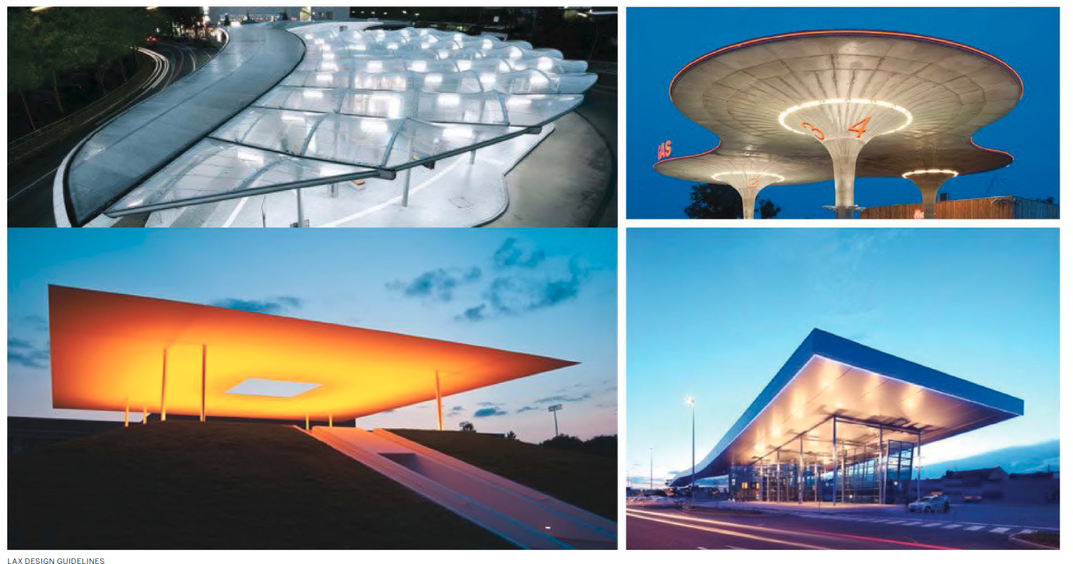
Design - APM Station Examples
23

Slide 24
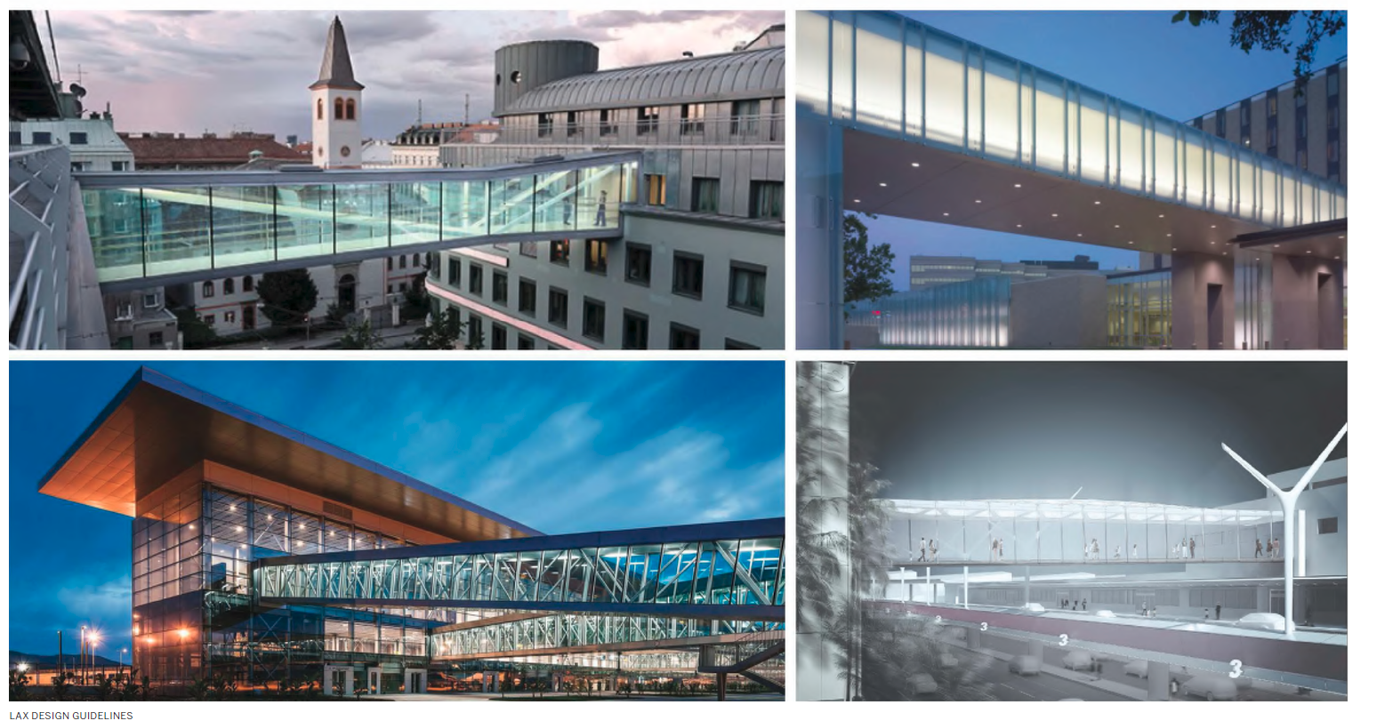
Design - Pedestrian Bridge Examples
24

Slide 25
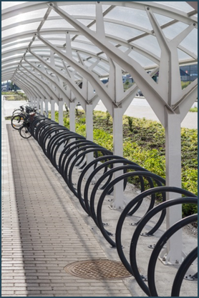
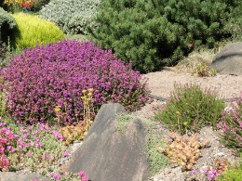
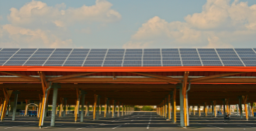
LAMP Sustainability Highlights
Elements & Guidelines
Facility Highlights
Minimum standards exceed Los Angeles Green Building Standard Codes for Tiers 1 & 2
Exceed CA 2008 energy efficiency standards by 15%
Reduce CA potable water use requirements by 30%
Comply with Low Impact Development
Xeriscaping
CONRAC
LEED Silver Goal
Provide infrastructure for up to 10% parking for electric vehicle charging stations & preferred parking for low emitting vehicles
APM Maintenance Facility
Cool roof materials to reduced heat island impacts
Intermodal Transportation Facility
Bike parking & shower facilities
Preferred parking for low-emitting &
fuel-efficient vehicles
Up to 10% electric vehicle charging stations
On-site solar (as applicable)

Slide 26
PROPOSED ENTITLEMENT REQUESTS

Slide 27
Entitlements
Department of City Planning | General Plan Amendment LAX Plan Amendment Westchester – Playa del Rey Community Plan Amendment Mobility Plan 2035 Amendment Specific Plan Amendment Zone Changes Tentative Tract Maps
Bureau of Engineering | Tract maps Easements
Department of Building and Safety | Haul Route Permits

Slide 28
General Plan Amendment
LAX Plan Amendment
Map amendment to add and remove areas from LAX Plan.
Text update to reflect LAMP components as currently planned.
Westchester – Playa del Rey Community Plan Amendment
Map amendment to add and remove areas to Westchester – Playa del Rey Community Plan.
Mobility Plan 2035 Amendment
Changes to General Plan Circulation System (Maps A1 and A3) to reflect updated street classifications.
Changes to Bicycle Network (Maps D1 and D2).

Slide 29
LAX Plan Amendment
Update the Vision Specific Plan Amendment Study discussion.
Update the Goals and Objectives to reflect LAMP Project.
Add description of Airport Landside Support subarea within the Land Use section.
Update policies throughout to reflect LAMP Project and other programs, including expanding sustainability policies.
Revise to remove text regarding specific projects such as runway projects.
Replace existing requirement for Flyaway program.

Slide 30
Mobility Plan 2035 Amendment – Roadway Classifications

Slide 31
Mobility Plan 2035 – Bike Plan re-routing

Slide 32
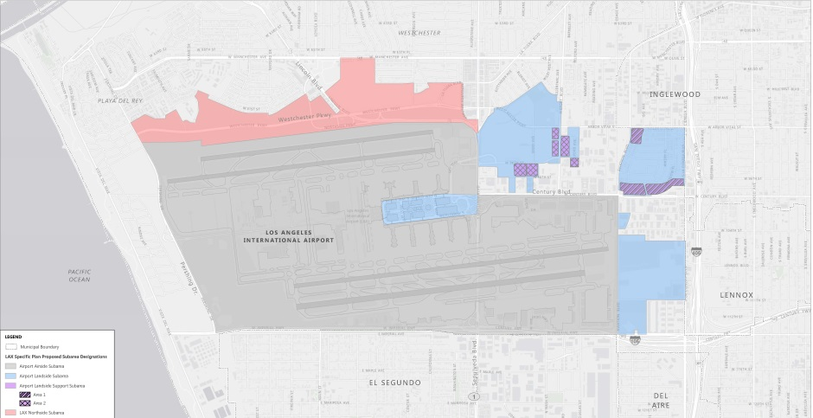
LAX Specific Plan Amendment
Facilitate implementation of the programs and policies in the plan.
Addition of a new Airport Landside Support Subarea.
Reorganization of text for consistency and clarity.
Removal of the parking regulations specific to the LAX Master Plan.
Clarification of which parcels within the LAX Specific Plan are subject to the trip cap.
New LAX Design Guidelines.

Slide 33
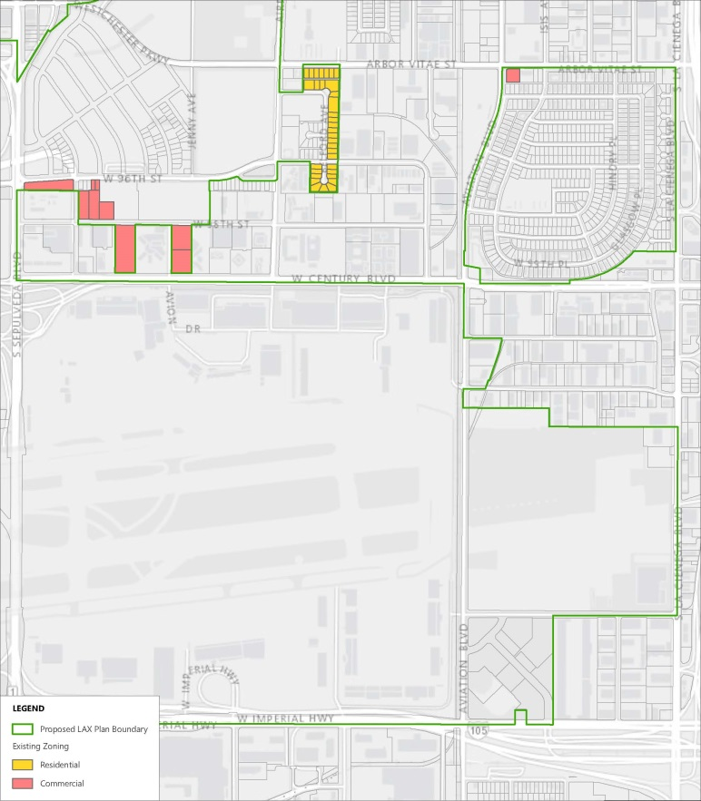
Parcels to be Re-Zoned to LAX Zone
Change commercial zoning on parcels owned by LAWA containing LAX Parking facilities, Skyview Center and parcels that will contain APM or road improvements to LAX Zone.
Change residential zoning on LAWA-owned Belford Property that will contain APM Maintenance Facility and parking to LAX Zone.

Slide 34
Next Steps and Timeline for Project Approval
February 1, 2017 | Airport Land Use Commission @ RPC Hearing Room
February 2, 2017 | LA City Planning Hearing Officer Hearing @ Flight Path
March 2, 2017 | BOAC Hearing @ LAWA Board Room (EIR Certification & Executive Director’s Review Recommendation for Approval)
March 23, 2017 | Joint CPC and BOAC Hearing @ Van Nuys City Hall
May 2017 | Joint IGTC&T and PLUM Council Committees @ City Hall
May 31, 2017 | Airport Land Use Commission Hearing @ RPC Hearing Room (Consistency Determination Hearing)
June 2017 | City Council Hearing @ City Hall (Committee Reports consideration & LAMP project approval)

