Slide 1
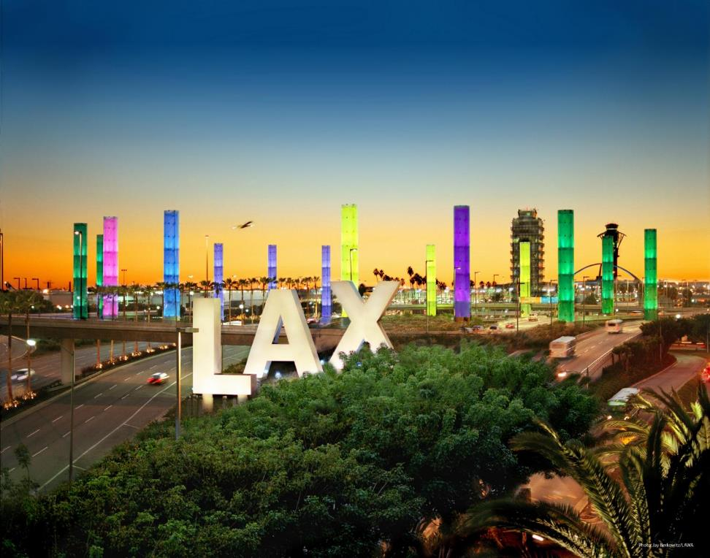

DOING BUSINESS with
Los Angeles World Airports
Rev. 6 / 2021

Slide 2

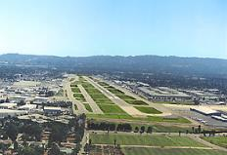
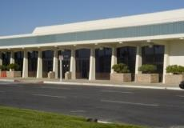
Los Angeles World Airports
 | LAX ranked 15th in the world for passenger service In 2020, airlines served 28,779,527 passengers (#5 in US) In 2019, airlines served 88,068,013 passengers (#2 in US)
 | Van Nuys Airport – one of the world’s busiest General Aviation airports Dedicated to non-commercial air travel
 | LA/Palmdale - LAWA owns and maintains the Palmdale Land Holdings, previously an FAA-certified airport

Slide 3
Workshop Overview
    Business Opportunities
    Competitive Processes
    Concessions
    The Development Group
    Registering on LABAVN
    Business Assistance Programs
    Certification
    Administrative Requirements
    Next Steps

Slide 4

Business Opportunities
LAWA procures hundreds of
million $ annually in Request
for Bids (RFBs):
    Goods and Equipment
    Materials and Supplies
    Non-professional services.
LAWA has administered over $14 Billion in Request for Proposals (RFPs):
    Construction Projects (Planning & Development Group)
    Professional Services including On-Call contracts.

Slide 5
Request For Proposals (RFP)
A Request for Proposal is used for the competitive procurement of the following:
  Capital Projects (Terminals, Runways, Railroads, etc.)
  Professional Services (Engineering, Architectural, &/or Environmental Services, etc.
The award is based on the winning score according to the selection criteria which may include:
    Concept
    Experience
    Cost
    Etc.
RFP’s can be for individual items, services, or contracts.

Slide 6
Important RFP Information to Note
DUE DATE (COVID-19 info)
  There are no exceptions to the stated Due Date and Time
  RFP proposal submittal must be uploaded through Box
  Upload instructions are located on LABAVN RFP page.
QUESTIONS & CLARIFICATIONS
  Must contact the designated LAWA Project Manager for RFPs.
AUTHORIZATION
  RFP must be signed by someone authorized to encumber the bidding/proposing company.
PRE-PROPOSAL MEETINGS
  Non-mandatory.

Slide 7
Additional RFP Requirements
COMPLETION OF DOCUMENTS
  Any Worksheets and Administrative Requirements must be filled out as directed and returned complete, in the order received. Failure to do so may invalidate RFP.
BE CAREFUL
  Be sure to read and complete the RFP documents accurately. Failure to do so may invalidate your RFP.

Slide 8
Construction Forecast Report (Planning & Development Group)
See Contracts and Procurements Document
For questions, contact PDGprocurement@lawa.org

Slide 9
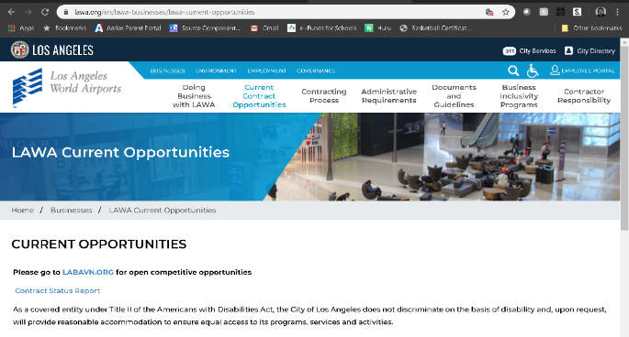
Contract Status Report (updated monthly)
https://www.lawa.org/en/lawa-businesses/lawa-current-opportunities
Questions?

Slide 10
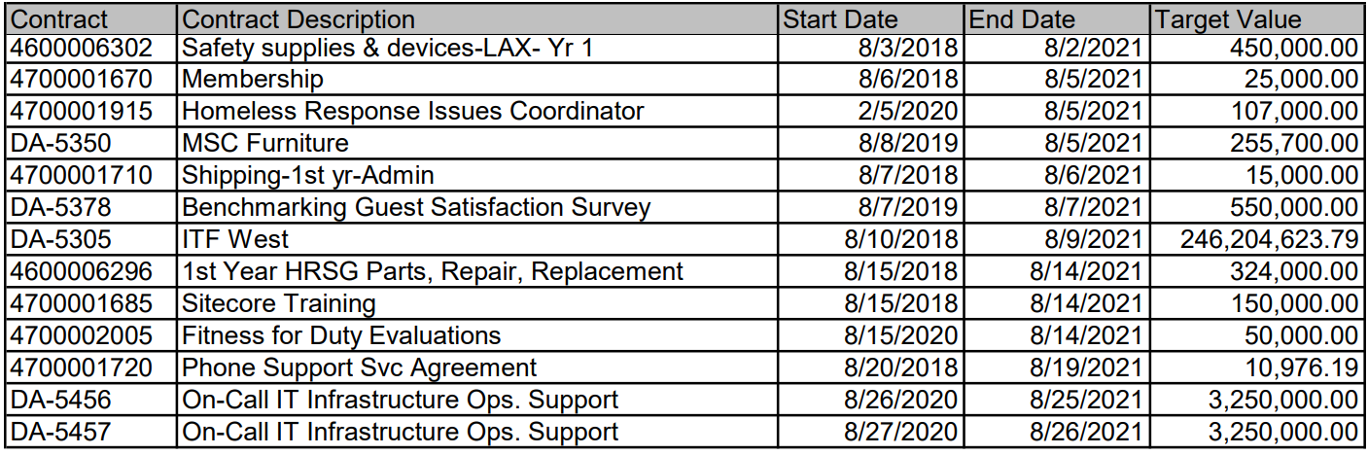
Current Contract Status Report:

Slide 11
Request For Bids (RFB)
A Request for Bid is used for the competitive purchase of the following:
  Goods
  Equipment
  Non-professional services.
The contract award is made to the lowest priced bid that is deemed to be:
  Responsive – accurate completion of the bid
  Responsible – determined to be capable of meeting the specifications.
Bids can be for individual items, services, or contracts from 1 to 5 years in duration.

Slide 12
Important RFB Information to Note
DUE DATE (COVID-19 Info)
  There are no exceptions to the stated Due Date and Time
  RFB bid submittal must be uploaded through Box
  Upload instructions are located on LABAVN RFB page.
QUESTIONS & CLARIFICATIONS
  Must contact the designated LAWA Procurement Analyst via email for RFBs.
AUTHORIZATION
  RFB must be signed by someone authorized to encumber the bidding/proposing company.
PRE-BID MEETINGS
  Mandatory vs. Non-mandatory.

Slide 13
Additional RFB Requirements
COMPLETION OF DOCUMENTS
  Bid, Worksheets and Administrative Requirements must be filled out as directed and returned complete, in the order received. Failure to do so may invalidate RFB.
PAYMENT TERMS
  Discount terms of 25 days or more can impact your RFB evaluation.
DEVIATION FROM SPECIFICATIONS
  When allowed, bidders desiring to quote on any other comparable make/brand must indicate make/brand and model name/number.
BE CAREFUL
  Be sure to read and complete the bid documents accurately. Failure to do so may invalidate your RFB.

Slide 14
Soliciting Bids and Proposals
All City of Los Angeles RFB/RFPs are available on:
  The Los Angeles Business Assistance Virtual Network web site: www.labavn.org.
  Questions?

Slide 15
LAWA Concessions Overview
What is a concession?
An Airport Concession is defined as:
  A business located on an Airport that is engaged in the sale of consumer goods or services to the public under an agreement with an Airport, another concessionaire, or the owner or lessee of a terminal.
  A business conducting one or more of the following activities, even if it does not maintain an office, store, or other business location on an Airport, as long as the activities take place on the Airport: management contracts and subcontracts, a web based or other electronic business in a terminal or which passengers can access at the terminal, an advertising business providing advertising displays or messages to the public on the Airport, or a business providing goods and services to concessionaires.
Does LAWA manage all concessions at LAX?
Yes, using two concession management models – (1) direct management for airport wide concession services and for Food & Beverage and Retail for Terminals 4, 5, 7 and 8; and (2) via a Terminal Commercial Manager (TCM) for Terminals 1, 2, 3, 6 and Tom Bradley International Terminal (TBIT).

Slide 16
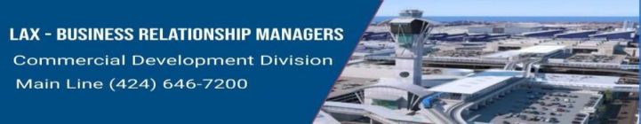
LAWA’s Current Concession Operators
Company Name | Concession Type | Business Relationship Managers (BRM)
Alclear LLC | Expedited Travel Service | Titus G DeCoursey (Concessions)
Areas USA LAX, LLC | Food and Beverage | Vimal A Patel (Concessions)
Bank of America | ATM | Titus G DeCoursey (Concessions)
Bottling Group LLC | Vending Machines | Vimal A Patel (Concessions)
DFS Group LP | Duty-Free Retail | Melanie A Torres (Concessions)
DN Dakota/JME LAX 8549 Pucks LLC | Food and Beverage | Vimal A Patel (Concessions)
DN Dakota/JME LAX 8589 Farmers LLC | Food and Beverage | Vimal A Patel (Concessions)
HG-LAX T6 JV | Vending (Personal Protective Equipment) | Vimal A Patel (Concessions)
Host International Inc | Food and Beverage | Vimal A Patel (Concessions)
Hudson-Magic Johnson Enterpr-Concourse Venture LLC | Retail Shops | Melanie A Torres (Concessions)
JCDecaux Airport Inc | Advertising | Denise G Sample (Concessions)
LAX Retail Magic 2 JV | Retail Shops | Melanie A Torres (Concessions)
LAX Retail Magic 3-4 JV | Retail Shops | Melanie A Torres (Concessions)
Lenlyn Limited | Currency Exchange | Titus G DeCoursey (Concessions)
Smarte Carte Inc | Luggage Carts | Vimal A Patel (Concessions)
URW Airports LLC | Food/Beverage & Retail | Benet Yowarski (Concessions)
Wing Society LLC | Food Truck | Titus G DeCoursey (Concessions)
XpresSpa LAX Airport LLC | Spa Services | Melanie A Torres (Concessions)

Slide 17
LAWA Concession Opportunities
How do I get my business at the airport?
Concessions are selected via an open competitive solicitation basis. To be notified of any opportunities, interested parties may:
  Register with the LA City website to be notified of an opportunity.
  Reach out to Unibail Rodamco Westfield (URW) at (310) 646-1770 to learn more about opportunities available for terminals managed by TCM.
Other than an RFP issued by LAWA, how can I get my business at the airport?
  Educate yourself on partnership opportunities. Airport Concessions Disadvantaged Business Enterprise (ACDBE) is a certification your business may qualify for.
  Educate yourself on concession companies and research their ACDBE opportunities.
  Competitive Evaluation Process (CEP) through TCM.

Slide 18
LAWA Concession Timelines
When do LAWA concession agreements expire?
  LAWA concession and service agreements expire on June 30, 2025.
  Depending on the agreement, there may be an opportunity to extend the agreement.
  Unit Concession agreements managed by TCM have various expiration dates.
How long are LAWA concession agreements?
The average term for a concession agreement is 10 years.

Slide 19
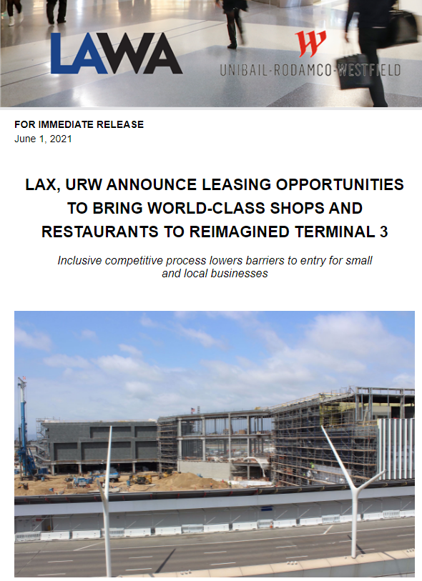
Upcoming Concessions Opportunities
Small, local business, and certified Airport Concessions Disadvantaged Business Enterprises (ACDBE) operators are encouraged to compete for leasing opportunities for 10 new dining and retail destinations in Terminal 3
Attend the upcoming LAX Terminal 3 Leasing Opportunities virtual information session about these opportunities on June 8th
The deadline for proposals is July 27th

Slide 20
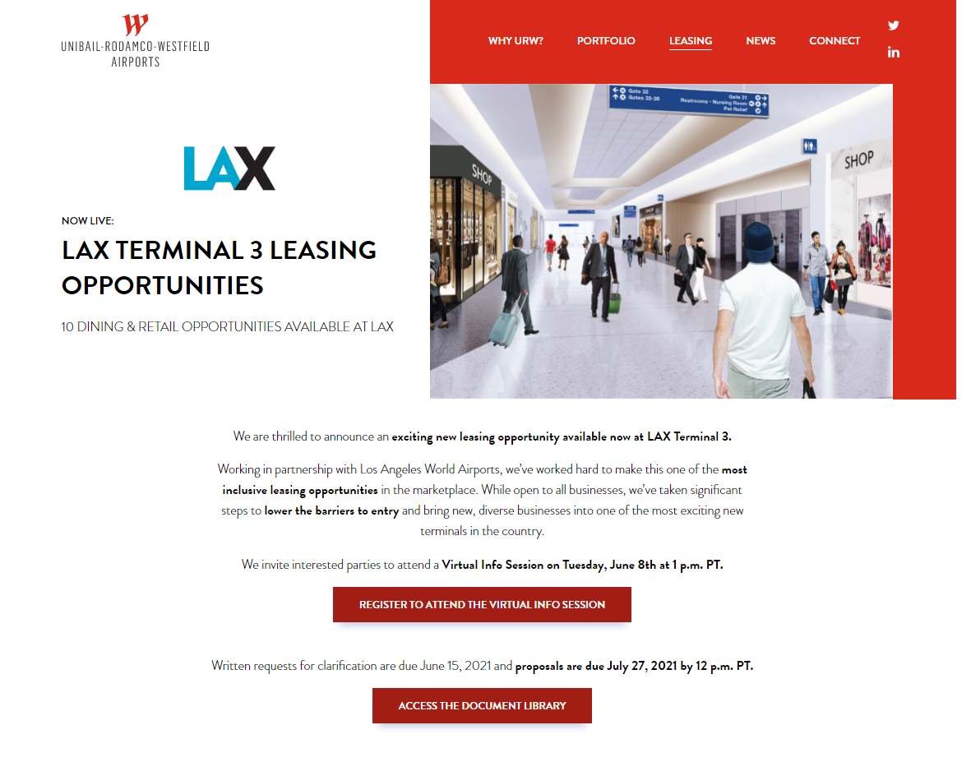
Upcoming Concessions Opportunities
www.urwairports.com/leasing

Slide 21
Concessions Contact
Concessions Questions:
Melanie Torres: Commercial Development Division
          Matorres2@lawa.org
          424-646-7210

Slide 22
The Development Group (TDG) Procurement
What We Do:
Procure construction and professional services to advance the development of projects at our airports
Oversee the procurement process to ensure fair and legal competition for all TDG projects.
Assist with addenda, pre-bid/proposal conferences, contract conformance, and other processes related to procuring these services.

Slide 23
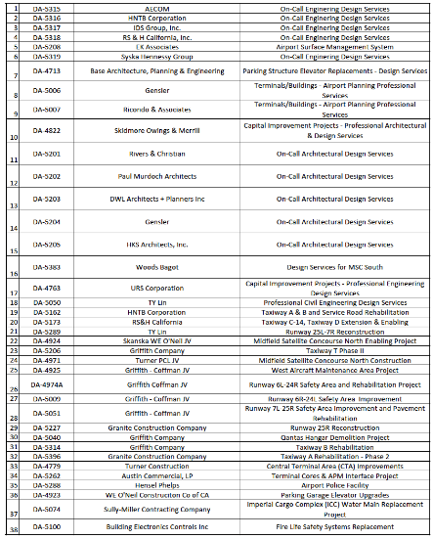
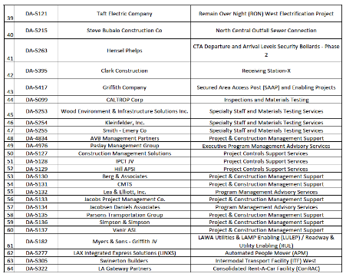
TDG Procurement - Past Procurements/Contracts

Slide 24
TDG Procurement Opportunities
How do I get my business at the airport?
Firms/Contractors are selected via an open competitive solicitation basis.
Familiarize yourself with the following:
  LAPOP (formerly LABAVN)
    https://labavn.force.com/LABAVN/s/
  LAWA
    www.lawa.org
      Procurement Outlook
      https://www.lawa.org/-/media/lawa-web/business-opportunities/files/pdg_procurement_outlook.ashx
      Contract Status Report and Potential Opportunities:
      https://www.lawa.org/lawa-businesses/lawa-current-opportunities
      LAWA’s Business Jobs and Social Responsibility (BJSR) Program:
      https://author.lawa.org/groups-and-divisions/business-jobs-and-social-responsibility

Slide 25
TDG Contact Info
PDGprocurement@lawa.org

Slide 26
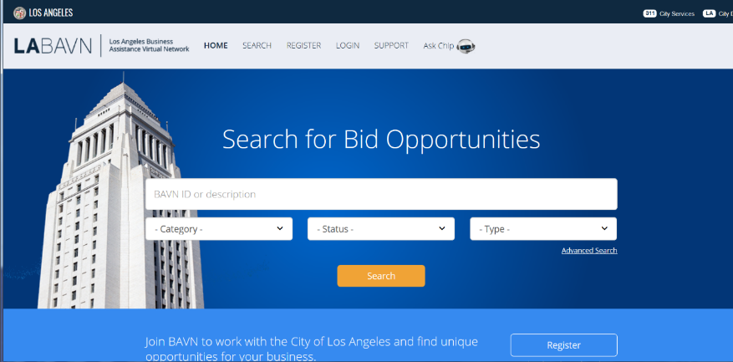
Registering w/LABAVN…

Slide 27
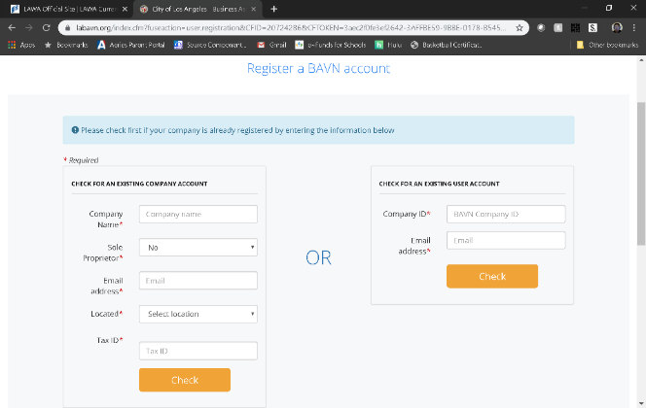
Registering on LABAVN

Slide 28
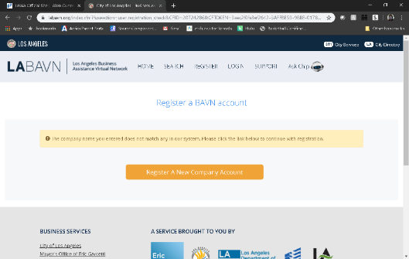
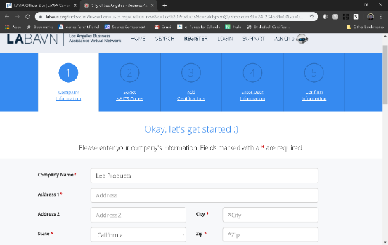

Slide 29
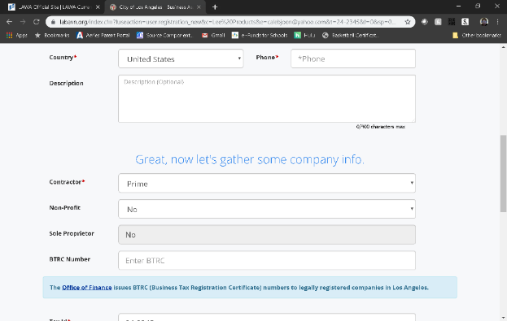
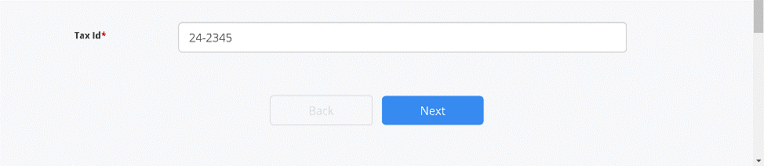

Slide 30
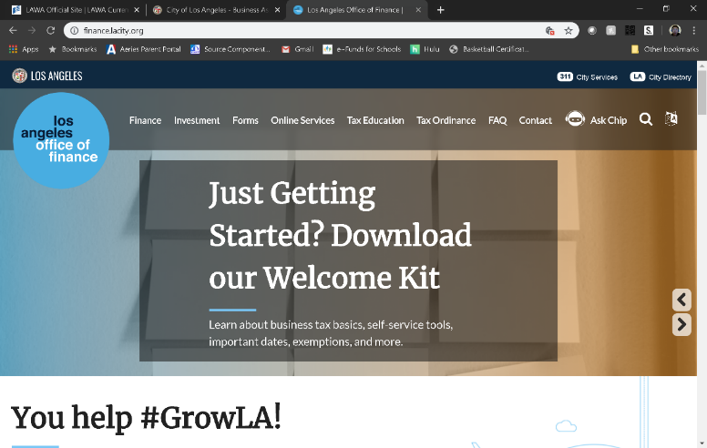
https://finance.lacity.org/

Slide 31
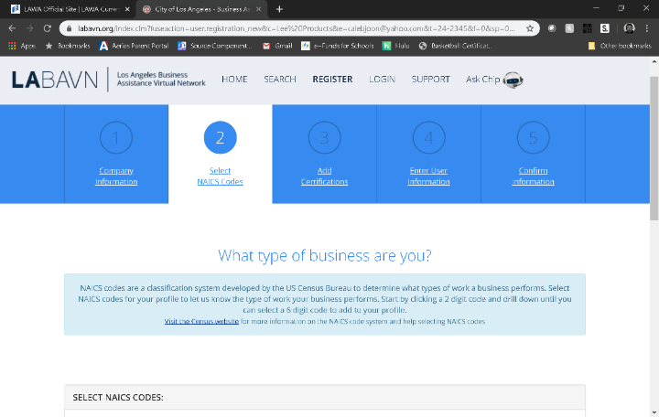
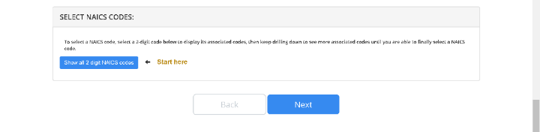

Slide 32
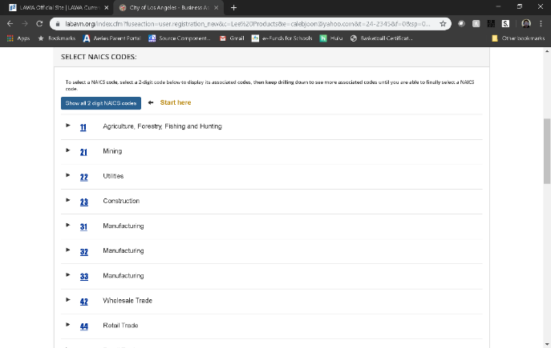
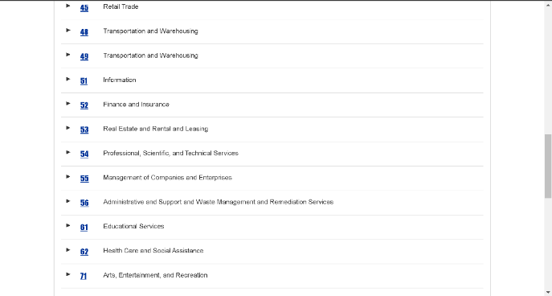

Slide 33
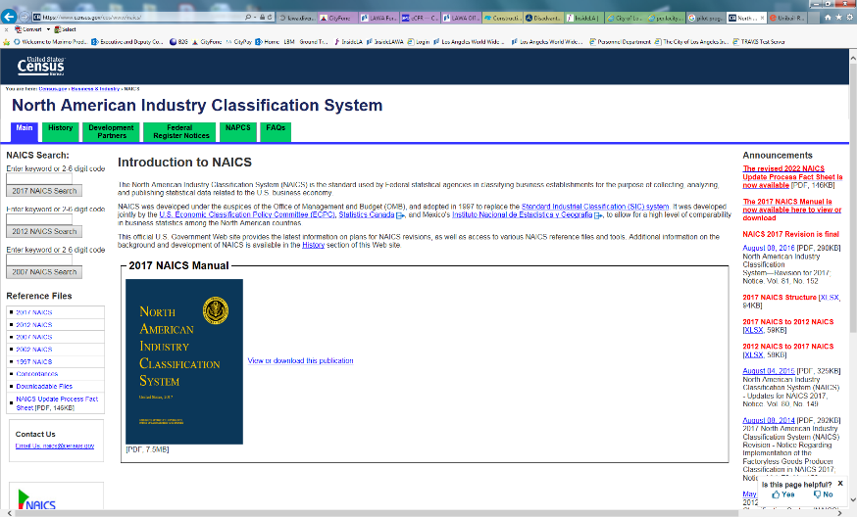

Slide 34
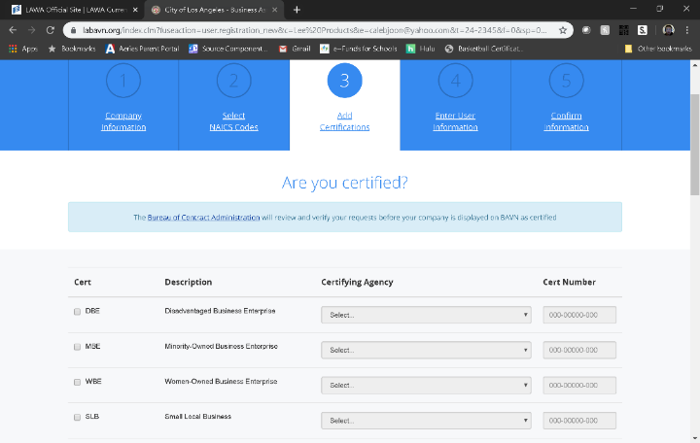
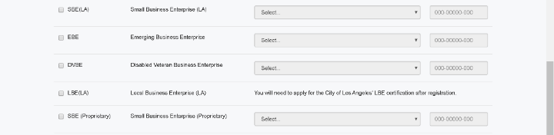

Slide 35
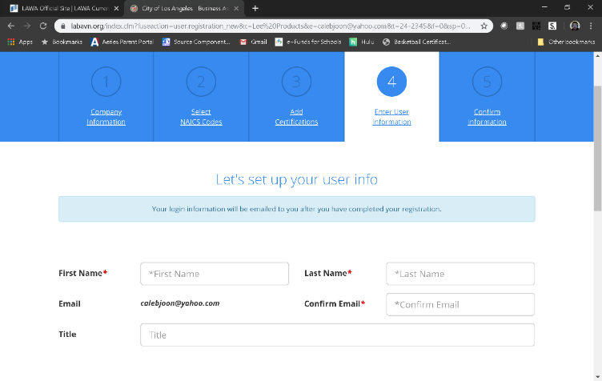

Q & A

Slide 36
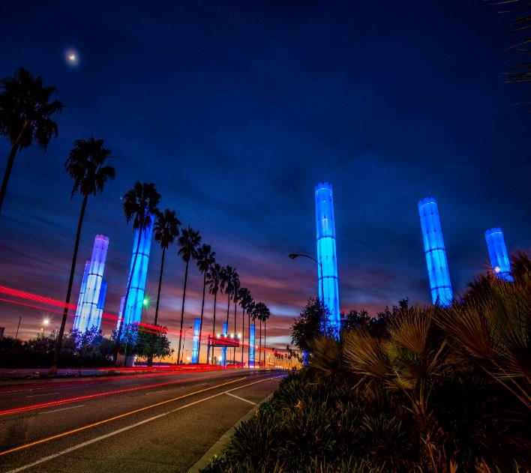

BUSINESS, JOBS
& SOCIAL RESPONSIBILITY
OUR MISSION
Maximize access to business and job opportunities
Ensure that local, diverse communities benefit from LAWA’S investments
Set the global airport standard for public corporate social responsibility
THE FUTURE IS NOW

Slide 37
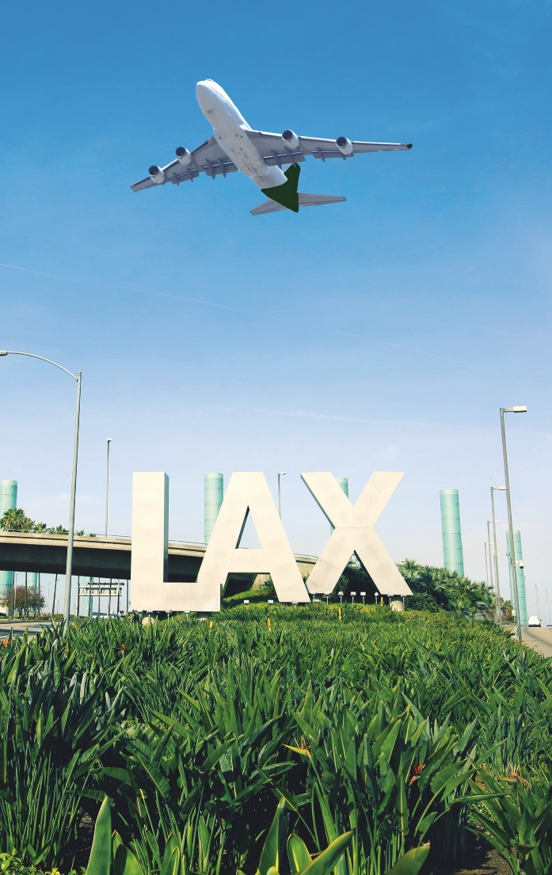
LAWA BUSINESS, JOBS & SOCIAL RESPONSIBILTITY DIVISION
BUSINESS
Business Navigation & Support
Business Inclusion Contract Requirements
Contractor Development
Bonding Assistance Program
Contract Finance Assistance Program
Workforce Recruitment & Sourcing
Diversity, Equity, Inclusion Engagement
Targeted Outreach & Engagement
businessandjobs@lawa.org
424-646-7300
www.lawa.org/groups-and-divisions/business-jobs-and-social-responsibility

Slide 38
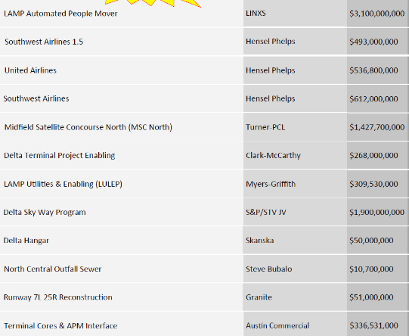
LAX: OPPORTUNITIES- ACTIVE PROJECTS
PROJECT
LAMP BUSINESS INCLUSION REQUIREMENTS
PROJECT NAME | DEVELOPER or PRIME | APPROX. PROJECT VALUE
APM
PHASE | SBE | LBE | LSBE | DVBE
DESIGN | 22% | 8% | 3% | 3%
BUILD | 18% | 7% | 5% | 3%
O & M | 17% | 10% | 5% | 3%
CONRAC
PHASE | SBE | LBE | LSBE | DVBE
DESIGN | 18% | 50% | 10% | 3%
BUILD | 22% | 20% | 5% | 5%
O & M | 20% | 7% | 5% | 3%
ITF-W
PHASE | SBE | LBE | LSBE | DVBE
DESIGN & BUILD | 20% | 10% | 5% | 3%
 | Plus all firms named in the proposal

Slide 39
LAX: WHAT YOU SHOULD KNOW
BE PREPARED
The doors of opportunity are open.
Prepare to walk through.
KNOW YOUR AGENCY
Do your Research
Understand opportunities & priorities
Understand administrative requirements
Develop relationships with agency staff
Register with BAVN
Attend workshops hosted by agency
STAY READY
Get (STAY) certified
Focus your business- do one thing & do it well
Build your capacity- look for training and mentor opportunities
Understand your finances- understand bonding, cash flow, insurance, taxes, credit
Network
Use the Project Labor Agreement to you Advantage
KNOW YOUR CUSTOMER
Understand the project: design, procurement and bid package schedule
Understand your contract
Plan for “the gap”
Develop relationships with your prime
Be careful about your bid- Bid to make a PROFIT

Slide 40

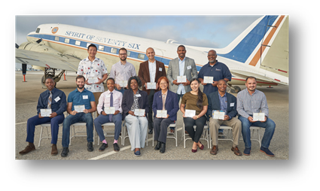


LAX: SMALL BUSINESS POLICIES & SUPPORT
ESTABLISH LAWA CONTRACTOR RECRUITMENT PIPELINE PARTNERSHIPS
Build a pipeline of firms at various levels of readiness
LAX BUSINESS NAVIGATION & SUPPORT OFFICE
Help small, local, diverse firms navigate LAWA and connect to resources
NEW!
BUILDLAX- THE LAWA CONTRACTOR DEVELOPMENT ACADEMY
Provides small contractors support and preparation to address the challenges they may encounter accessing contract opportunities on LAWA projects.
http://www.lawa.org - > About LAWA - > Business Opportunities - > Administrative Requirements

Slide 41
BUSINESS, JOBS & SOCIAL RESPONSIBILITY
For more information please contact:
Chamberlain Duru
CDURU@lawa.org |(424) 646-5374
For general inquires, contact the Business Jobs and
Social Responsibility Division at BusinessandJobs@lawa.org or (424) 646 -7300.

Slide 42


First Source Hiring Program
Business, Jobs & Social Responsibility Division (BJSR)
JobsatLAX.org
Business, Jobs & Social Responsibility (BJSR)

Slide 43
Program Description
The First Source Hiring Program (FSHP) is a valuable resource to connect LAX employers with job seekers.
The program requires employers and their sub-contractors to participate by posting and promoting their jobs on www.jobsatlax.org.
Applicants can apply directly on the company’s website or directly on the www.jobsatlax.org website.
Contractors can post their jobs manually and communicate with job seekers directly.
Currently the website has 100,000+ active job seeker accounts and 50,000+ searchable resumes.
JobsatLAX.org
Business, Jobs & Social Responsibility (BJSR)

Slide 44
Next Steps for Selected Contractors
Contact FSHP to register once a LAX contract has started by reaching Clarence Espinosa at cespinosa@lawa.org for guidance and technical assistance needs.
Complete the “FSHP Company Profile Form” located under the “Employment” tab on www.JobsatLAX.org
Designate a liaison to work with FSHP (i.e. Manager, Human Resources personnel, etc.).
Work with the FSHP team to post jobs online and utilize the features of the system to hire prospective employees.
JobsatLAX.org
Business, Jobs & Social Responsibility (BJSR)

Slide 45
Los Angeles World Airports
For more information, please contact:
Business, Jobs & Social Responsibility
First Source Hiring Program
6053 W. Century Blvd., Suite 300
Los Angeles, CA 90045
Phone: (424) 646-7300
Websites: www.jobsatlax.org
Email: cespinosa@lawa.org
JobsatLAX.org
Business, Jobs & Social Responsibility (BJSR)

Slide 46
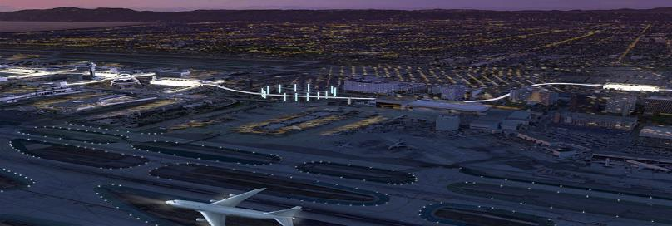

LAWA Contractor Development & Bonding Program
“Doing Business with Los Angeles World Airports”
Rosa Osorio
Senior Account Manager
550 S Hope Street, Suite 1835
Los Angeles, CA 90071
Cell: 213-327-5259
rosa@imwis.com

Slide 47

LAWA Contractor Development Program Services
  To reduce the barriers of bonding/capacity, enabling greater and successful participation of small, local, minority, women and disabled veteran owned businesses in public contract opportunities.

Slide 48

LAWA Contractor Development Program Services
Obtaining or Increasing Bonding Capacity
Contractor Development, Capacity Building and Technical Services
Dedicated Account Manager (Business Development)
Agency Collateral Support
  Bid, Performance & Payment Bonds for Qualified Contractors
Third Party Funds Administration
Accounting Cost Subsidy
  $3,200 for CPA Prepared Financial Statements
Weekly Bid, Project and Event Email Alerts

Slide 49
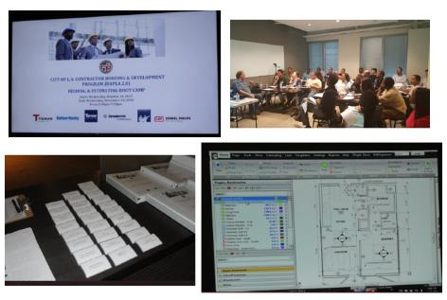
LAWA Contractor Development Technical Assistance
Assessment & Work Plan
Contractor Profile
Certifications
Capacity Building
Bid Document Review
Contract Monitoring
Monthly Workshops & Coaching
Construction Training Academy
    Bidding & Estimating
    Contract Award Management

Slide 50
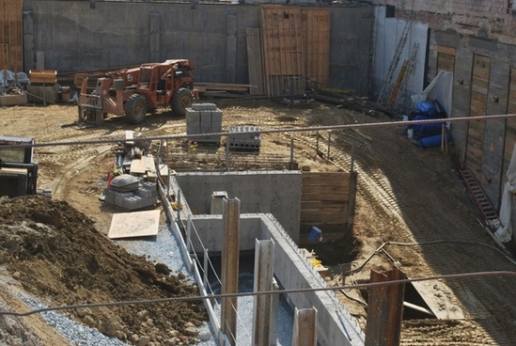
LAWA Contractor Development Bid Document Review
Bid Review Disclaimer: Bid Review is a courtesy for contractors enrolled in the Contractor Development and Bonding Program and who meet the minimum requirements. Neither Merriwether & Williams Insurance Services nor Metro Agency is responsible for errors, oversights, omissions or misstatements made in the preparation of the Bid Review.
Attend Pre-Bid
Review Plans & Specs
Assist with Identifying Risks
Assist with Identifying Required Bid Documents
Schedule Additional Meetings Prior to Bid Submission
Follow Up After Bidding Process

Slide 51
LAWA Contractor Development Contract Monitoring
Contract Review with Contractor
Project Kick-off
Monthly Site Visits (If Applicable)
Status Reports
Construction Schedule
Cost Management
Closeout

Slide 52
GETTING CERTIFIED
Small Business Enterprise (SBE-Proprietary)
Small Local Business (SLB)
Local Business Enterprise (LBE)
Disabled Veterans Business Enterprise
DVBE (LAWA)
Certification Recognition
Local Small Business Enterprise (LSBE) (LAWA)
Federal Programs Certification
Disadvantaged Business Enterprise (DBE)
Airport Concessions DBE (ACDBE)

Slide 53
SBE (Proprietary) Certification
Requirements:
  Firm is independently owned and operated
  Firm meets small business criteria set forth by the Small Business Administration (8a) Business Development Program or State DGS Small Business Program, whichever standard is higher
Advantage:
  Certification provides additional opportunities in competing against non-certified subcontractors for procurements opportunities calling for SBE (Proprietary)-certified firms
Process:
  If certified by one of the agencies on the chart in the following slide, provide copy of the certification or approval letter; OR if not, submit SBE (Proprietary) Application for processing.
  Certification is good for two years.
Applying:
  Go to https://bca.lacity.org/Uploads/cca/SBE%20%28Proprietary%29%20Application.pdf
Types of Projects: Construction, professional and non-professional projects valued over $150,000.

Slide 54
SBE (Proprietary) Certification
If your firm is currently certified with one of the following agencies you do NOT need to go through the Certification process, simply submit a copy of your certification to a Certification analyst or with your bid/proposal.
City of Los Angeles
City of Los Angeles
CERTIFYING AGENCY | CERTIFICATION | ACCEPTED BY LAWA FOR SBE (PROPRIETARY)?
Federal Small Business Administration (SBA) | SBA 8(a) Business Devpt. Program | Yes
State of California Department of General Services (DGS) | SB, SB-Public Works, SB (micro) | Yes
California Department of Transportation (CALTRANS) | SMBE, SWBE, DBE | Yes
L.A. County Metropolitan Transportation Authority (METRO) | SBE, DBE | Yes
California Unified Certification Program (CUCP) Agencies: • California Department of Transportation (CALTRANS) City of Fresno • City of Los Angeles L.A. County Metropolitan Transportation Authority (METRO) • San Diego County Regional Airport Authority (SAN) • San Francisco Bay Area Rapid Transit District (BART) • San Francisco International Airport (SFO) • San Francisco Municipal Transportation Agency (SFMTA) • San Mateo County Transit District (SAMTRANS) • Santa Clara Valley Transportation Authority (VTA) | DBE | Yes
US Women’s Chamber of Commerce (USWCC) | WOSB, EDWOSB | Yes
Women’s Business Enterprise Council West (WBEC-WEST) | WOSB | Yes
National Women Business Owners Corporation (NWBOC) | WOSB, EDWOSB | Yes
City of Los Angeles | SBE, SLB | Yes
County of Los Angeles | LSBE | Yes

Slide 55
Small Local Business (SLB) Certification
Requirements:
  Principal office located in the County of Los Angeles
  Gross receipts (including affiliates) for the previous fiscal year must be less than $3 million
  City of Los Angeles Business Tax Registration Certificate
Advantage:
  Certified SLB responsible bidders on procurement contracts under $100,000 given a 10% deduction on their bid amount
Process:
  Submit hard copies of one page application or submit via email, copy of current taxes, and BTRC
  Certification process is simple and good for two years
Applying:
  Go to https://bca.lacity.org/Uploads/cca/SLBApplication.pdf
Type of Contracts: Mostly goods and commodities.

Slide 56
LBE Certification
Requirements:
  Must have business workspace within County of Los Angeles boundaries:
    Headquartered (physically conducts and manages all operations) in the County; OR
    at least 50 of its full-time employees perform work within the boundaries of the County at least 60 percent of their total hours worked on annual basis; OR
    at least half of its full-time employees work within the boundaries of the County at a minimum of 60 percent of their total regular hours worked on annual basis.
  City of Los Angeles Business Tax Registration Certificate
  Current on all City & County taxes
Advantage:
  Certified LBEs on procurement contracts over $150,000 are given an 8% deduction on the bid amount or 8 points toward the proposal score
Process (on-line):
  Affidavit of Eligibility completed by Local Business
  Affidavit posted by Local Business on LABAVN (Mayor’s website) & verified by BCA/LAWA
  Certification valid for five years.

Slide 57
LBE Certification
Applying:
  After registering on LABAVN, download an LBE Affidavit and apply on-line
Example: Any type of business, the major eligibility criteria is business workspace/headquarters located within LA County boundaries
NOTE: LAWA does not accept Harbor’s LBE or LA County LSBE certification. LBE
Certification does not apply to contracts that involve the expenditure of funds that are not entirely within LAWA’s control; i.e., grants, federal funds, etc.
Also, virtual business offices, PO Box centers, mail centers, or other
temporary business locations are not eligible for LBE certification.

Slide 58
DVBE (LAWA) Certification
Requirements:
Must be certified by any one of three agencies, two Federal, one State of
California (see following slide) and
  Must also have business workspace within the State of California:
    Headquartered (physically conducts and manages all operations) in the State; OR
    at least 50 of its full-time employees perform work within the boundaries of the State at least 60 percent of their total hours worked on annual basis; OR
    at least half of its full-time employees work within the boundaries of the State at a minimum of 60 percent of their total regular hours worked on annual basis.
  City of Los Angeles Business Tax Registration Certificate
  Current on all City, County, & State taxes
Advantage:
  Certified DVBE(LAWA)s on procurement contracts over $150,000 are given an 8% deduction on the bid amount or 8 points toward the proposal score

Slide 59
Recognized for DVBE (LAWA) Certification
CERTIFYING AGENCY | CERTIFICATION | ACCEPTED BY LAWA AS DVBE (LAWA)?
U.S. Department of Veterans Affairs* | Service-Disabled Veteran-Owned Small Business (SDVOSB) | Yes
U.S. Small Business Administration* | Service-Disabled Veteran-Owned Small Business (SDVOSB) | Yes
State of California | Disabled Veteran Business Enterprise (DVBE) | Yes
*The Federal SDVOSB must be headquartered or have employees working at a business workspace in California in order to be certified as
a DVBE (LAWA)
If a firm, after uploading a DVBE(LAWA) Affidavit in BAVN, is verified as being certified by one of the Federal agencies as an SDVOSB and is also verified as certified as a City of Los Angeles LBE, that firm will be granted DVBE (LAWA) certification..

Slide 60
DVBE (LAWA) Certification
Process (on-line):
  Affidavit of Eligibility completed by Disabled Veterans Business firm
  Affidavit posted by Disabled Veterans Business firm on LABAVN (Mayor’s website) & verified by LAWA
  Certification valid for five years.
  An optional site visit may be conducted to verify State of California location.
  Applying:
  After registering on LABAVN, download a DVBE(LAWA) Affidavit and apply online.
Example: Any type of business
NOTE: DVBE (LAWA)Certification does not apply to contracts that involve the
expenditure of funds that are not entirely within LAWA’s control; i.e., grants,
federal funds, etc.

Slide 61
LAWA’s Local Small Business Enterprise (LSBE) Certification Recognition
There is no separate LSBE certification process with the City of Los Angeles or with LAWA. In order to qualify as a LAWA LSBE, a firm must be certified as an SBE(Proprietary) and LBE
What happens if I have LSBE certification from the County of Los Angeles?
  Your firm will be recognized as an SBE (Proprietary) by LAWA.
  However, you must submit a LBE Affidavit of Eligibility with the City of Los Angeles.
  If your firm meets the City of Los Angeles’ LBE criteria and consequently obtains LBE certification, your firm will then be recognized as both an LBE and LSBE by LAWA.

Slide 62
LAWA’s Local Small Business Enterprise (LSBE) Certification Recognition
Advantage: Certification provides additional opportunities in competing against non-certified subcontractors for procurements opportunities calling for LSBE (LAWA)-recognized firms
Example: Any type of business
NOTE: As mentioned previously, LAWA does not accept LA County LSBE Certification for Local Business Enterprise Certification Recognition.

Slide 63
DBE/ACDBE Certification Requirements
 | DBE | ACDBE
Ownership & Control Requirements | For-profit, independent business that is at least 51% owned and controlled by socially and economically disadvantaged individuals (Asian-Pacific, Black, Hispanic, Native American, Subcontinent Asian, Women)
Qualifying Owner’s Personal Financial Limit | Less than $1,320,000 (excluding equity in primary residence and applicant business)
Business Gross Receipts Limit, (Including Affiliates) | Small Business Administration Industry Size Standards up to $26.29* million (averaged over 3 years) |  | $56.42 million (averaged over 3 years)
Type of Business | Any |  | A business that is: (a) located on the airport selling consumer goods or services to the public (excludes taxi, custodial & security services, and aeronautical activities) OR (b) Suppliers of goods and services to concessionaires (includes management, advertising, & web-based contractors)
*Increased from $23.98 million, effective January 13, 2021

Slide 64
DBE / ACDBE Certification
Applying for DBE or ACDBE Certification:
  Please note: New as of March 2021
  For potential new DBE/ACDBE applicant firms, please use the weblink below to register and apply.
Click here to access the https://lacity.diversitysoftware.com/
Advantage:
  Certification provides additional opportunities in competing against non-certified subcontractors
  Marketing exposure through nationwide, statewide, and citywide databases
  One stop shop – the City’s DBE/ACDBE certifications are honored throughout CA (CUCP includes CALTRANS, Metro, etc.)
  DBE certification is good until or unless removed for cause; e.g., change in ownership or control, exceeds size standards or net worth or failure to cooperate.
ACDBE Examples:
  On-line and hard copy airport magazine publisher
  On-line digital advertising vendor
  Vehicle Service and Maintenance Provider off the LAWA campus who performs CHP-standard vehicle inspections and services. Staff also repairs, services, and maintains tour buses and shuttle vans that transport travelers to and from LAX.

Slide 65
DBE/ACDBE Certification Process
1. Preliminary Intake Review:
Submitted documents are checked for completeness
2. Desk Audit:
Supporting documents are reviewed to determine eligibility for certification, additional information may be requested
3. Mandatory Site Visit (Due to COVID-19, virtual or telephonic):
Interview applicant at the business location; physical verification that business exists, additional information may also be requested
4. Final Review for Approval/Denial
Start the Certification Process Today!

Slide 66
Getting Certified
For more information:
http://bca.lacity.org
  Certification Helpline
  (213) 847-2684
  bca.certifications@lacity.org
Shaun Shimoda-Kobayashi, LAWA Certification Manager
(213) 847-2650
shaun.shimoda-kobayashi@lacity.org
Elaine Luong-Huynh, LAWA Certification Analyst
(213) 847-2667
elaine.luong@lacity.org
Dana Tominaga, LAWA Certification Analyst
(213) 847-2375
dana.tominaga@lacity.org
Directories of Certified Firms:
CUCP: https://dot.ca.gov/programs/business-and-economic-opportunity/dbe-search> Directory City of LA: http://bca.lacity.org -> Certification Listings -> Click on DBE/MBE/WBE Directory

Slide 67
ADMINISTRATIVE REQUIREMENTS

Slide 68
Administrative Requirements
Due with bid/proposal
Affidavit of Non-Collusion (Form: Notary signature)
Bid Bond (Form, project specific)*
Bidder Contribution Limits (Form CEC 55, >$100,000)
Contractor Responsibility Program (Form, Board approval)
Equal Benefits Ordinance (Form, project specific)*
Municipal Lobbying Ordinance (Form CEC 50, > $25,000)
Vendor Identification Form
Subcontractor Participation Plan
Iran Contracting Act of 2010
Insurance (pricing only), if greater than $1 million…requirements…

Slide 69
Administrative Requirements
Selected Bidder/ Proposer Requirements
Affirmative Action Plan (Language)
Assignment of Anti-Trust Claims (Language)
Child Support Obligations (Language)
First Source Hiring Program (LAX only)
Labor Peace Agreement (Language, concessions only)
Living Wage Ordinance/Service Contractor Worker Retention Ordinance (Language; if applicable, complete the Correct Exemption Form)*
Insurance (Form)

Slide 70
Administrative Requirements
Administrative Requirements Website:
http://www.lawa.org - > About LAWA - >
Business Opportunities - > Administrative Requirements

Slide 71
Next Steps…
1. Check the products and services that LAWA needs on www.lawa.org -> Business
Opportunities -> What LAWA Buys as well as the LAWA Construction
Forecast Report. Additionally, reach out to Prime Contractor and
potential business partners.
2. Research applicable CERTIFICATION Programs and APPLY.
3. Register on Los Angeles Business Assistance Virtual Network –
LABAVN at www.labavn.org
4. Check the Expiring Contracts Report at https://www.lawa.org/en/lawa-businesses/lawa-current-opportunities for contracts that are about to expire.

Slide 72
Next Steps…
5. Contact Business Jobs & Social Responsibility Division for upcoming Outreach
Events.
6. Attend any relevant pre-bid/proposal meetings (refer to RFB/P)
7. Research LAWA’s Contractor Development & Bonding Program for technical
assistance.
8. Research LAWA’s First Source Hiring Program for any employee needs.
9. If applying, contact the Contract Administrators of the RFB/P regarding
questions on the scope of work.

Slide 73
Next Steps… (cont.)
10. Contact Procurement Services Division (Contract Services Unit) regarding
Administrative Requirements at (424) 646-5380 or go to www.lawa.org
- > About LAWA - > Business Opportunities - >
Administrative Requirements

Slide 74
Contact Information
LAWA Business, Jobs & Social Responsibility | (424) 646-7300 | businessandjobs@lawa.org | https://www.lawa.org/groups-and-divisions/business-jobs-and-social-responsibility
LAWA Procurement Services Division | PSD Main Line: (424) 646-5380 | Purchasing: (424) 646-7392 | https://www.lawa.org/en/groups-and-divisions/procurement
City of Los Angeles Contractor Development and Bonding Program (Rosa Osorio, Senior Account Manager) | (213) 327-5259 |  | rosa@imwis.com
LAWA First Source Hiring Program | (424) 646-7300 |  | cespinosa@lawa.org
LAWA Risk Management Insurance Compliance Section | (424) 646-5480
Department of Public Works, Bureau of Contract Admin. | bca.certifications@lacity.org
LA Business Assistance Virtual Network | http://www.labavn.org

Slide 75

DOING BUSINESS with
Los Angeles World Airports

