Slide 1
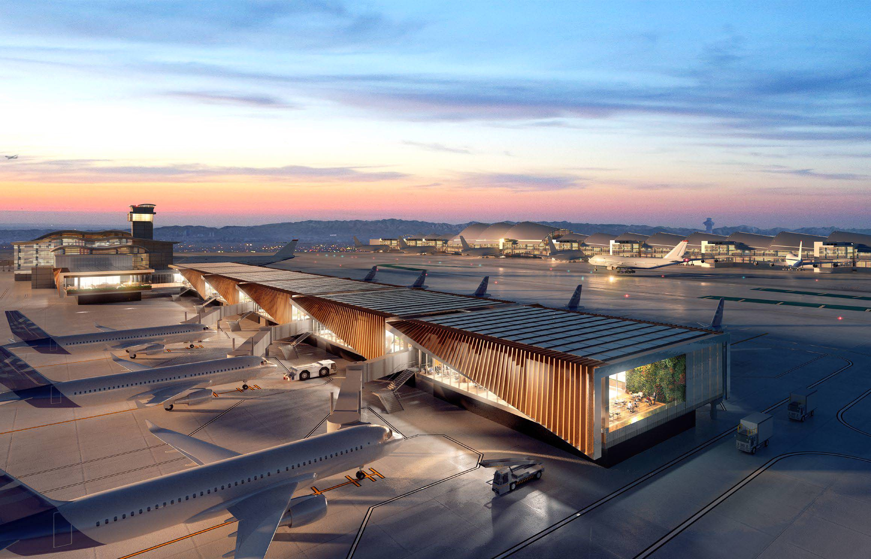
ACDBE Goals for Federal Fiscal Years 2024-2026
LAX will set the ACDBE goals for federal fiscal years 2024-2026 for Non-Car Rental and Car Rental Concessions. The goal will commence October 1, 2023 and end on September 30, 2026. The proposed goals will take into consideration the availability of ACDBE-certified firms to perform the work as compared to the total number of available firms. LAWA has analyzed the six local counties (Los Angeles, Orange, Riverside, San Diego, San Bernadino, and Ventura) to determine all available firms with relevant NAICS codes and determined the ACDBE certification of firms using available databases such as California UCP. The previous year’s ACDBE performance as well as the lingering effects of COVID-19 were taken into consideration.
LAWA will accept written comments related to LAWA’s proposed ACDBE Triennial Goals until January 26, 2024 sent to Joon Lee, LAWA Strategic Sourcing Division, at JLEE@LAWA.ORG.
The online Stakeholder Meeting will be held on January 9, 2024 at 10am-11am (PST). Please RSVP to Kim McAdams at KMCADAMS@LAWA.ORG and include your firm name and contact info.
LOS ANGELES WORLD AIRPORTS

