Slide 1
DOING BUSINESS WITH LAWA
By Procurement Services Division
Rev. 9/2019

Slide 2
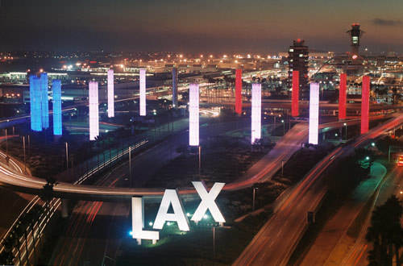
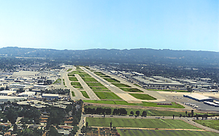
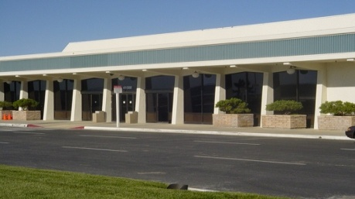
Workshop Overview - Airport Locations
 | LAX ranked 4th in the world for passenger service In 2018, airlines served 84,557,968 passengers
 | Van Nuys Airport – one of the world’s busiest General Aviation airports with almost 220,228 take-offs annually Dedicated to non-commercial air travel
 | LA/Palmdale - LAWA owns and maintains the Palmdale Land Holdings, previously an FAA certified airport

Slide 3
Workshop Overview
    Procurement Services Division
    Administrative Requirements
    Business Programs
    Break
    Getting Certified
    Business, Jobs & Social Responsibility

Slide 4
Procurement Services Division (PSD) Mission
To provide consistent and timely procurement and contract-related services to LAWA Divisions and the business community
To efficiently, fairly, and effectively obtain goods and services needed to support LAWA operations
To enforce compliance with established policies, procedures and guidelines set forth in the Los Angeles City Charter, the Los Angeles Administrative Code, BOAC Resolutions, and applicable Mayoral Directives related to the procurement process.

Slide 5
Procurement Process at LAWA
LAWA procures over $500 million annually in goods, materials, and services (excluding major construction projects) through the following:
    Request for Proposals (RFP)
    Request for Qualifications (RFQ)
    Request for Bids (RFB)

Slide 6
What is an RFQ/RFP/RFB?
 | RFP (Professional Services) | RFB (Goods, Equipment, Non-Professional Services)
RFQ | Qualifications | Specifications
 | Selection criteria | Selection is the lowest price
  In order to be considered for award, you must meet the
    RFP qualifications
    RFB specifications
  In order to be selected for award, you must have the
    RFP – Winning score according to the selection criteria
    RFB – Lowest price, including any discounts

Slide 7
Request For Bids (RFB)
A Request for Bid is used for the purchase of materials, supplies, equipment, construction projects and non-professional services
The award is made to the lowest priced responsive and responsible bidder who meets the specifications.

Slide 8
Types of Request for Bids (RFB)
Informal bid – Signed response can be sent by fax or e-mailed to a Procurement Analyst and must be received prior to the due date and time. Responses missing Administrative and other requirements will be rejected
Formal bid – typically over $25,000 – Signed response may be hand-delivered or sent by mail and must be received by the due date & time, NO EXCEPTIONS! Formal bids are submitted sealed and publicly opened.

Slide 9
Types of RFB (cont.)
These thresholds may be modified according to the best interest of the Los Angeles World Airports (LAWA)
Board of Airport Commissioners awards contracts over $150,000 per year – Large construction RFBs are handled by the Planning and Development Group
Bids can be for individual items, services, one-time purchase orders, or annual contracts for a maximum of 3 years.

Slide 10
Important Bid Information to Note
NO EXCEPTIONS to due date and time, as recorded by the Purchasing Office clock and/or fax machine
Buyer’s Name (for questions & clarifications to be addressed in writing, the sooner the better, to specific buyer prior to bid due date and time)
Location to which bid response should be returned (LAX Airport Purchasing)
Bidder must sign his/her bid response and is advised to keep a copy of the response. Bidder shall carefully follow the directions for completing signature per instructions in the RFB.
Bidders must comply with specifications or explain in writing the exceptions taken with bid response.

Slide 11
Please Read, Understand and Agree
How prices are to be quoted (Firm fixed price, Total Lump sum, Labor Rates & Materials, Discount/Mark-up from Price List, etc.)
General Conditions address various issues of bid award, specification change, default by supplier, payments, patent rights, attorney’s fees, bid protest, etc.

Slide 12
Submit Where and as Required
Specifications, Make/Model of equipment or parts When bidding on an alternate brand, make sure to specify the alternate brand and model number offered
Bid Response and Administrative Requirements must be filled out and returned complete, as received
If certified with City of Los Angeles, claim either Small Local Business (SLB) preference and submit SLB # or Local Business Enterprise (LBE) preference and register on LABAVN (will provide details later regarding SLB and LBE certification)
Fill out Contractor’s License Requirements, if applicable.

Slide 13
Useful Tips from PSD
Invoice must be submitted in compliance with Invoice Instruction sheet provided in the bid
Payment Terms (Discount offered for payment of 25 days and greater) are taken into consideration for award
Be aware of and comply with time and delivery requirements (see Bid/Specifications)
Promotional materials, testimonials, and brochures are not required in the bid response, unless specifically requested
Bid Results are available within 1 week of the bid due date at www.labavn.org.

Slide 14
Soliciting Bids/Proposals and Qualifications
All City of Los Angeles RFB/RFP/RFQs are available on:
  The Los Angeles Business Assistance Virtual Network web site: www.labavn.org
  Various media depending on project scale.

Slide 15
ADMINISTRATIVE REQUIREMENTS

Slide 16
Administrative Requirements
Due with bid/proposal
Affidavit of Non-Collusion (Form: Notary signature)
Bid Bond (Form, project specific)*
Bidder Contribution Limits (Form CEC 55, >$100,000)
Contractor Responsibility Program (Form, Board approval)
Equal Benefits Ordinance (Form, project specific)*
Municipal Lobbying Ordinance (Form CEC 50, > $25,000)
Vendor Identification Form
Subcontractor Participation Plan
Insurance (pricing only)

Slide 17
Administrative Requirements
Selected Bidder/ Proposer Requirements
Affirmative Action Plan (Language)
Assignment of Anti-Trust Claims (Language)
Child Support Obligations (Language)
First Source Hiring Program (LAX only)
Labor Peace Agreement (Language, concessions only)
Living Wage Ordinance/Service Contractor Worker Retention Ordinance (Language; if applicable, complete the Correct Exemption Form)*
Insurance (Form)

Slide 18
Administrative Requirements
Administrative Requirements Website:
http://www.lawa.org - > About LAWA - >
Business Opportunities - > Administrative Requirements

Slide 19
BREAK & NETWORKING
9:50 – 10:00 A.M.

Slide 20
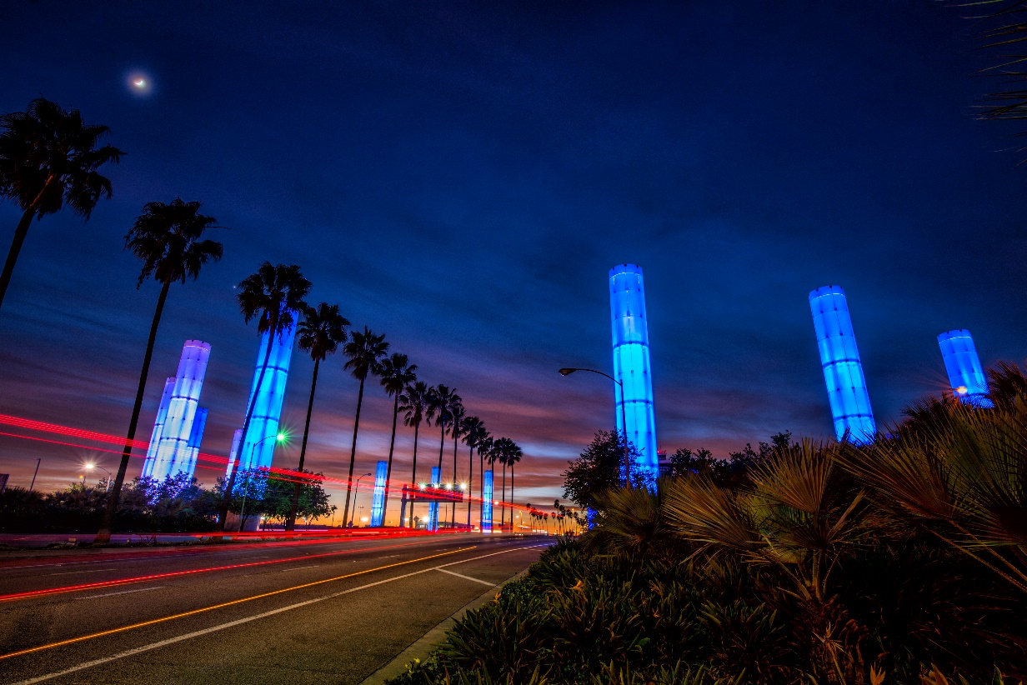

BUSINESS, JOBS
& SOCIAL RESPONSIBILITY
OUR MISSION
Maximize access to business and job opportunities
Ensure that local, diverse communities benefit from LAWA’S investments
Set the global airport standard for public corporate social responsibility
THE FUTURE IS NOW
Notes:
Now we want to share with you a short DRAFT video introducing how the BJSR team is putting INCLUSIVITY into action.

Slide 21
LAX: OPPORTUNITIES- CAPITAL PROGRAM SUMMARY
Major Category | Total Project Cost
Major Tenant Projects | $5,584,329,837
LAMP Projects | $5,500,000,000*
Terminal Projects | $2,149,240,332
Utilities & Environmental Projects | $518,148,350
Airside Projects | $451,782,625
Security & IT Projects | $427,338,879
Landside Projects | $38,452,770
Planning / Study Projects | $24,235,000
TOTAL | $14,693,527,793*
*LAMP Subtotal is currently being finalized
Note: Figures are expressed in 2018 dollars and are subject to escalation. Does not include estimate for Asset Renewal or Program Reserve.
Notes:
Women HireLAX grads speak to tapping into the underrepresented populations
4 key partners: South Bay WIB, County of LA with Foster Youth, LA Urban League, and LA Unified School District

Slide 22
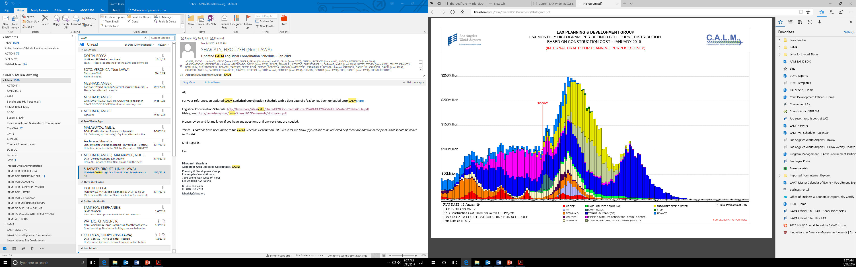
LAX: OPPORTUNITIES

Slide 23
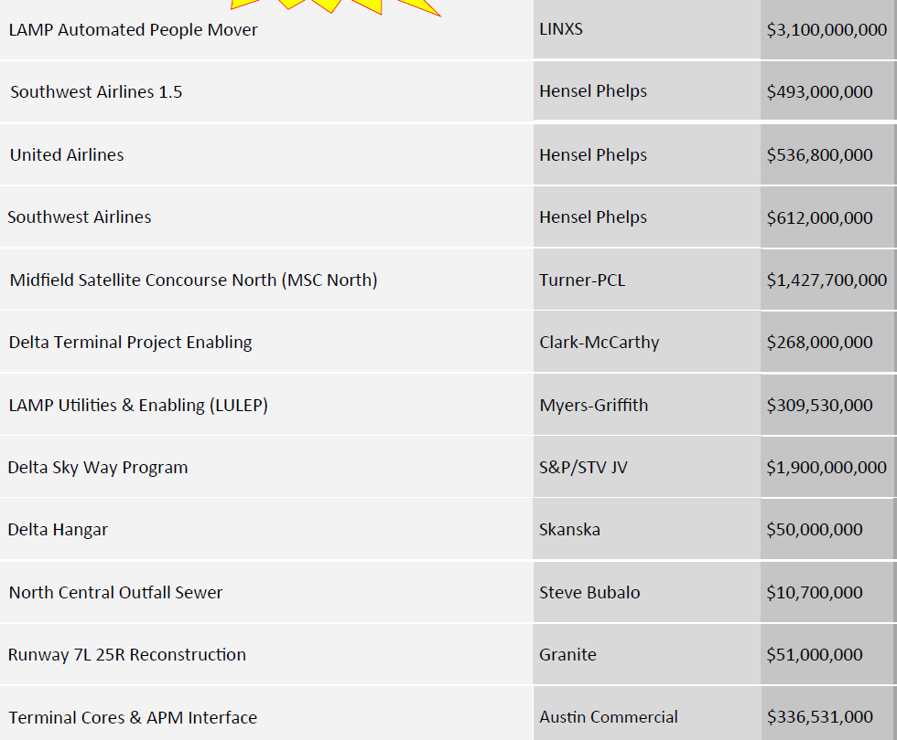
LAX: OPPORTUNITIES- ACTIVE PROJECTS
PROJECT
LAMP BUSINESS INCLUSION REQUIREMENTS
PROJECT NAME | DEVELOPER or PRIME | APPROX. PROJECT VALUE
APM
PHASE | SBE | LBE | LSBE | DVBE
DESIGN | 22% | 8% | 3% | 3%
BUILD | 18% | 7% | 5% | 3%
O & M | 17% | 10% | 5% | 3%
CONRAC
PHASE | SBE | LBE | LSBE | DVBE
DESIGN | 18% | 50% | 10% | 3%
BUILD | 22% | 20% | 5% | 5%
O & M | 20% | 7% | 5% | 3%
ITF-W
PHASE | SBE | LBE | LSBE | DVBE
DESIGN & BUILD | 20% | 10% | 5% | 3%
 | Plus all firms named in the proposal
LULEP
(contract precedes
DVBE ordinance)
PHASE | SBE | LBE | LSBE | DVBE
DESIGN & BUILD | 19.63% | 12.5% | 7.49% | N/A
Notes:
Women HireLAX grads speak to tapping into the underrepresented populations
4 key partners: South Bay WIB, County of LA with Foster Youth, LA Urban League, and LA Unified School District

Slide 24



LAX: SMALL BUSINESS POLICIES & SUPPORT
BUSINESS ENTERPRISE PROGRAMS
Small and Local Business (SLB) | Used for bids under $100,000 in value. Principal office located in the County of Los Angeles Gross receipts (including affiliates) less than $3 million Certified SLB responsible bidders given a 10% deduction on their bid amount to determine the lowest bidder (bidder is paid their full amount)
Local Business Preference Program (LBPP) Non-federal projects | Goods, Equipment, Services (including construction) $150,000 +. 8% preference applied to bids and proposals (LBE or a preference of up to 5% applied for LBE subs that perform work under the contract, up to $1M
Small Business Enterprise (SBE) Local Small Business Enterprise (LSBE) Disabled Veterans Business Enterprise (DVBE) | MANDATORY on Construction, professional and non-professional projects valued over $150,000. Independently owned and operated SBE Firm meets small business criteria set forth by the Small Business Administration (8a) Business Development Program or State DGS Small Business Program, whichever is higher DVBE Certification from U.S. Department of Veterans Affairs and/or State of California
ESTABLISH LAWA CONTRACTOR RECRUITMENT PIPELINE PARTNERSHIPS
Build a pipeline of firms at various levels of readiness
LAX BUSINESS NAVIGATION & SUPPORT OFFICE
Help small, local, diverse firms navigate LAWA and connect to resources
COMING SOON!
BUILDLAX- THE LAWA CONTRACTOR DEVELOPMENT ACADEMY
Train and mentor small, local, diverse firms to meet the challenges unique to LAWA
http://www.lawa.org - > About LAWA - > Business Opportunities - > Administrative Requirements
Notes:
BUSINESS ENTERPRISE PROGRAM
BUSINESS ENTERPRISE PROGRAM
Small and Local Business (SLB)
Used for bids under $100,000 in value.
Principal office located in the County of Los Angeles
Gross receipts (including affiliates) for the previous fiscal year must be less than $3 million
Valid City of Los Angeles Business Tax Registration Certificate
Certified SLB responsible bidders given a 10% deduction on their bid amount to determine the lowest bidder (bidder is paid their full amount)
Local Business Preference Program (LBPP)
Procurement of Goods, Equipment, and Services, including Construction, valued in excess of $150,000.
8% preference applied to bids and proposals of Local Business Enterprise (LBE) certified companies or a preference of up to 5% applied for LBE certified Subcontractor(s) that perform work under the contract, up to $1M
LBPP does not apply to contracts that involve the expenditure of funds that are not entirely within LAWA’s control (i.e. grants, federal funds)
Small Business Enterprise (SBE)
Local Small Business Enterprise (LSBE)
Disabled Veterans Business Enterprise (DVBE)
MANDATORY on Construction, professional and non-professional projects valued over $150,000.
Independently owned and operated SBE Firm meets small business criteria set forth by the Small Business Administration (8a) Business Development Program or State DGS Small Business Program, whichever is higher
DVBE Certification from U.S. Department of Veterans Affairs and/or State of California
Disadvantaged Business Enterprise (DBE)
Federal Program – applies to projects using Federal funds as required by Code of Federal Regulations 49, Part 26
DBE goal is set on a project-by-project basis
Good Faith Effort documentation is required only if DBE participation proposed is lower than LAWA’s goal for the project
Airport Concessions Disadvantaged Business Enterprise (ACDBE)
Required by Code of Federal Regulations 49, Parts 23 for airport activities considered Concessions
Goal is established by LAWA on a project-by-project basis
Prime Contractor must submit documentation of their “Good Faith Effort” to obtain certified ACDBE subcontractors (75/100 points)
No GFE documentation required when Prime Contractor is a Certified ACDBE or
Prime Contractor meets or exceeds the goal with a pre-determined team of Certified ACDBE subcontractors
Small and Local Business (SLB)
Used for bids under $100,000 in value.
Principal office located in the County of Los Angeles
Gross receipts (including affiliates) for the previous fiscal year must be less than $3 million
Valid City of Los Angeles Business Tax Registration Certificate
Certified SLB responsible bidders given a 10% deduction on their bid amount to determine the lowest bidder (bidder is paid their full amount)
Local Business Preference Program (LBPP)
Procurement of Goods, Equipment, and Services, including Construction, valued in excess of $150,000.
8% preference applied to bids and proposals of Local Business Enterprise (LBE) certified companies or a preference of up to 5% applied for LBE certified Subcontractor(s) that perform work under the contract, up to $1M
LBPP does not apply to contracts that involve the expenditure of funds that are not entirely within LAWA’s control (i.e. grants, federal funds)
Small Business Enterprise (SBE)
Local Small Business Enterprise (LSBE)
Disabled Veterans Business Enterprise (DVBE)
MANDATORY on Construction, professional and non-professional projects valued over $150,000.
Independently owned and operated SBE Firm meets small business criteria set forth by the Small Business Administration (8a) Business Development Program or State DGS Small Business Program, whichever is higher
DVBE Certification from U.S. Department of Veterans Affairs and/or State of California
Disadvantaged Business Enterprise (DBE)
Federal Program – applies to projects using Federal funds as required by Code of Federal Regulations 49, Part 26
DBE goal is set on a project-by-project basis
Good Faith Effort documentation is required only if DBE participation proposed is lower than LAWA’s goal for the project
Airport Concessions Disadvantaged Business Enterprise (ACDBE)
Required by Code of Federal Regulations 49, Parts 23 for airport activities considered Concessions
Goal is established by LAWA on a project-by-project basis
Prime Contractor must submit documentation of their “Good Faith Effort” to obtain certified ACDBE subcontractors (75/100 points)
No GFE documentation required when Prime Contractor is a Certified ACDBE or
Prime Contractor meets or exceeds the goal with a pre-determined team of Certified ACDBE subcontractors

Slide 25
LAX: WHAT YOU SHOULD KNOW
BE PREPARED
The doors of opportunity are open.
Prepare to walk through.
KNOW YOUR AGENCY
Do your Research
Understand opportunities & priorities
Understand administrative requirements
Develop relationships with agency staff
Register with BAVN
Attend workshops hosted by agency
STAY READY
Get (STAY) certified
Focus your business- do one thing & do it well
Build your capacity- look for training and mentor opportunities
Understand your finances- understand bonding, cash flow, insurance, taxes, credit
Network
Use the Project Labor Agreement to you Advantage
KNOW YOUR CUSTOMER
Understand the project: design, procurement and bid package schedule
Understand your contract
Plan for “the gap”
Develop relationships with your prime
Be careful about your bid- Bid to make a PROFIT
Notes:
AM/ ALL
JEFF TIP: GO DOWNLOAD OLD RFP’S TO LEARN WHAT AN AGENCY DOES
JAMAAL TIP: TELL YOUR STORY– AS WHO YOU ARE, WHY LAWA/PRIME WOULD BENEFIT FROM WORKING WITH YOU.
- ALL JUMP IN-

Slide 26
BUSINESS, JOBS & SOCIAL RESPONSIBILITY
For more information please contact:
Chamberlain Duru
CDURU@lawa.org
(424) 646-5374
Notes:
Now we want to share with you a short DRAFT video introducing how the BJSR team is putting INCLUSIVITY into action.

Slide 27


First Source Hiring Program

Slide 28
Program Description
The First Source Hiring Program (FSHP) is administered by the Business, Jobs and Social Responsibility Division. The FSHP was designed to provide employment information to all residents from local communities surrounding the airport and those impacted by airport operations.
FSHP language is in most all LAX contracts.
The program requires employers and sub-contractors to participate in the program by posting their jobs with LAX. Employers that have job openings must post their jobs on the website within 5 days before posting to the general public.
We are known as Jobs@LAX
Employers can post their jobs manually or automatically posted from their company website to the Jobs@LAX website.
Positions include: professional, administrative, concessions, security, warehouse, drivers, ramp, technical, ticket agents, etc….
28

Slide 29
Benefits for LAX Employers
FSHP services are provided at NO COST to your company.
FSHP saves employers time and money.
FSHP assists your company with finding qualified candidates for your employment opportunities
Applicants apply directly on the company’s website or directly on the Jobs@LAX website.
Applicants make their resumes searchable so employers can search hundreds of resumes for the perfect candidate at any time
29

Slide 30
Benefits to LAX Employers
FSHP has two resource centers for job seekers to visit and apply to LAX employment opportunities.
FSHP also promotes LAX jobs by:
  partnering with local Community Organizations, such as WorkSource Centers and colleges
  participating in job fairs, local hiring events, and social media to promote LAX jobs
  assisting LAX companies with recruitment events
Employers can post unlimited number of jobs and receive instant access to hundreds of LAX candidates resumes
Employers can contact candidates directly through the website
30

Slide 31
Next Steps for Selected Contractors
Contact FSHP to register at gacarter@agile1.com once an LAX contract has started
Complete the Company Registration form and email to gacarter@agile1.com
Designate a liaison to work with FSHP (i.e. General Manager or Human Resources personnel)
Work with FSHP to post jobs online and utilize the features of the system to hire prospective employees
31

Slide 32

Los Angeles World Airports
For more information, please contact:
Gabriela Carter
Business, Jobs and Social Responsibility
First Source Hiring Program
6053 W. Century Blvd., Suite 300
Los Angeles, CA 90045
Phone: (424) 646-7300
Websites: www.jobsatlax.org
Email: businessandjobs@lawa.org
32

Slide 33
BUSINESS PROGRAMS

Slide 34
Current Business Programs
LAWA encourages the participation and inclusion of diverse, small and disadvantaged businesses in our contracts and uses the following programs to procure goods, equipment and services:
Small and Local Business (SLB)
Local Business Preference Program (LBPP)
Local Small Business Enterprise (LSBE)
Small Business Enterprise (SBE)
Disadvantaged Business Enterprise (DBE)
Airport Concessions Disadvantaged Business Enterprise (ACDBE)
Disabled Veterans Business Enterprise (DVBE).

Slide 35
Small and Local Business Program (SLB)
  Used for bids under $100,000 in value.
  Requirements:
  Principal office located in the County of Los Angeles
  Gross receipts (including affiliates) for the previous fiscal year must be less than $3 million
  Valid City of Los Angeles Business Tax Registration Certificate
  Certified SLB responsible bidders given a 10% deduction on their bid amount to determine the lowest bidder (bidder is paid their full amount).

Slide 36
Local Business Preference Program (LBPP)
Procurement of Goods, Equipment, and Services, including Construction, valued in excess of $150,000.
8% preference applied to bids and proposals of Local Business Enterprise (LBE) certified companies or a preference of up to 5% applied for LBE certified Subcontractor(s) that perform work under the contract
  1% preference, up to a maximum of 5%, applied to the quoted bid price or proposal score for every 10% of the proposed work provided to LBE Subcontractor(s)
The maximum bid preference shall not exceed $1 million for any bid
LBPP does not apply to contracts that involve the expenditure of funds that are not entirely within LAWA’s control (i.e. grants, federal funds).
Notes:
Requirements:
Must have workspace within the County of Los Angeles:
Headquartered (physically conducts and manages all operations) in the County; OR
at least 50 of its full-time employees perform work within the boundaries of the County at least 60 percent of their total hours worked on annual basis; OR
at least half of its full-time employees work within the boundaries of the County at a minimum of 60 percent of their total regular hours worked on annual basis.
City of Los Angeles Business Tax Registration Certificate
Current on all City & County taxes
Advantage:
Certified LBPPs on procurement contracts over $150,000 are given up to an 8% deduction on the bid amount or up to an 8% addition in points on the proposal scoring
Process:
Affidavit of Eligibility completed by local business & verified by City of Los Angeles Public Works Bureau of Contract Administration
Affidavit posted by Local Business on LABAVN
Certification valid for five years

Slide 37
Local Business Enterprise / Local Small Business Enterprise
Ordinance approved November 2016
Applies to BOAC awarded contracts for procurement of goods, equipment and services, including design and construction, valued in excess of $150,000
Designed as a Subcontracting Program.

Slide 38
Small Business Enterprise Program (SBE)
Construction, professional and non-professional projects valued over $150,000.
Requirements:
Firm meets small business criteria set forth by the Small Business Administration (8a) Business Development Program or State DGS Small Business Program, whichever is higher
Firm independently owned and operated
Mandatory goal established by LAWA on project by project basis (penalty for failure to meet the goal)
Notes:
INDUSTRY LAWA SIZE STANDARD*
General Building and Heavy Construction Contractors - $33.5 million
Special Trade Construction Contractors - $14 million
Most Manufacturing Industries - 500 employees
Computer Programming, Data Processing & Systems Design - $25 million
Engineering Services - $14 million
Environmental Consulting Services - $14 million
Architectural Services - $14 million
Financial Investments and Related Activities - $14 million

Slide 39
Disadvantaged Business Enterprise Program (DBE)
  Federal Program – applies to projects using Federal funds as required by Code of Federal Regulations 49, Part 26
  DBE goal is set on a project-by-project basis
  Good Faith Effort documentation is required only if DBE participation proposed is lower than LAWA’s goal for the project

Slide 40
Airport Concessions Disadvantaged Business (ACDBE) Program
  Required by Code of Federal Regulations 49, Part 23 for airport activities considered Concessions
  Goal is established by LAWA on a project-by-project basis
  Prime Contractor must submit documentation of their “Good Faith Effort” to obtain certified ACDBE subcontractors (75/100 points)
  No GFE documentation required when Prime Contractor is a Certified ACDBE or
  Prime Contractor meets or exceeds the goal with a pre-determined team of Certified ACDBE subcontractors.

Slide 41
Disabled Veterans Business Enterprise Program (DVBE)
  Ordinance approved May 2017
  City Council adopted and implemented on July 11, 2017
  Applies to BOAC awarded contracts for Personal and Professional Services, Non-Professional Services, and Construction contracts for the procurement of goods, equipment and services valued in excess of $150,000
  Mandatory DVBE goal is set on a project-by-project basis
  Certification from U.S. Department of Veterans Affairs and/or State of California.

Slide 42
GETTING CERTIFIED
Small Local Business (SLB)
Local Business Enterprise (LBE)
Small Business Enterprise (SBE-Proprietary)
Disadvantaged Business Enterprise (DBE)
Airport Concessions Disadvantaged Business Enterprise (ACDBE)
Certification Recognition
Disabled Veterans Business Enterprise (DVBE)
Local Small Business Enterprise (LSBE)

Slide 43
Small Local Business (SLB) Certification
Requirements:
  Principal office located in the County of Los Angeles
  Gross receipts (including affiliates) for the previous fiscal year must be less than $3 million
  City of Los Angeles Business Tax Registration Certificate
Advantage:
  Certified SLB responsible bidders on procurement contracts under $100,000 given a 10% deduction on their bid amount
Process:
  Certification process is simple and good for two years
  Submit one page application, copy of current taxes, BTRC

Slide 44
LBE Certification
Requirements:
  Must have workspace within the County of Los Angeles:
    Headquartered (physically conducts and manages all operations) in the County; OR
    at least 50 of its full-time employees perform work within the boundaries of the County at least 60 percent of their total hours worked on annual basis; OR
    at least half of its full-time employees work within the boundaries of the County at a minimum of 60 percent of their total regular hours worked on annual basis.
  City of Los Angeles Business Tax Registration Certificate
  Current on all City & County taxes
Advantage:
  Certified LBEs on procurement contracts over $150,000 are given an 8% deduction on the bid amount or 8 points toward the proposal score
Process (on-line):
  Affidavit of Eligibility completed by Local Business & verified by BCA
  Affidavit posted by Local Business on LABAVN (Mayor’s website)
  Certification valid for five years.

Slide 45
SBE (Proprietary) Certification
Requirements:
  Firm is independently owned and operated
  Firm meets small business criteria set forth by the Small Business Administration (8a) Business Development Program or State DGS Small Business Program, whichever is higher
Process:
  If certified by one of the agencies on the following chart, provide copy of the SBE certification; OR if not, submit SBE (Proprietary) Application for processing.
  Certification is good for two years.

Slide 46
SBE (Proprietary) Certification
If your firm is currently certified with one of the following agencies you do NOT need to go through the Certification process, simply submit a copy of your certification with your bid/proposal.
City of Los Angeles
City of Los Angeles
CERTIFYING AGENCY | CERTIFICATION | ACCEPTED BY LAWA FOR SBE (PROPRIETARY)?
Federal Small Business Administration (SBA) | SBA 8(a) Business Devpt. Program | Yes
State of California Department of General Services (DGS) | SB, SB-Public Works, SB (micro) | Yes
California Department of Transportation (CALTRANS) | SMBE, SWBE, DBE | Yes
L.A. County Metropolitan Transportation Authority (METRO) | SBE, DBE | Yes
California Unified Certification Program (CUCP) Agencies: • California Department of Transportation (CALTRANS) City of Fresno • City of Los Angeles L.A. County Metropolitan Transportation Authority (METRO) • San Diego County Regional Airport Authority (SAN) • San Francisco Bay Area Rapid Transit District (BART) • San Francisco International Airport (SFO) • San Francisco Municipal Transportation Agency (SFMTA) • San Mateo County Transit District (SAMTRANS) • Santa Clara Valley Transportation Authority (VTA) | DBE | Yes
US Women’s Chamber of Commerce (USWCC) | WOSB, EDWOSB | Yes
Women’s Business Enterprise Council West (WBEC-WEST) | WOSB | Yes
National Women Business Owners Corporation (NWBOC) | WOSB, EDWOSB | Yes
City of Los Angeles | SBE, SLB | Yes
County of Los Angeles | LSBE | Yes

Slide 47
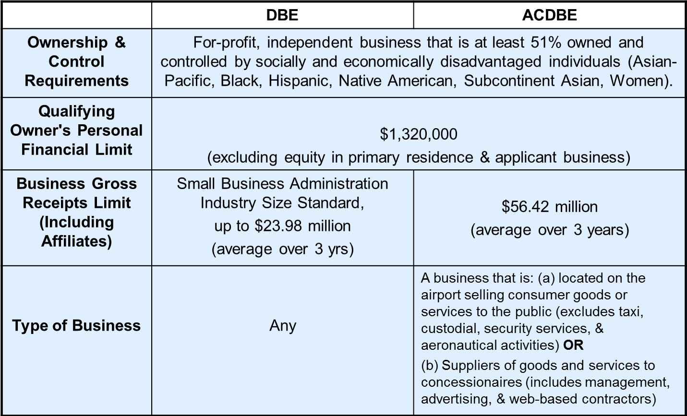
DBE/ACDBE Certification Requirements

Slide 48
DBE/ACDBE Certification Process
1. Preliminary Intake Review:
Submitted documents are checked for completeness
2. Desk Audit:
Supporting documents are reviewed and additional information may be requested
3. Site Visit:
Interview applicant at the business location; physical verification that business exists
4. Final Review for Approval/Denial
Start the certification process today!

Slide 49
Advantages of DBE/ACDBE Certification
  Certification provides additional opportunities in competing against non-certified subcontractors
  Marketing exposure through nationwide, statewide and citywide databases
  One Stop Shop - the City's DBE/ACDBE certifications are honored throughout CA (CUCP includes CalTrans, Metro, etc.)
  DBE/ACDBE certification is good until or unless removed for cause (e.g. change in ownership or control, exceeds size standards or net worth, failure to cooperate)

Slide 50
DVBE Certification Recognition
CERTIFYING AGENCY | CERTIFICATION | ACCEPTED BY LAWA AS DVBE?
U.S. Department of Veterans Affairs* | Service-Disabled Veteran-Owned Small Business (SDVOSB) | Yes
U.S. Small Business Administration* | Service-Disabled Veteran-Owned Small Business (SDVOSB) | Yes
State of California | Disabled Veteran Business Enterprise (DVBE) | Yes
*The SDVOSB must be headquartered in California
to qualify as a
DVBE
with LAWA.
** County of Los Angeles recognizes US Dept
of Veteran Affairs and US SBA DVBE certifications

Slide 51
LAWA’s Local Small Business Enterprise (LSBE) Certification Recognition
There is no separate LSBE certification process with the City of Los Angeles or with LAWA. In order to qualify as a LAWA LSBE, a firm must be certified as an SBE and LBE
What happens if I have LSBE certification from the County of Los Angeles?
  Your firm will be recognized as an SBE (Proprietary) by LAWA.
  However, you must submit a LBE Affidavit of Eligibility with the City of Los Angeles.
  If your firm meets the City of Los Angeles’ LBE criteria and consequently obtains LBE certification, your firm will then be recognized as an LBE and LSBE by LAWA.

Slide 52
Getting Certified
For more information:
http://bca.lacity.org
  Certification Helpline
  (213) 847-2684
  bca.certifications@lacity.org
Shaun Shimoda-Kobayashi, LAWA Certification Manager
(213) 847-2650
shaun.shimoda-kobayashi@lacity.org
Elaine Luong-Huynh, LAWA Certification Analyst
(213) 847-2667
elaine.luong@lacity.org
Directories of Certified Firms:
CUCP: https://sites.google.com/view/cucp/home -> Directory
City of LA: http://bca.lacity.org -> Certification Listings -> Click on DBE/MBE/WBE Directory

Slide 53
Contractor Development and Bonding Program
Rosa Osorio

Slide 54
Contractor Development And Bonding Program
CDABP Services
  Bond guarantees up to 40% to a maximum of $250,000 (whichever is less)
  Accounting cost subsidy up to $3,200 for financial statements
  Funds Administration payment of fees 1% of contract price
  Contractor Development: Development Plan and Marketing Profile, Self-Assessment
  Training - individual counseling and group workshops on bonding, financing and business management

Slide 55
LAWA
Contractor Development And Bonding Program
What Has Been the Success of these Programs?
City of Los Angeles
$162,557,255 in Bid Bonds
$37,721,894 in Bid Bonds for LAWA
$64,606,661 in Final Bonds
$19,521,894 in Final Bonds For LAWA
For more information, please contact:
Rosa Osorio, Account Manager
(424) 646-7312
rosa@imwis.com

Slide 56
Next Steps…
1. Register on Los Angeles Business Assistance Virtual Network –
LABAVN at www.labavn.org
2. Check the products and services that LAWA needs on www.lawa.org -> Business Opportunities -> What LAWA Buys
3. Contact LAWA Business and Job Resources Center
at (424) 646-7300 or go to www.lawa.org/bjrc
4. Request from Procurement Services Division (Purchasing Unit) the list of the contracts with upcoming expiration date at 424-646-7392
5. Contact the Procurement Services Division (Purchasing Unit), send a business card to the appropriate analyst with a note indicating your group(s) of products/services at 424-646-7392

Slide 57
Next Steps… (cont.)
6. If applicable, get certified (SLBE/LBE/SBE/DBE/ACDBE)
For information, contact Department of Public Works at (213) 847-2684
7. Attend the pre-bid/proposal meetings (refer to RFB/P)
8. If applying, contact the Contract Administrators regarding
questions on the scope of work (refer to RFB/P)
9. Contact Procurement Services Division (Contract Services Unit) regarding Administrative Requirements at (424) 646-5380 or go to www.lawa.org - > About LAWA - > Business Opportunities - > Administrative Requirements

Slide 58
Contact Information
LAWA Business, Jobs & Social Responsibility | (424) 646-7300 | (424) 646-9257 | http://www.lawa.org/bjrc
LAWA Procurement Services Division | (424) 646-5380 (424) 646-7392 | (424) 646-9262 | www.lawa.org
City of Los Angeles Bond Assistance Program (Rosa Osorio, Surety Specialist) | (213) 258-3000 | (213) 258-3099 | http://www.imwis.org rosorio@lawa.org
LAWA First Source Hiring Program | (424) 646-7304 |  | http://www.lawa.org/bjrc
LAWA Risk Management Insurance Compliance Section | (424) 646-5466 | (424) 646-5480 | www.lawa.org
Department of Public Works, Bureau of Contract Admin. | (213) 847-2684 | (213) 847-2777 | http://bca.lacity.org
LA Business Assistance Virtual Network |  |  | http://www.labavn.org

Slide 59
Q & A
Thank you!

