Slide 1
LAX Operations: An Overview
Edward Bushman
Director of Emergency Management

Slide 2
Objectives
Upon competing this training, the trainer will have knowledge of:
  LAWA organizational structure
  Roles and responsibilities of stakeholder agencies
  Location of resources identifying airport and terminal layouts
  LAWA communications platforms

Slide 3

City of Los Angeles
Los Angeles World Airports (LAWA) is the City of Los Angeles department that owns and operates Los Angeles International (LAX) and Van Nuys (VNY) general aviation airports.

Slide 4
Los Angeles International Airport (LAX)
About LAX
  5th busiest airport in the world
  2nd busiest airport in the United States
  84.9 Million Annual passengers in 2017
  2.2 million tons of cargo
  LAX handled 697,138 operations (landings and takeoffs) in 2016.
  3,500 Acres
  1,800 Airfield Acreage

Slide 5
LAX Generated
620,610 jobs in Southern California
Labor income of $37.3 billion
Economic output (business revenues) of more than $126.6 billion
$6.2 billion to local and state revenues and
$8.7 billion in federal tax revenues.
LAX’s ongoing capital-improvement program creates:
21,640 annual jobs
Labor income of $7.6 billion
Economic output of $20.3 billion
$966 million in state and local taxes
$1.6 billion in federal tax revenues.
Source: Economic study based on 2014 operations

Slide 6
LAWA Organization

Slide 8
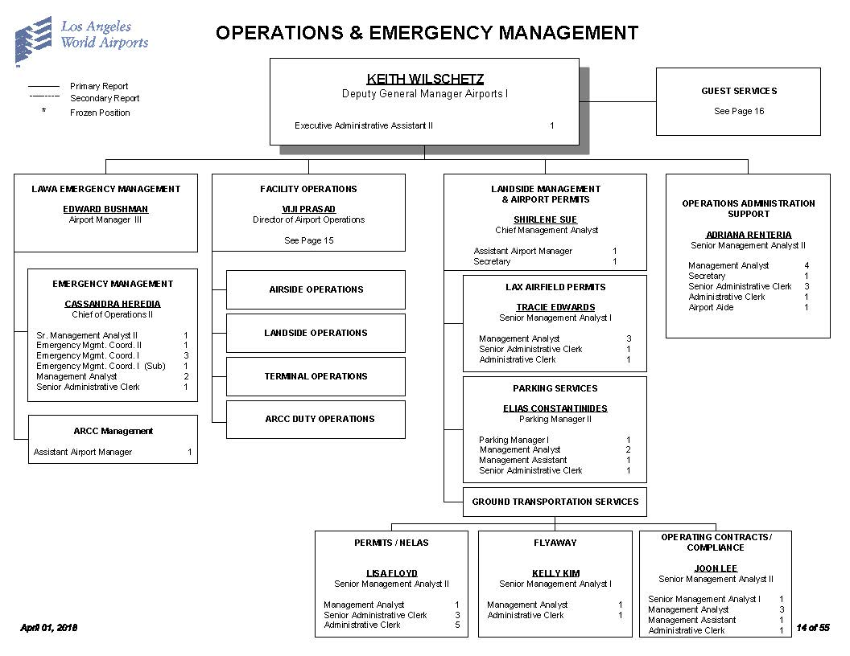
We are not

Slide 9
  Location of resources identifying airport and terminal layouts

Slide 10
Airport Layout

Slide 11
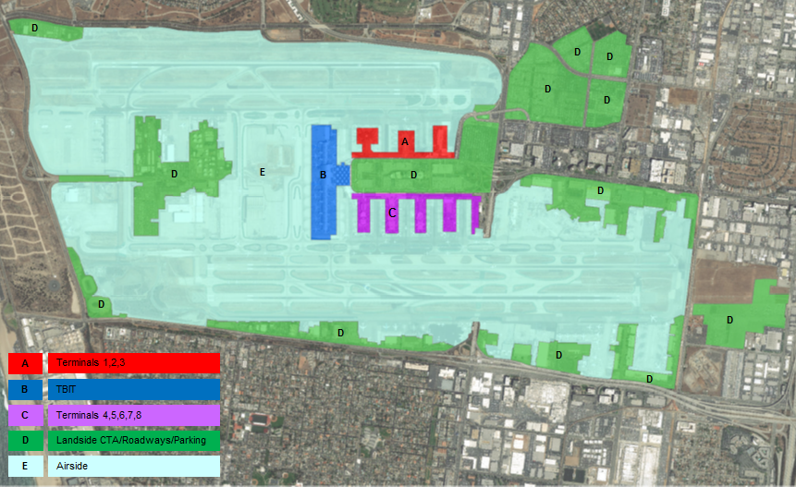

Slide 12
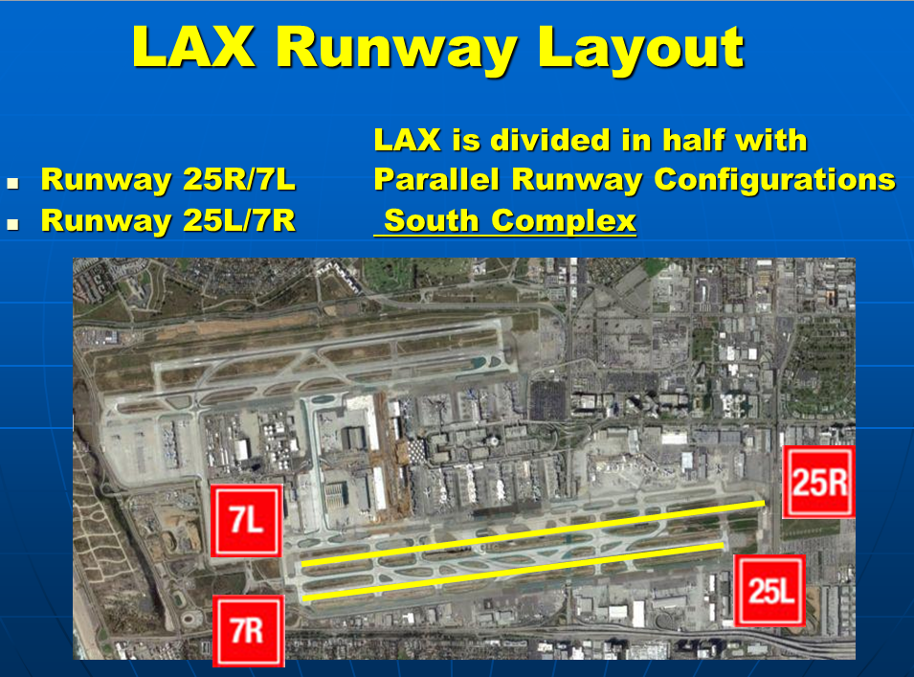
Odd numbers South

Slide 13
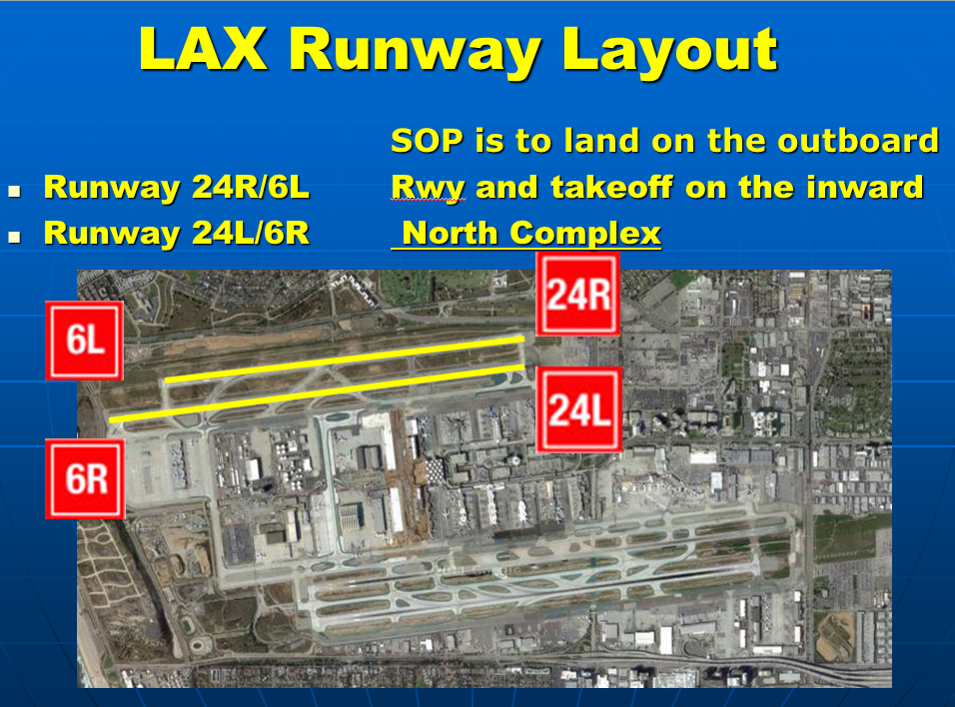
Even numbers North

Slide 14
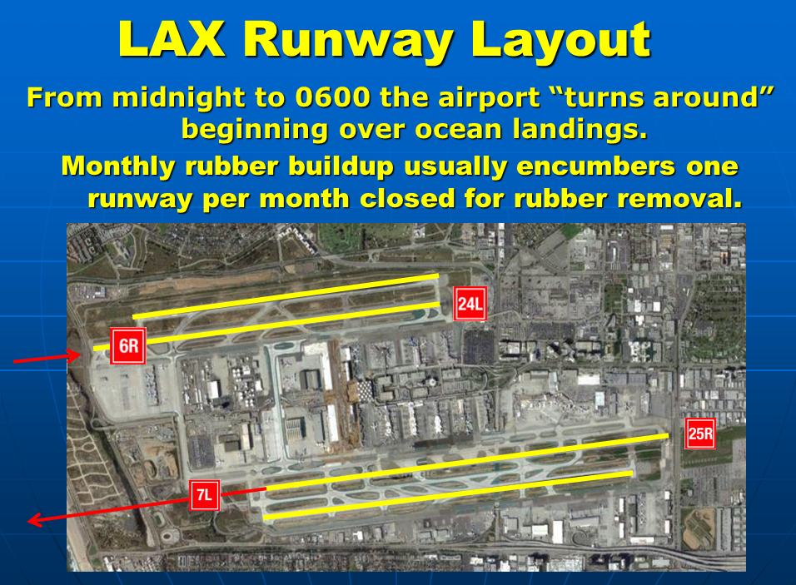

Slide 15
LAX Airfield Operations
Daily inspection and reporting of aircraft, vehicle, equipment, construction and infrastructure compliance, operations and maintenance of Airport Operations Areas.
CFR 139 inspection items includes:
  Airfield pavement, signage, markings, lighting,
  Wildlife management,
  Training in aircraft rescue and firefighting,
Staff also escorts aircraft, vehicles and equipment and responds to emergencies

Slide 17

Escort aircraft maintenance personnel when crossing runways

Slide 18
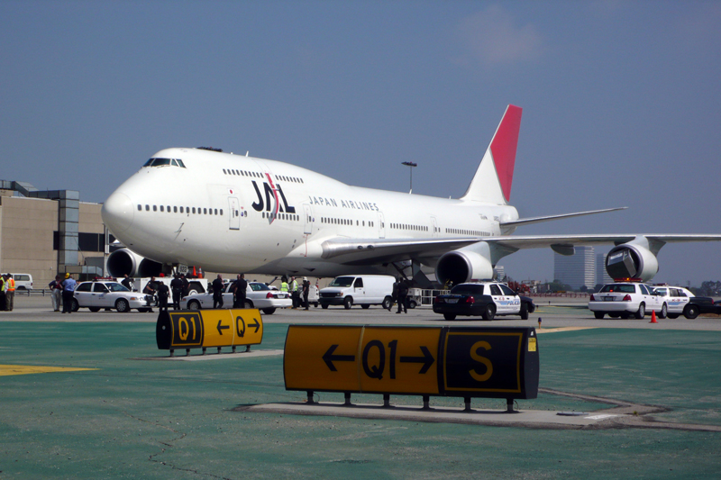
Coordinate minor aircraft incidents

Slide 19
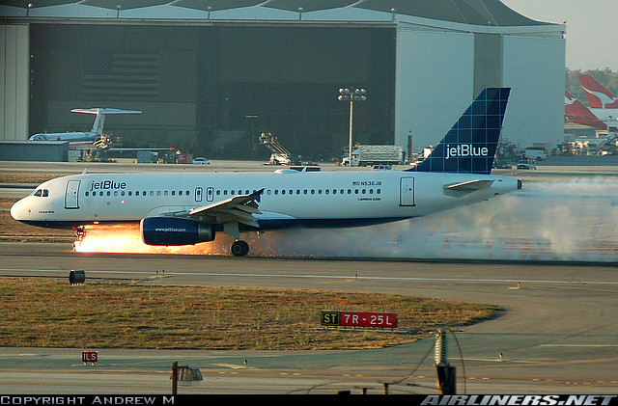
Coordinate response to potential accidents

Slide 20
LAX Airfield Bus Operations
Passenger Transport - LAX Airfield Bus Operations is responsible for busing crew and passengers between aircraft gates and terminals on the LAX airfield.
ADA Assistance – Transport of passengers with reduced mobility
  Scissor lift ADA Truck
  Lowered to the ground the passengers board an LAX Airfield Bus for transport to the terminal.

Slide 21

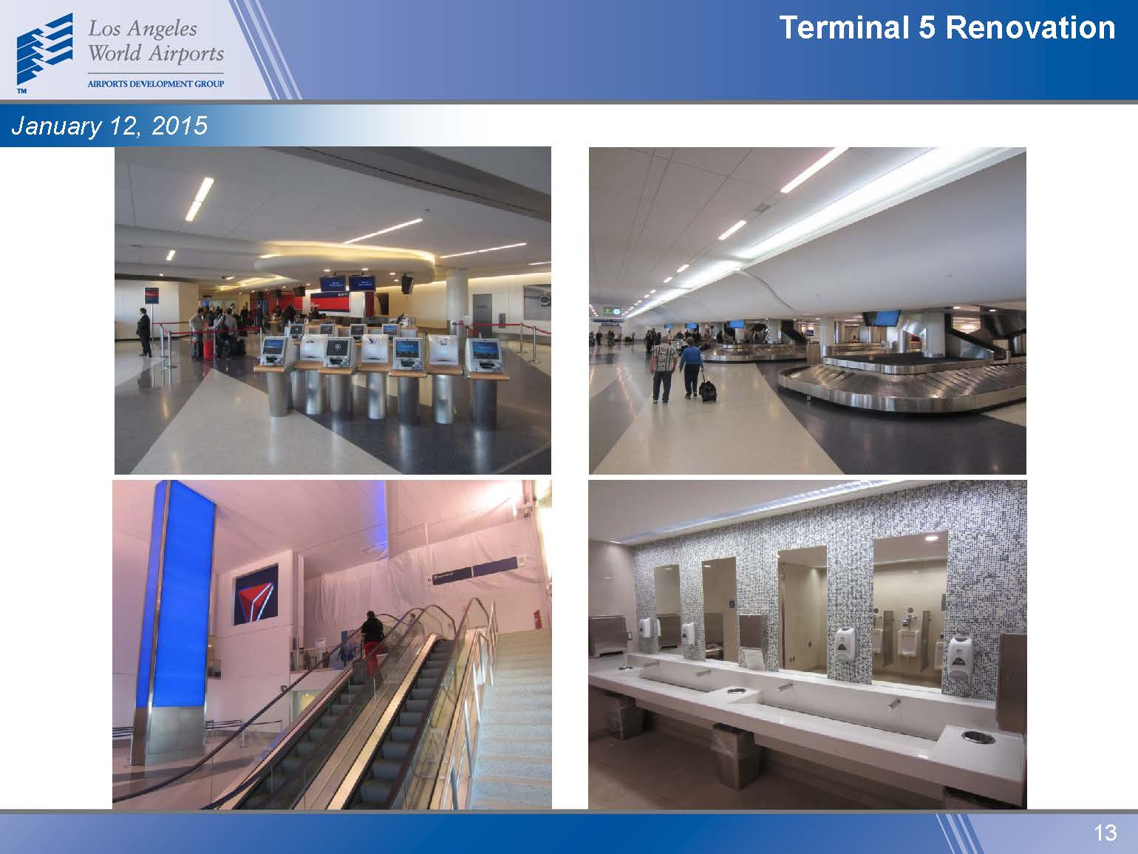
LAX Terminal Operations
LAX Terminal Operations has two core functions:
Terminal Support –
  tenant’s liaison to LAWA for all operational issues.
  construction activity in the terminal areas,
  shutdown requests
  development of work-arounds for their business operations.
Terminal Duty Operations –
  24/7
  inspect LAX terminals and facilities to ensure they are
  operational and clean.

Slide 22
LAX Landside Operations
Inspect Landside Infrastructure
  Roadways, parking structures, cargo facilities
  Sidewalk, vertical circulators, doorways
  Respond to emergency incident, part of the ICP, respond to incident calls
USR/ASR Review & Approval
  When, how, and where
  Coordinate with GCs and Shutdown Coordination Center (SCC) to ensure operational impact is kept to a minimum
Liaison
  Liaise with airlines, consortiums, tenants, GCs, APD, other LAWA divisions
  Consult with partner agencies: LADOT, DWP, BSS, Metro, etc.
Focus
  Ensure safe, efficient, and effective management of pedestrian and vehicular traffic flow into and out of the airport
  Enforce the LAX Ground Transportation Rules and Regulation
Roadway closure

Slide 23
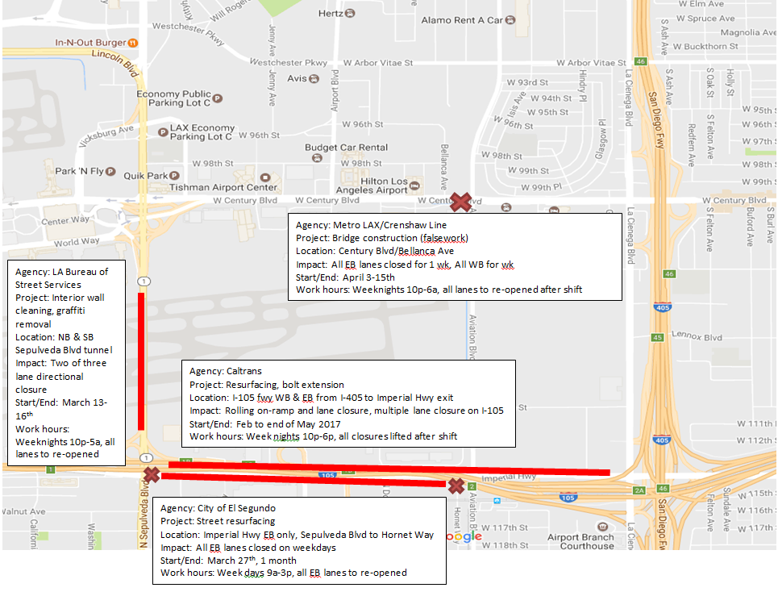
Roadway closures
Share info?

Slide 24


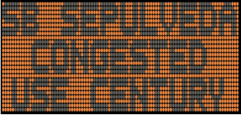
Traffic Management
--Changeable Message Signs (CMS)
dashboard

Slide 25
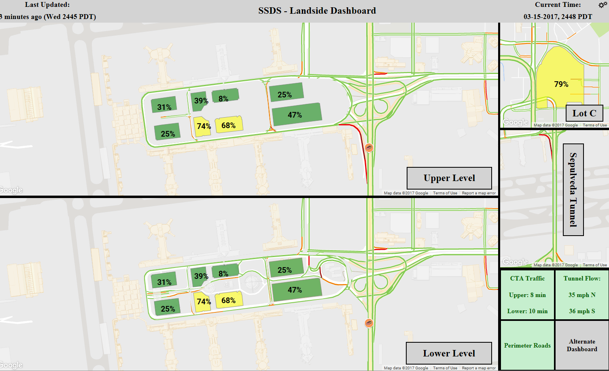
Information Technology: A Resource to Traffic Management
--Landside Operations “Dashboard”
Other stuff

Slide 26

LAX Guest Services
The Guest Services Division embodies the LAX brand statement:
“At LAX, we strive to make our guest visits efficient, hospitable and
memorable by providing modern, world-class facilities and services
that showcase the ambiance and excitement of Los Angeles
and the lifestyle and warmth of sunny Southern California.
It’s all about LAXceptional Xperiences!”
The LAX Guest Experience team accomplish this objective through four programs:
      Guest Experience Members
      Volunteer Information Professionals (VIP)
      Pets Unstressing Passengers (PUP)
      Airport Response Team (ART)

Slide 27
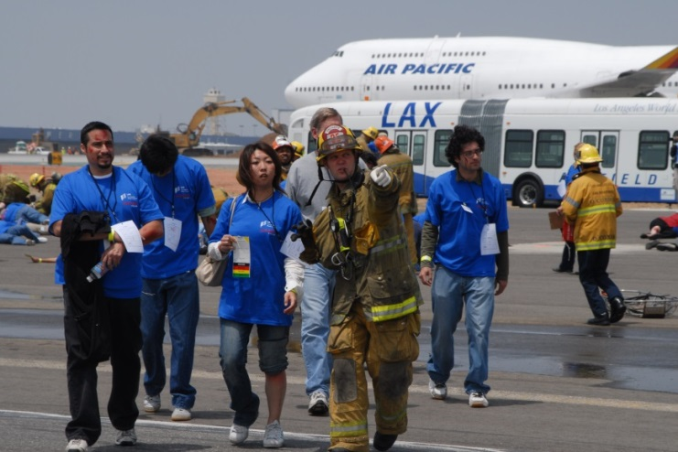
LAX Emergency Management
Emergency Management and the Department Operations Center.
  emergency response plan development,
  emergency preparedness,
  training, and facilitation.

Slide 28
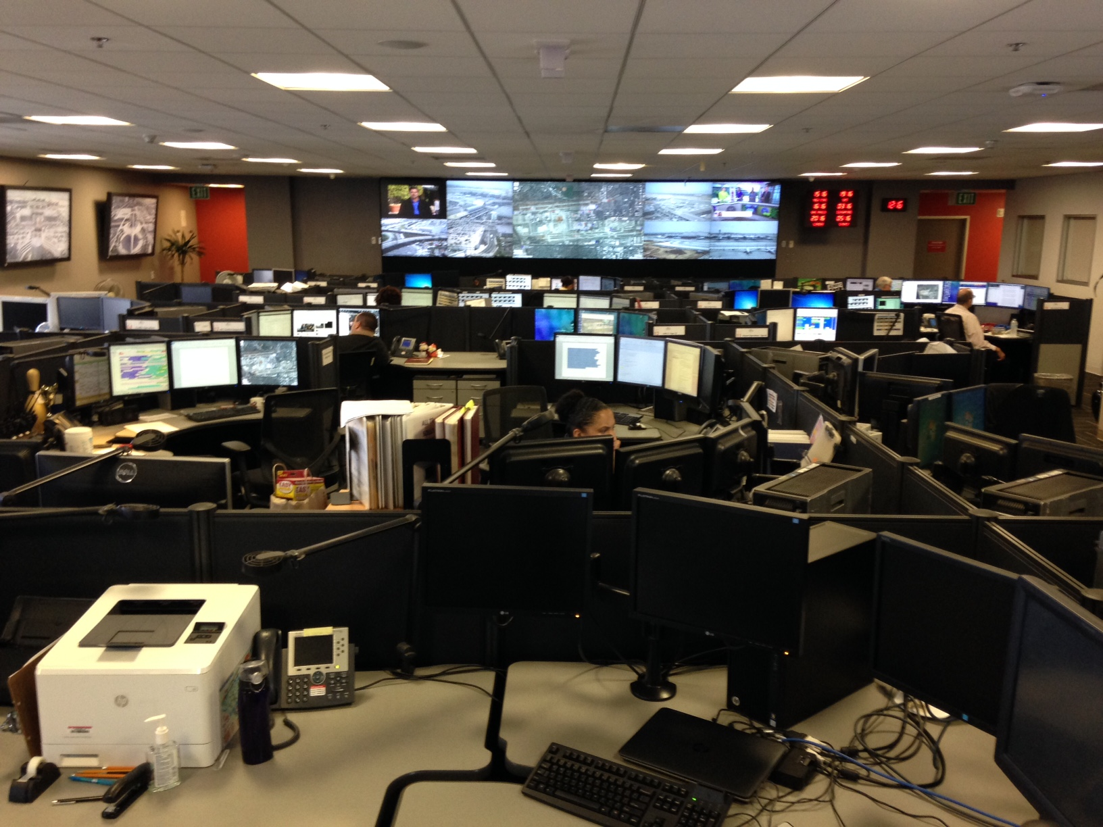
Airport Response Coordination Center
ARCC
Notes:
The ARCC consists of representatives from five primary entities: Airport Police, Airport Maintenance, TSA, Airport Operations, and IT.
The daily roles of Airport Police in the ARCC are for information and intelligence collection and dissemination; they monitor and research the CCTV system; and they send mass notification via our Emergency Notification System (Everbridge), twitter, and control the variable message signs on the roadways.
Airport Maintenance have a supervisor who works in the ARCC to assist with resource coordination, monitoring scheduled and un-scheduled construction activity, distributes information during incidents, and they assist with providing as the liaison between the ARCC and maintenance subject matter experts.
TSA representatives are also an information and intelligence group which are a link to the TSA Coordination Center and their passenger and baggage screening personnel at the terminals.
Airport Operations manages aircraft gates for 2 of the 9 terminals, the remote hard stand gates, and cargo spots on the south side of the airport. We our Airfield Bus Operations supervisor staffed in the ARCC. Airport Operations provides the airport maintenance dispatch function and data entry for maintenance service requests; our Airport Operations dispatch; and airport operations provides the duty manager to oversee the daily operations at the airport.
IT provides support to the ARCC systems and they provide a dashboard display in the ARCC which continually scrolls schedule maintenance and active IT related incidents.
Airport Police Dispatch is in a separate location, and requests for fire departments resources are requested through LA City Metro via airport police dispatch.

Slide 29
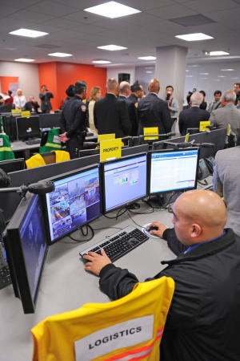
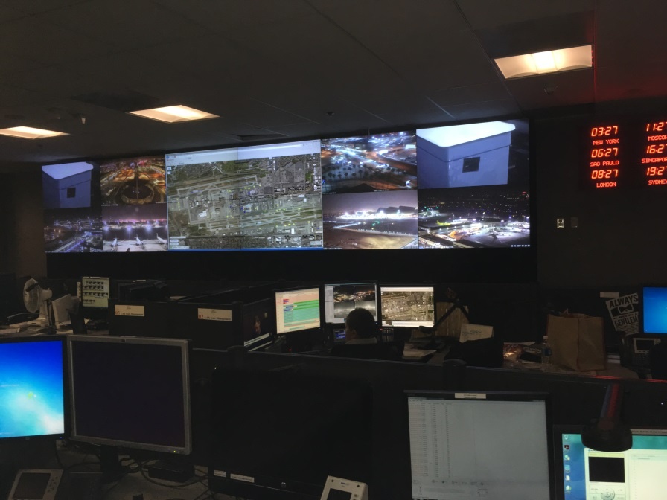
Airport Response Coordination Center (ARCC)
  Handles daily operational issues
  24/7
  (424) 646-5292 (LAWA)
  Focused on the continuity of operations
contacts

Slide 30
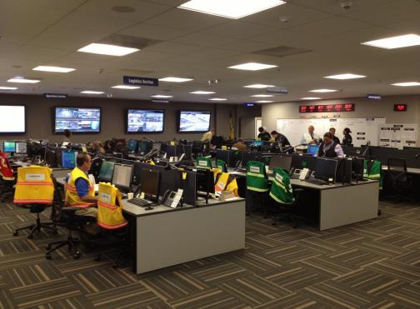
Department Operations Center (DOC)
DOC
  424-646-6911
DOC Activations
  Level 1 (Guarded)
  Level 2 (Elevated)
  Level 3 (Severe)
Responders
  LAWA employees
  Tenants and Stakeholders
  City, County, State, and
  Federal employees
  Technical experts

Slide 31
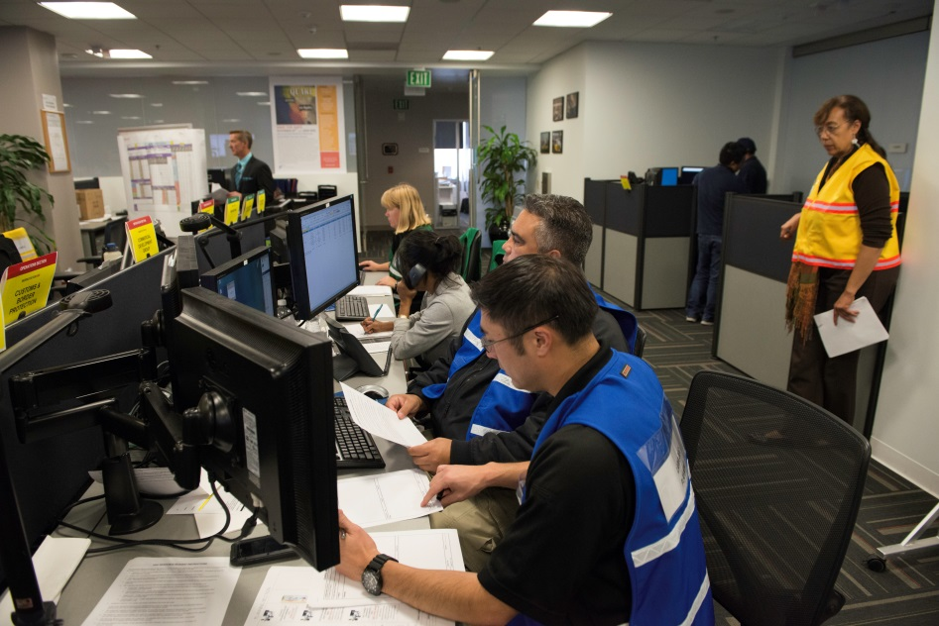
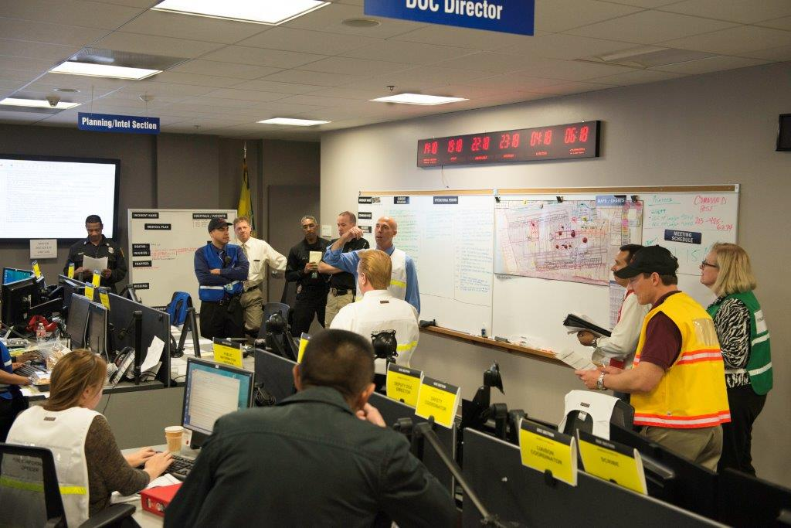
Department Operations Center (DOC)
  Activates for Large scale incidents
  Supports Incident Command Post
  Coordinates incident’s impact on airport operations
  Maintains situational awareness
  Provides communications to LAWA and all stakeholders

Slide 32
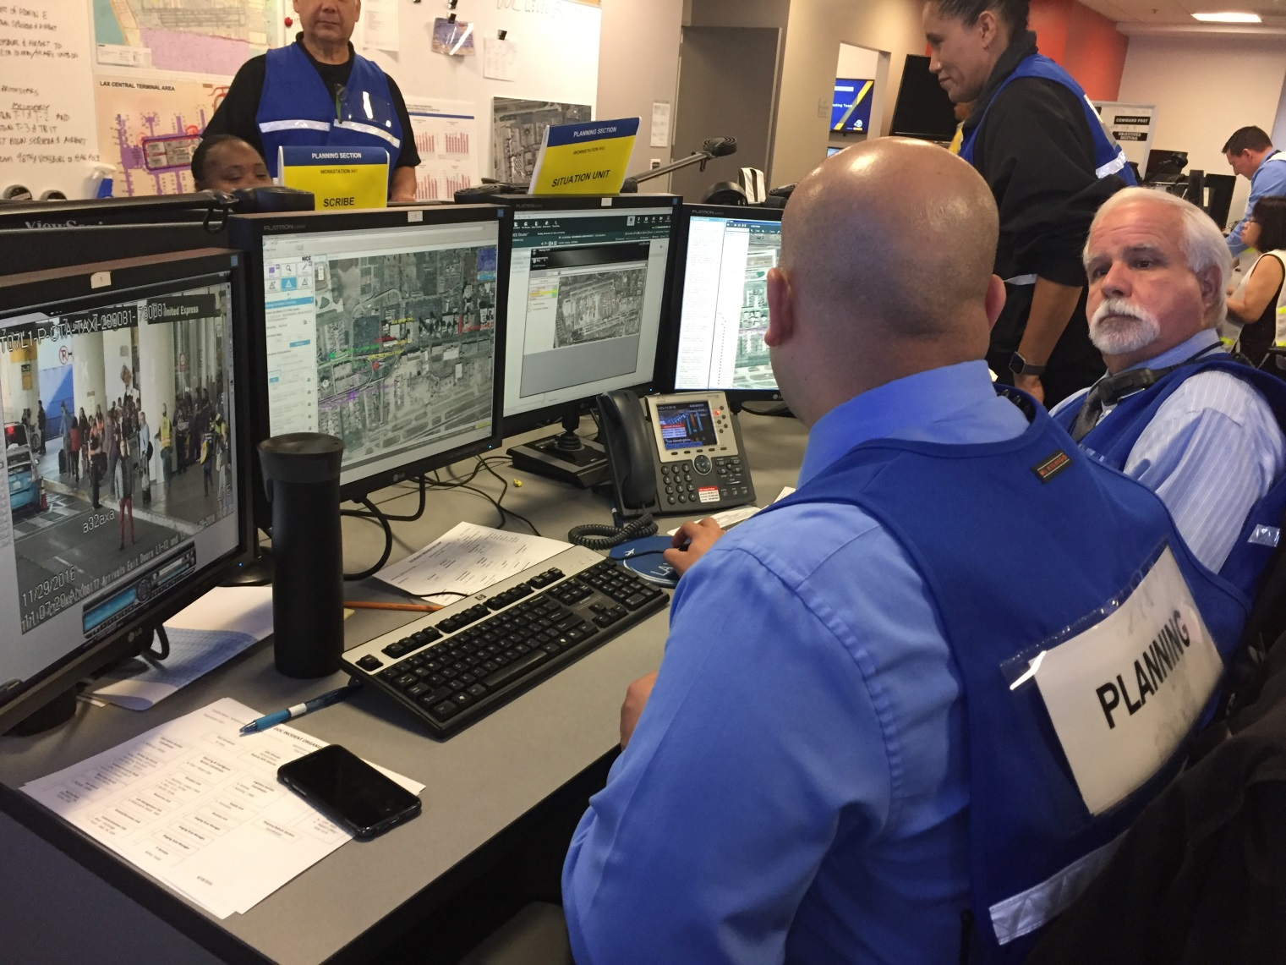
DOC Section Coordinators

Slide 33
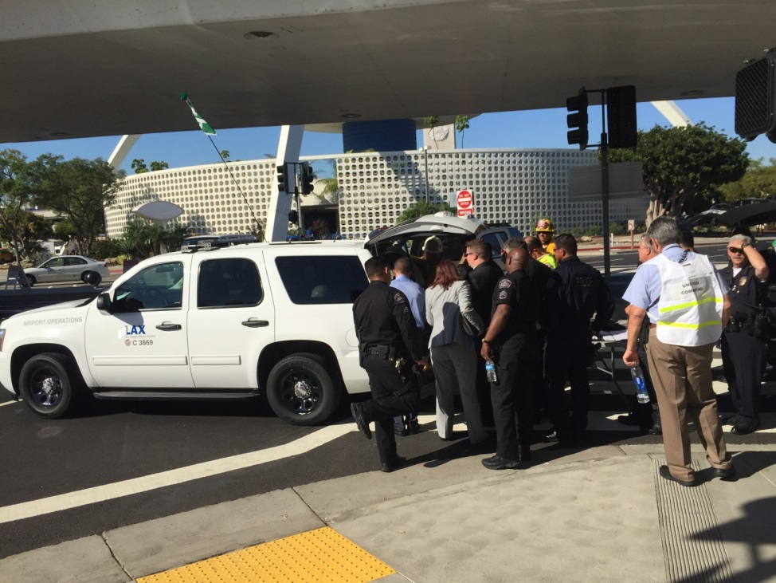
Incident Command Post
Assumption of command and naming of an incident immediately upon arrival of the first Unit.
Establishment and designation of an ICP and Staging Area.
Conduct a structured assessment of the situation “Size Up”
Establish incident objectives, strategies, and tactics based on ICS
Determine Resource Needs
Establish Initial Organization with Span of Control
Begin development of IAP using an ICS 201 form
Transmission of radio reports (Preliminary and Progress Update Reports every 15/30 min).

Slide 34

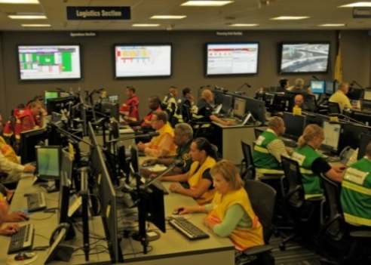
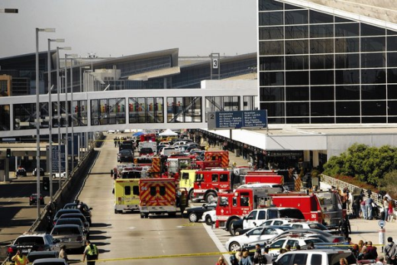
Information Flow - During a DOC Elevated Activation
COMMAND POST
Tactical Responders
Unified Command
Planning Section Chief
+ Sit Stat Unit
ARCC Unit
Support to CP/Unified Command
Operations
Section Chief
+ Sit Stat Unit
DOC
Support to CP/Area Command
DOC Director
Planning Section Chief
+ Sit Stat Unit
Legend
PRIMARY SUPPORT
MONITOR
PRE-DOC
ACTIVATION
UPDATES
MONITOR
DOC ACTIVATION
RESOURCE REQUESTS & INCIDENT UPDATES
Notes:
Information Flow
The Unified Command at the Incident Command Post requires information to aide them in making decisions about their objectives and plans for their tactical response. The ARCC and DOC may provide information to the ICP in the diagram as shown.
Methods to Gather Information Include:
Closed Circuit Television Cameras
Radio
Phone
Near-term – Computer Tablets for field staff
Sharing Information
It is imperative that the ARCC and DOC share information with members of the ICP and stakeholders as quickly as possible. This is performed through the use of the following software solutions
ARCC Notifications – Mass Notification System
Email
Tablets
Future eGIS
The flow of information is between the Incident Command Post and the ARCC at the onset of an incident.
Depending on the severity of the incident the DOC will be activated, such as in the Active Shooter. This type of incident warrants the automatic opening of the DOC because of the anticipated impact to passenger safety and flow, police activity, medical treatment, and impact to flight operations.

Slide 35
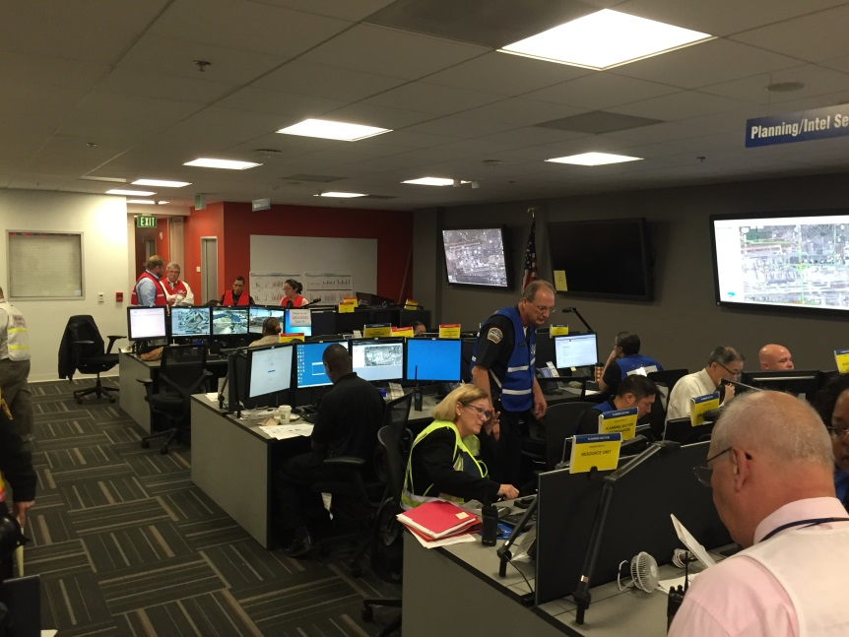
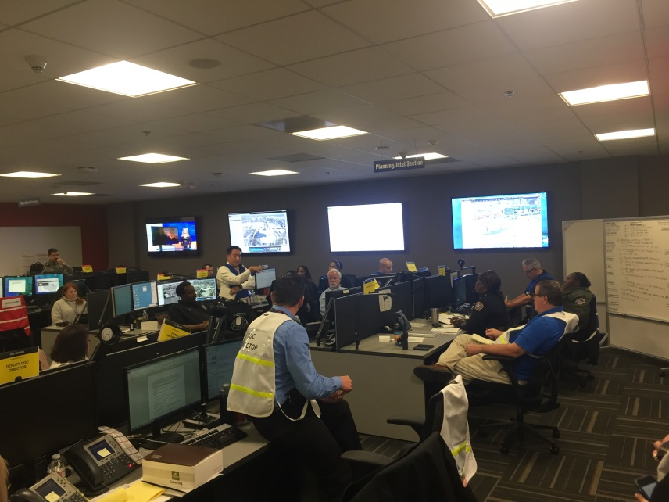
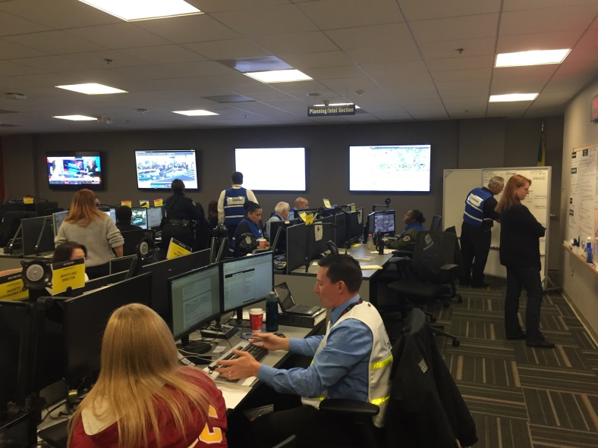
Conditions Actions and Needs (CAN)
Information and Intelligence - SA/COP

Slide 36
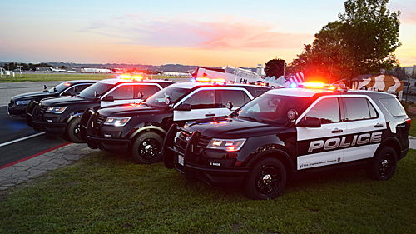
Airport Police Division
Los Angeles Airport Police employs over 1,100 law enforcement and civilian personnel.
For Emergencies Call -
310-646-7911

Slide 37



Collaboration
Incident Management Protocols
  ICS/SEMS/NIMS
Active Participants
  Collaborative Response by LAWA Airport Police, LAPD, LAFD, Airport Operations, and the LAWA DOC
Incident Objectives
  Life
  Property
  Incident Stabilization
  Ensure Safety/Security
  Focus on Recovery
  Continuity of Operations
Nov 1 – Incident Command Post
LAX Airport Response Coordination Center
LAWA Department Operations Center
Notes:
LAWA bases its incident management protocols on the National Incident Management System and the Incident Command System. This structure emphasizes common terminology and an incident command structure to effectively respond tactically to the incident and manage resources.
Major Participants included:
Law enforcement agencies, Los Angeles Police Department & LAWA Airport Police Department, the Los Angeles Fire Department, and LAX Airport Operations Staff.
First Responders
Each of the groups below had a unique jurisdictional responsibility at LAX and as a result worked together as a Unified Command with LAPD and LAWA APD serving as the spokespersons for the group.
LAPD/LAWA APD was responsible for apprehending the suspect and securing the airport to federal security standards. LAWA APD provided support and ensured the airport maintain federal security standards.
Los Angeles Fire Department was responsible for the medical response to injured individuals.
LAX Airport Operations provided support to the LAPD, LAWA APD, and LAFD by coordinating flight activity and passenger operations to ensure that no additional individuals entered the area as potential targets for the gunman. These members worked closely with the FAA Air Traffic Control Tower, airlines, and concession tenants throughout the incident.
ARCC/DOC
The Airport Response Coordination Center (ARCC) was notified of the Active Shooter as soon as Airport Police Dispatch was notified via radio. This allowed the ARCC Duty Manager to activate the Department Operations Center (DOC) within five (5) minutes of the start of the incident.
The DOC was activated at a Level 3, the highest level, to provide support to the Incident Command Post with resources upon request. Additionally, the DOC was responsible for communicating with LAWA Executive Staff, City Managers, and airport stakeholders on the status of the incident.
Objectives
These objectives are reoccurring for most incidents at LAX and were used for the Active Shooter Event of November 1st. These objectives are what drives the need to obtain, analyze, and share information with our incident responders as quickly as possible. This incident demonstrated the critical role that technology has in connecting people together and allowing them to share information.
It is our mission to preserve life for all at our airports, protect people and property, secure the airport and restore normal operations as quickly as possible. Less than 36 hours after the active shooter incident in Terminal 3 began, LAX Airport Operations and Tenants restored operations.

Slide 38
  Roles and responsibilities of stakeholder agencies
Los Angeles Fire Department (LAFD)
Los Angeles Police Department (LAPD)
Transportation Security Administration (TSA)
Customs and Border Protection (CBP)
Federal Aviation Administration (FAA)

Slide 39

Preserves life and property as an all risk life safety response provider.
Fire and EMS on LAX
Aircraft Rescue firefighting (ARFF)
Fire Prevention

Slide 40

Law enforcement outside of LAWA
Responds to support Airport Police Division
Supports LAX with K-9 and Bomb Squad

Slide 41

Protect the nation's transportation systems to ensure freedom of movement for people and commerce.
  Part 1542

Slide 42

U.S. Customs and Border Protection
  Federal Inspection Areas (FIS)

Slide 43

Air Traffic Control (ATC)
Part 139

Slide 44
FAR 139 Responsibilities
FAR 139 Subpart D mandates that certificate holder airports perform inspections of airfield facilities, including movement areas to ensure compliance with FAR 139 Standards. These inspections are mandated to be daily, or after incident, or during inclement weather. LAX performs these primary inspections once each of three shifts.
Primary inspections cover four main areas of concentration.
Pavement inspections of aircraft movement areas – cracks, potholes, spalling.
Markings/Signs visual inspection of pavement markings, missing signs, obstructed signs.
Lighting proper operation, good condition, obstruction free
FOD Foreign Object Debris – removal from aircraft movement areas and adjacent zones.
ATC frequencies North and South Ground are monitored for FAA directed tasks including FOD removal, escorts, cross bleed, Alert response, non pilot runway crossings, movement area construction mitigation.
An airfield tour of duty inspection requires rolling over all aircraft movement areas inspecting for safe FAA compliant conditions. A completed field tour and runway inspection is reported to the duty log. All FAA reported responses as well as escorts are also reported in the log.

Slide 45
LAWA Communication Platforms
Everbridge
LAXEmergency
  https://www.lawa.org/LAWAalerts/

Slide 46
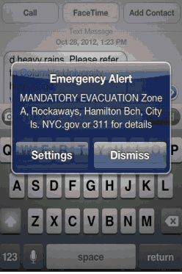


Communications
Incident Description: Loaded Gun at Checkpoint 1
Impact to Operations and Facilities:Low
Impact to Security, Life, Safety:Low
Incident Magnitude:Low
Date & Time of Occurrence: 020514 at 0907hrs
Narrative: Upon routine vehicle search at Checkpoint 1 Century/ Vicksburg. A loaded gun (38 caliber) was found in the back seat of the truck with two minors as passengers.
Current Status: Suspect is in custody
Incident Location: Century/Vicksburg
Command Post Location: Century/Vicksburg
Incident #11-051897
ARCC Notifications
Notify thousands of stakeholders simultaneously
Provide public messages about measures for individual safety or operational information
Status of Incident
Message is developed in parallel with Public Relations
  Via www.lawa.org and
Wireless Emergency Alerts (WEA)
Issued by authorized by government administrator.
Cell Phone Alert within a designated radius
For users not subscribed to ARCC Notifications.
Message content provides advisory of airport status
Emergency use only
Notes:
LAWA uses technology to communicate to stakeholders. This includes LAWA Executive Management, City of Los Angeles Officials, airline tenants, concessionaires, government stakeholders, and LAWA operations, law enforcement, and facilities management staff. The primary method of communications is through a mass notification software solution that allows hundreds of users to be contacted simultaneously through email, phone, text, or TYY. This type of message has proven been beneficial to recipients during incidents of various magnitudes because the contents of the message reflects current information on the status of the incident.
LAWA has recently developed procedures to use WEA notifications to reach out to individuals beyond our mass notification system by cell phone. This system allows authorized government alerting administrators to send geographically targeted notifications through a mobile carrier to mobile devices (referenced from Everbridge site, the provider of LAWA’s notification system) without the use of applications or software. This will allow LAWA to reach potential airport users as they may be inbound to the airport and unaware of a major emergency situation in progress at the airport.

Slide 47
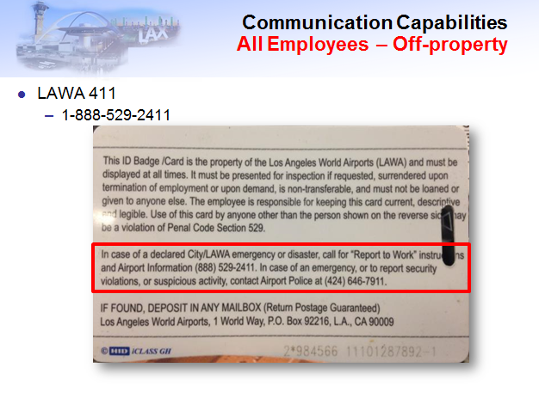
AT&T System for Automated Messaging
– Print on the Back of 60,000 Badge Holders

Slide 48
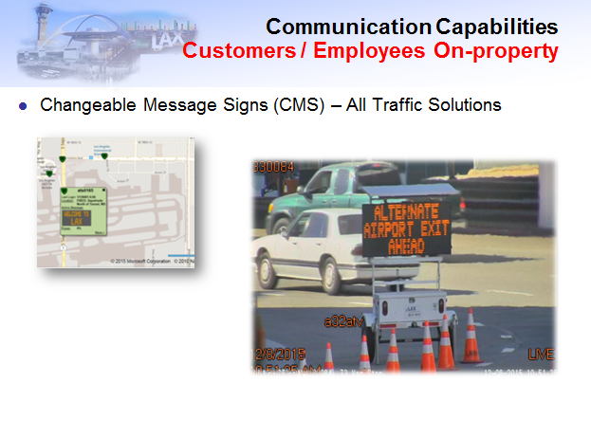
Changeable Message Signs

Slide 49
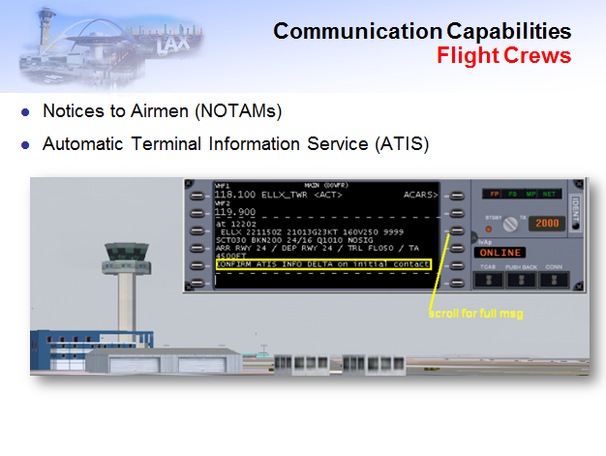
Flight Crew Communication Messaging

Slide 50
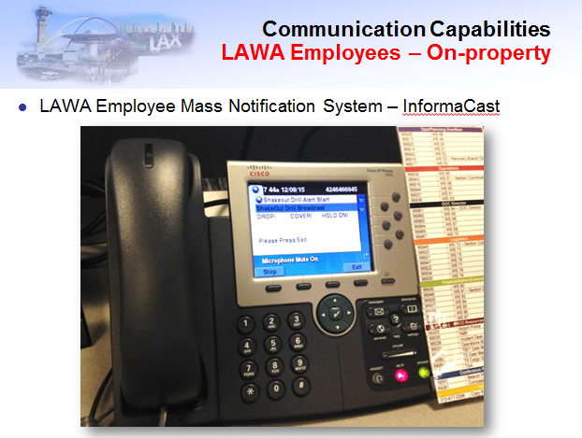
Desktop Phone Notifications (Audio & Visual)

Slide 51
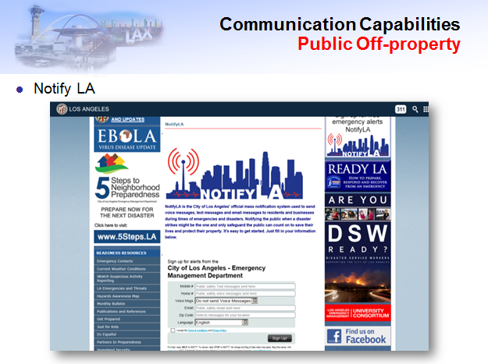
Notify LA – City EMD Program for Reverse 911 to Landline and Cell Phones (Nixel 360)

Slide 52
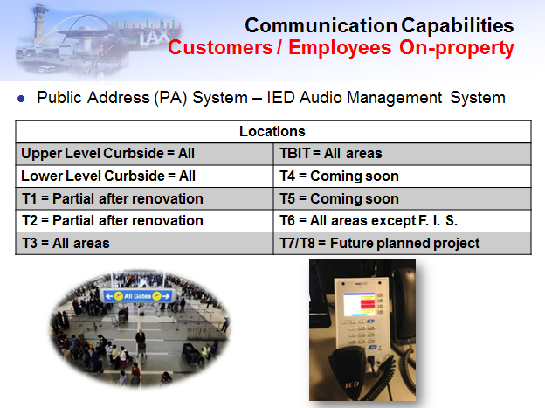
Public Address System – All Terminals and Central Terminal Area

Slide 53
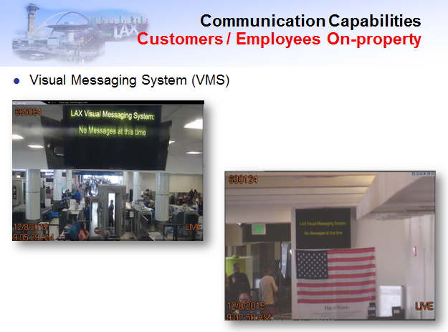
Visual Message System

Slide 54
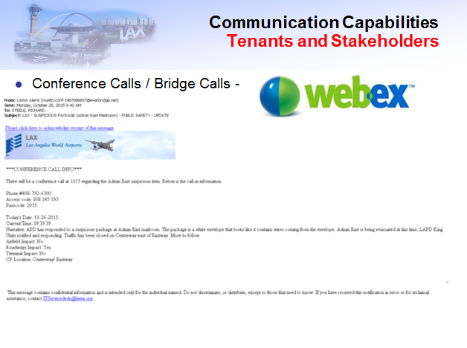
WebEx – Conference Call Capability

Slide 55
LAWA Tenant Suite
https://lawa-tenant-suite.bssnet.com/

Slide 56
What we are looking for in Application
Training Instructor(s) Resume(s)
Training Calendar
Company Point of Contact for Training
Emergency Preparedness at Home Module
General Airport Overview
Developing Observation and Reporting Skills
Orientation on Roles and Responsibilities During an Incident
Basic ICS/NIMS/SEMS

Slide 57
What we are looking for in Application
9. Hazard specific training on:
a. Earthquake
b. Active Shooter
c. Hazardous Materials
d. Aircraft Accident
e. Power Failure
f. Suspicious Article
g. Fire
h. Bomb Threat
i. Severe Weather
j. Contagious Disease

Slide 58
What we are looking for in Application
Terminal Evacuation and Repopulation Procedures
Assisting Persons with Disabilities
Available Emergency Communication Platforms at LAWA*
Procedures to Account for Staff in an Emergency
Certification in CPR, AED, Basic First Aid or Hands Only CPR
Orientation on Company Emergency Plan or COOP
*see sample

Slide 59
Example
Airport Superintendent of Operations (ASO)/Incident Commander (IC) Training
Anticipated Length | 12 hours (over 2 days)
Target Audience | ASO3s, ASO2s, ASO1s
Target Class Size | 6, 8, or 12
Description | The goal of this course is to equip participants with the knowledge, skills, and abilities to establish a command presence within LAWA’s Unified Command structure and function as an Incident Commander responding to and recovering from emergency incidents.
Course Goal | Demonstrate the ability to function as an effective Incident Commander in LAWA’s Unified Command structure.
Terminal Objectives | Module 1 - Describe how the dynamics of LAWA’s Unified Command structure affects how ASOs should approach their IC responsibilities. Module 2 - Demonstrate the ability to develop incident objectives and delegate assignments in support of those objectives. Module 3 – Describe how to demonstrate key leadership competencies critical to performing successfully as an Incident Commander. Module 4 – Describe strategies for establishing command presence as an Incident Commander. Module 5 - Demonstrate the ability to function as an effective Incident Commander in LAWA’s Unified Command structure.
Logistics | Ensure ASOs come to class wearing AO vests Ensure there are enough IC vests on hand in the classroom. Confirm APD and LAFD participation in Day 2.

Slide 60
Questions
Edward Bushman
Director of Emergency Management
Ebushman@lawa.org

