Slide 1

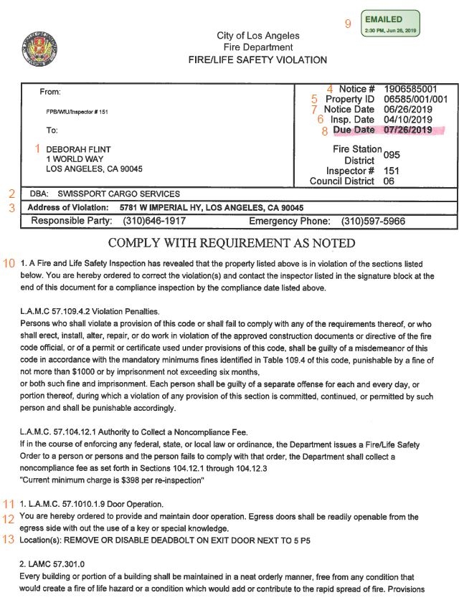
Did you receive an NOV?
NOV Sample
Recipient (LAWA CEO)
Company Name
Address of Violation
Notice #
Property ID (LA County Assessor’s)
Inspection Date
Notice Date
Due Date (30 Days from Notice Date)
“Emailed To LAWA” Date
Standard Notice Language
Violation Number and Applicable Code Section
Applicable Code Section Language – “Forthwith”
Location of Violation and Instructions to Comply
Note: Photos may be attached at end of NOV
Notes:
LAWA’s responsibility: Any buildings/structures on LAWA land are LAWA’s resp.
LAWA leases/agreements: Tenant must comply with all Fed/State/Local laws/ordinances/regulations, which includes the Code.
CDG: Ensures tenant compliance: CDG ensures tenants comply with leases/agreements, therefore we are for ensuring tenants comply with Code.

