Slide 1
RESPONSIVENESS Resolve NOV violations within 30 days
LAFD Inspector issues a Notice of Violation (NOV) for any Fire Code violations identified during annual site walk.
NOV will also include any outstanding Reg. 4 violations.
NOV provides 30 calendar days to address violations.
“FORTHWITH” requires immediate remediation
LAFD may require Tenant provide 24/7 immediate Fire Watch for any critical Reg. 4 violation in order to ensure safety of people and structure until Reg. 4 violation is properly addressed.
Notes:
LAWA’s responsibility: Any buildings/structures on LAWA land are LAWA’s resp.
LAWA leases/agreements: Tenant must comply with all Fed/State/Local laws/ordinances/regulations, which includes the Code.
CDG: Ensures tenant compliance: CDG ensures tenants comply with leases/agreements, therefore we are for ensuring tenants comply with Code.

Slide 2
RESPONSIVENESS
NOV Timeline – 30 days
Every TUE. – by close of business
Tenant emails update for each violation on NOV (action plan, ECD) →
to BRM
LAWA/BRM forwards to Tenant – requests ack (1 bus. day)
Tenant emails ack to BRM
Wk 3: Tenant 1) updates violations and 2) highlights if any violations will extend past Due Date
If so: Provide documentation
(PO, etc.) to BRM to demonstrate due diligence.
Remaining violations:
Tenant sends last-minute updates to BRM
Wk 1:
Tenant provides to BRM for
each violation:
1) Action plan (proposed solution)
2) Estim. completion date
LAFD sends Notice (NOV) to LAWA
CLOCK STARTS
Day 1
Day 2-4
Week 1
TUE
Week 2
TUE
Week 3
TUE
Due Date minus 2 bus. days
DUE DATE
Day 30

Slide 3
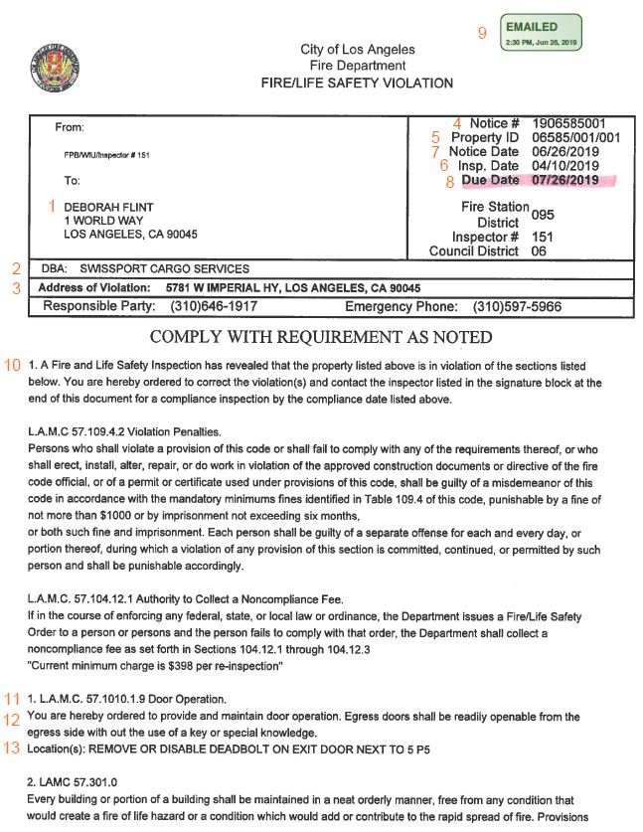
RESPONSIVENESS NOV Contents – Sample
Recipient (LAWA CEO)
Company Name
Address of Violation
Notice #
Property ID (LA County Assessor’s)
Inspection Date
Notice Date
Due Date (30 Days from Notice Date)
“Emailed To LAWA” Date
Standard Notice Language
Violation Number and Applicable Code Section
Applicable Code Section Language – “Forthwith”
Location of Violation and Instructions to Comply
Note: Photos may be attached at end of NOV
Notes:
LAWA’s responsibility: Any buildings/structures on LAWA land are LAWA’s resp.
LAWA leases/agreements: Tenant must comply with all Fed/State/Local laws/ordinances/regulations, which includes the Code.
CDG: Ensures tenant compliance: CDG ensures tenants comply with leases/agreements, therefore we are for ensuring tenants comply with Code.

