Slide 1
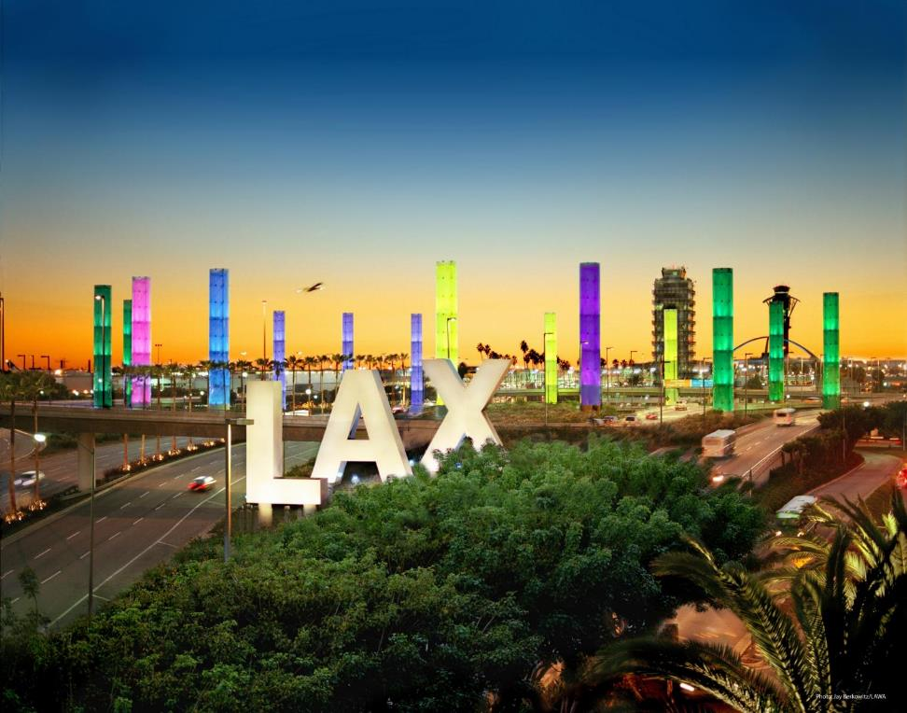

DOING BUSINESS with
Los Angeles World Airports
Rev. 10 / 2020

Slide 2
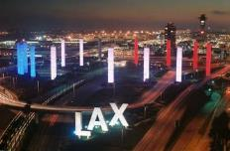
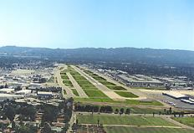
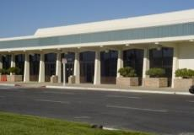
Los Angeles World Airports
 | LAX ranked 4th in the world for passenger service In 2019, airlines served 88,068,013 passengers
 | Van Nuys Airport – one of the world’s busiest General Aviation airports with almost 220,228 take-offs annually Dedicated to non-commercial air travel
 | LA/Palmdale - LAWA owns and maintains the Palmdale Land Holdings, previously an FAA-certified airport

Slide 3
Workshop Overview
    Business Opportunities
    Competitive Processes
    Concessions
    Registering on LABAVN
    Business Assistance Programs
    Certification
    Administrative Requirements
    Next Steps

Slide 4

Business Opportunities
LAWA procures over $500
million annually in Request
for Bids (RFBs):
    Goods and Equipment
    Materials and Supplies
    Non-professional services
LAWA has administered over $14 Billion in Request for Proposals (RFPs):
    Construction Projects (Planning & Development Group)
    Professional Services including On-Call contracts

Slide 5
Request For Proposals (RFP)
A Request for Proposal is used for the competitive procurement of :
  Capital Projects (Terminals, Runways, Railroads, etc.)
  Professional Services (Engineering, Architectural, &/or Environmental Services, etc.
The award is based on the winning score according to the selection criteria which may include:
    Concept
    Experience
    Cost
    Etc.
RFP’s can be for individual items, services, or contracts.

Slide 6
Important RFP Information to Note
DUE DATE (COVID-19 info)
  There are no exceptions to the stated Due Date and Time
  RFP must be delivered and time-stamped at:
        7301 World Way West, 4th Floor
        Los Angeles, CA 90045
  RFP delivery location varies.
QUESTIONS & CLARIFICATIONS
  Must contact the designated LAWA Project Manager for RFPs.
AUTHORIZATION
  RFP must be signed by someone authorized to encumber the bidding/proposing company.
PRE-PROPOSAL MEETINGS
  Non-mandatory.

Slide 7
Additional RFP Requirements
COMPLETION OF DOCUMENTS
  Any Worksheets and Administrative Requirements must be filled out as directed and returned complete, in the order received. Failure to do so may invalidate RFP.
BE CAREFUL
  Be sure to read and complete the RFP documents accurately. Failure to do so may invalidate your RFP.

Slide 8
Construction Forecast Report (Planning & Development Group)
See Contracts and Procurements Document
For questions, contact PDGprocurement@lawa.org

Slide 9
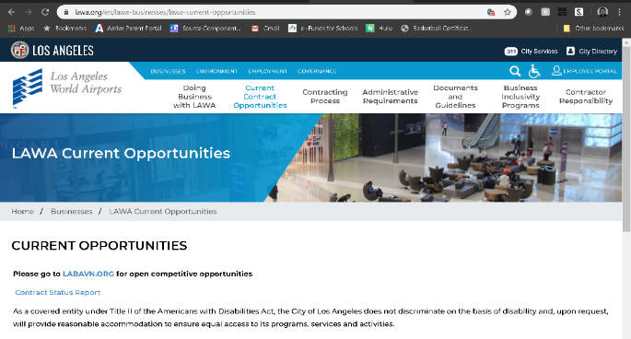
Contract Status Report (updated monthly)
https://www.lawa.org/en/lawa-businesses/lawa-current-opportunities
Questions?

Slide 10
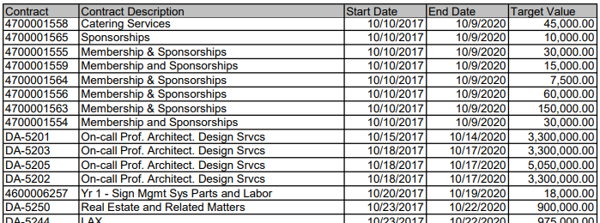
Current Contract Status Report:

Slide 11
Request For Bids (RFB)
A Request for Bid is used for the competitive purchase of:
  Goods
  Equipment
  Non-professional services
The contract award is made to the lowest priced bid that is deemed to be:
  Responsive – accurate completion of the bid
  Responsible – determined to be capable of meeting the specifications
Bids can be for individual items, services, or contracts from 1 to 5 years in duration.

Slide 12
Important RFB Information to Note
DUE DATE (COVID-19 Info)
  There are no exceptions to the stated Due Date and Time
  RFB bid submittal must be uploaded through Box
  Upload instructions are located on LABAVN RFB page
QUESTIONS & CLARIFICATIONS
  Must contact the designated LAWA Procurement Analyst via email for RFBs.
AUTHORIZATION
  RFB must be signed by someone authorized to encumber the bidding/proposing company.
PRE-BID MEETINGS
  Mandatory vs. Non-mandatory

Slide 13
Additional RFB Requirements
COMPLETION OF DOCUMENTS
  Bid, Worksheets and Administrative Requirements must be filled out as directed and returned complete, in the order received. Failure to do so may invalidate RFB.
PAYMENT TERMS
  Discount terms of 25 days or more can impact your RFB evaluation.
DEVIATION FROM SPECIFICATIONS
  When allowed, bidders desiring to quote on any other comparable make/brand must indicate make/brand and model name/number.
BE CAREFUL
  Be sure to read and complete the bid documents accurately. Failure to do so may invalidate your RFB.

Slide 14
Soliciting Bids and Proposals
All City of Los Angeles RFB/RFPs are available on:
  The Los Angeles Business Assistance Virtual Network web site: www.labavn.org.
  Questions?

Slide 15
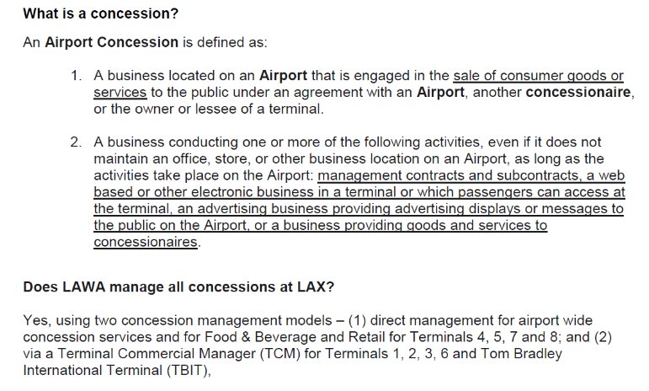
LAWA Concessions Overview

Slide 16
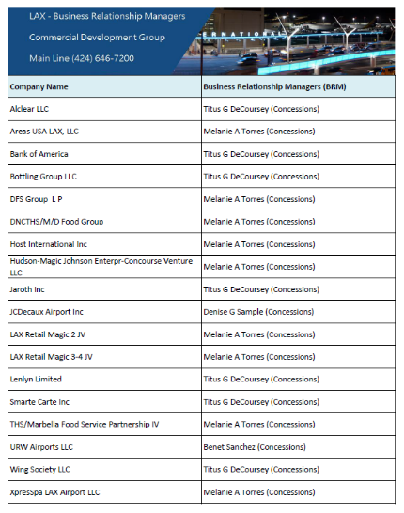
LAWA’s Current Concession Operators

Slide 17
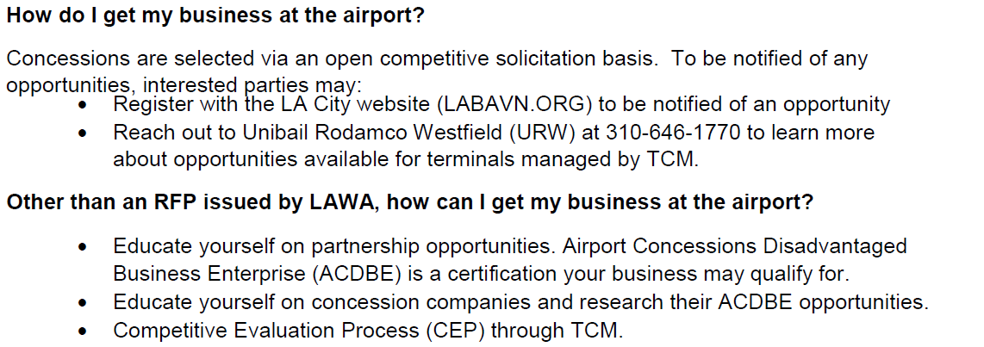
LAWA Concession Opportunities

Slide 18
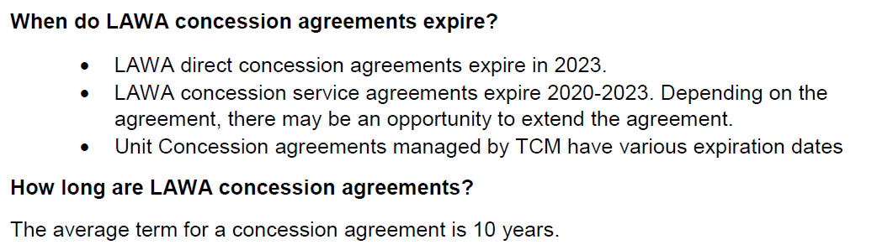
LAWA Concession Timelines

Slide 19
Concessions Contact
Concessions Questions:
Isela Toledo: Commercial Development Group
          ITOLEDO@LAWA.ORG
          424-646-5148

Slide 20
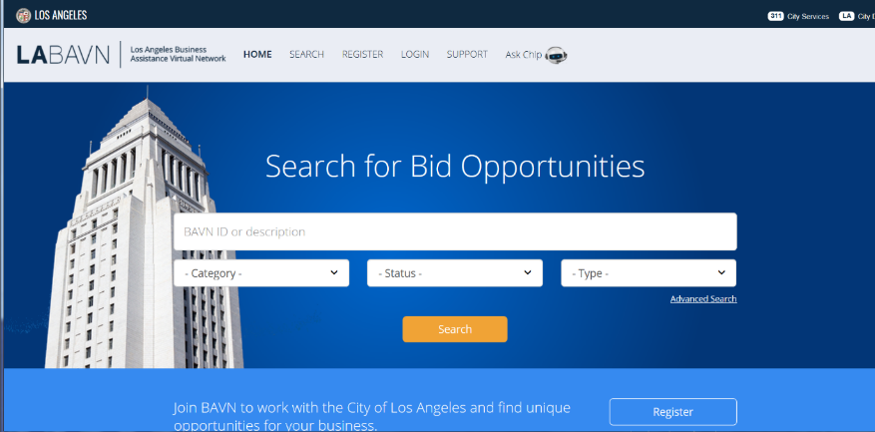
Registering w/LABAVN…

Slide 21
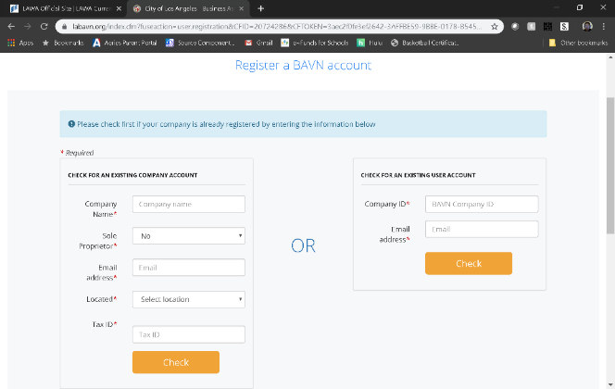
Registering on LABAVN

Slide 22
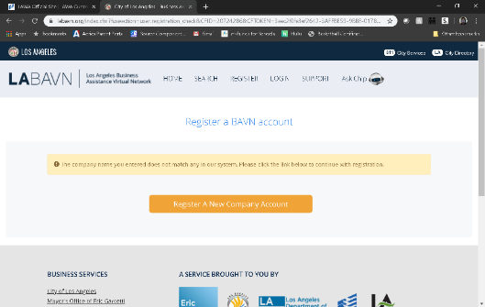
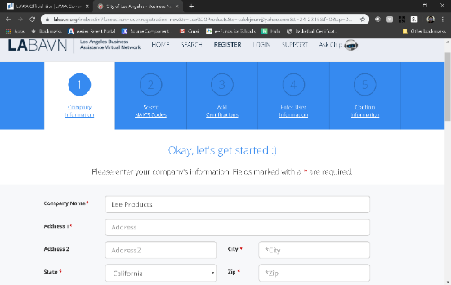

Slide 23
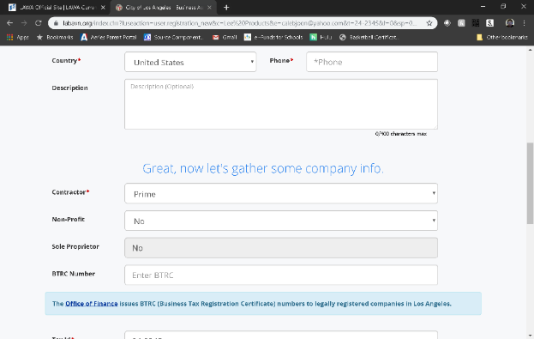
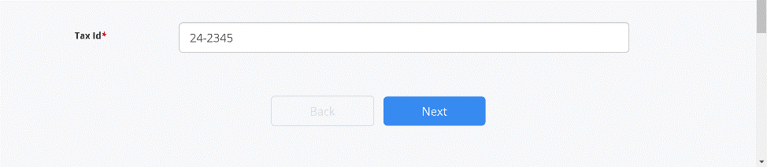

Slide 24
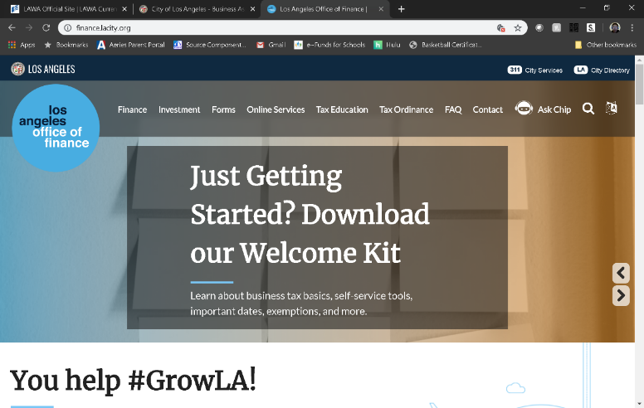
https://finance.lacity.org/

Slide 25
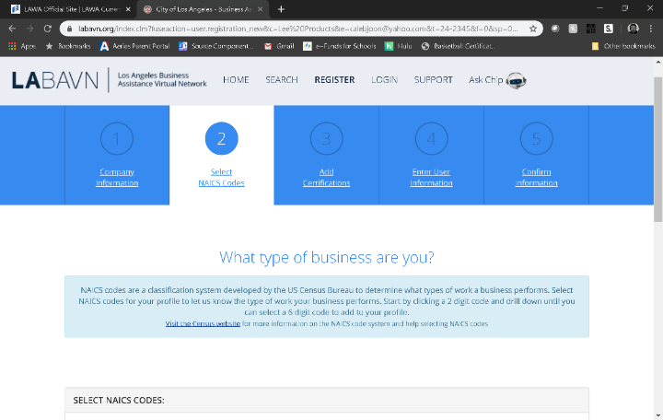
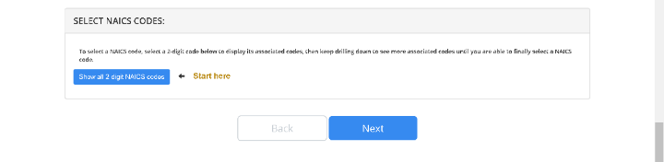

Slide 26
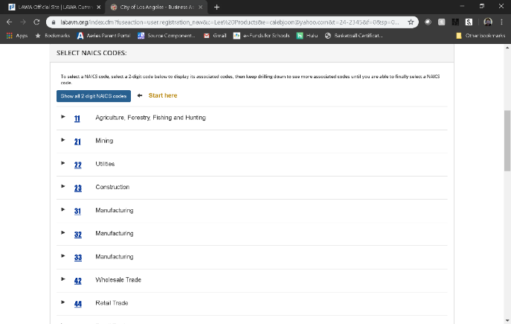
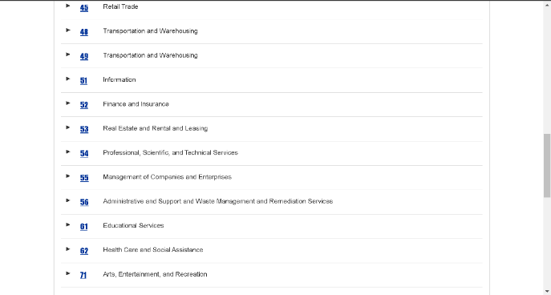

Slide 27
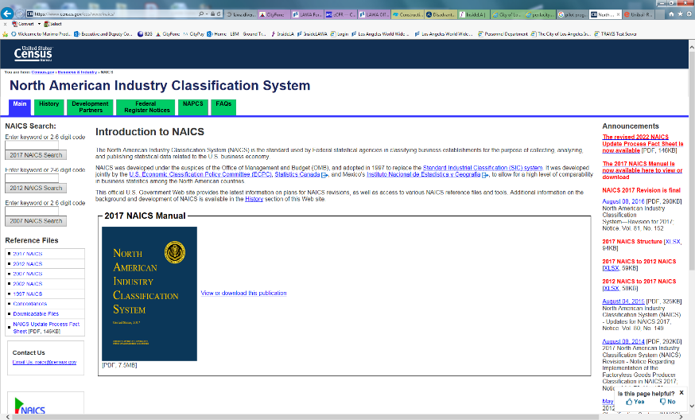

Slide 28
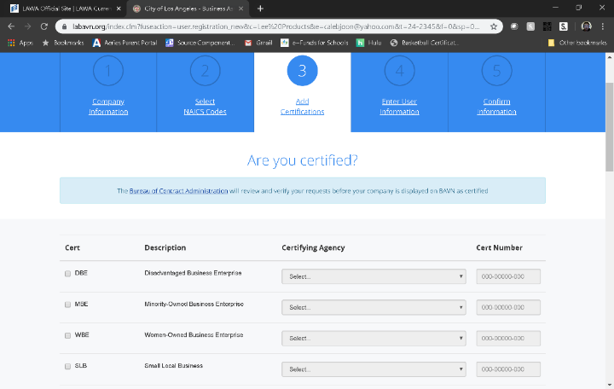
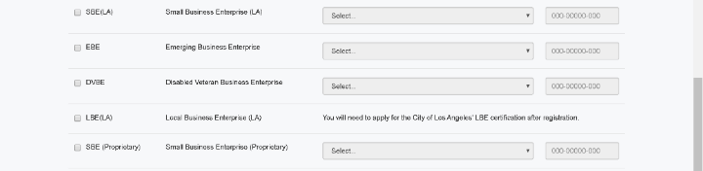

Slide 29
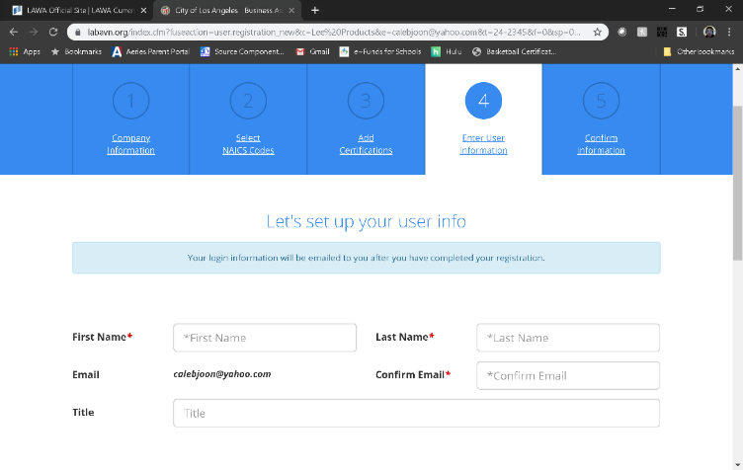

Q & A

Slide 30
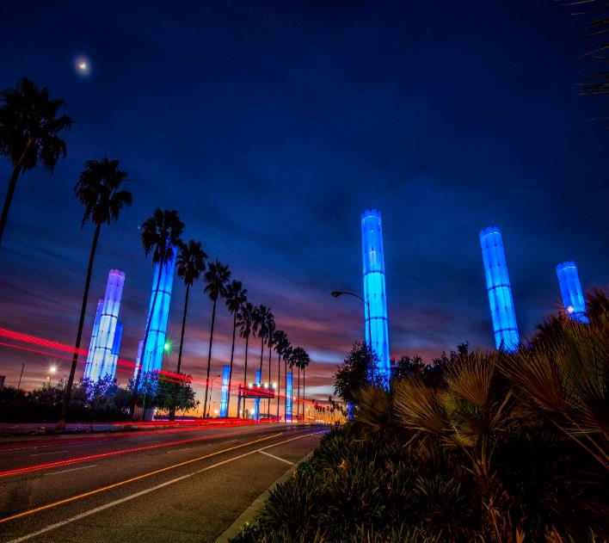

BUSINESS, JOBS
& SOCIAL RESPONSIBILITY
OUR MISSION
Maximize access to business and job opportunities
Ensure that local, diverse communities benefit from LAWA’S investments
Set the global airport standard for public corporate social responsibility
THE FUTURE IS NOW

Slide 31
LAX: OPPORTUNITIES- CAPITAL PROGRAM SUMMARY
Major Category | Total Project Cost
Major Tenant Projects | $5,584,329,837
LAMP Projects | $5,500,000,000*
Terminal Projects | $2,149,240,332
Utilities & Environmental Projects | $518,148,350
Airside Projects | $451,782,625
Security & IT Projects | $427,338,879
Landside Projects | $38,452,770
Planning / Study Projects | $24,235,000
TOTAL | $14,693,527,793*
*LAMP Subtotal is currently being finalized
Note: Figures are expressed in 2018 dollars and are subject to escalation. Does not include estimate for Asset Renewal or Program Reserve.

Slide 32
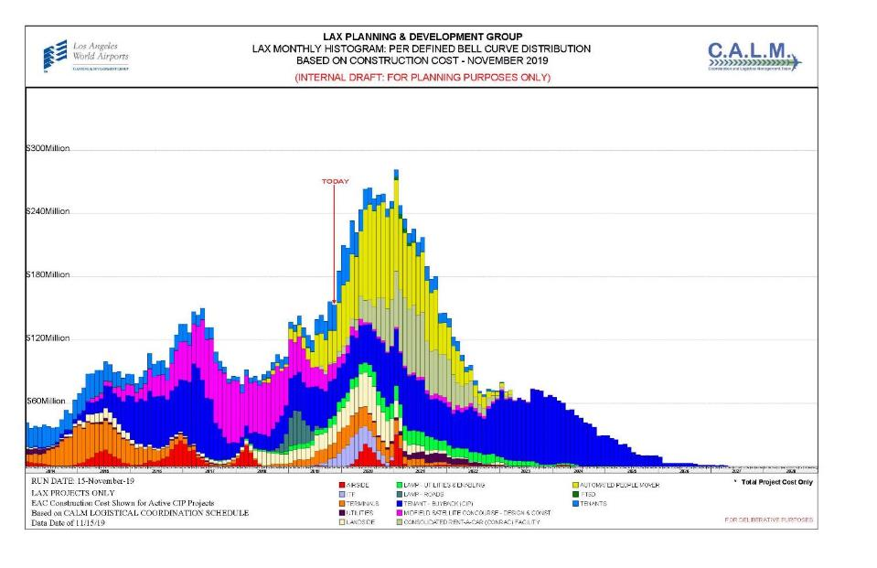
LAX: OPPORTUNITIES

Slide 33
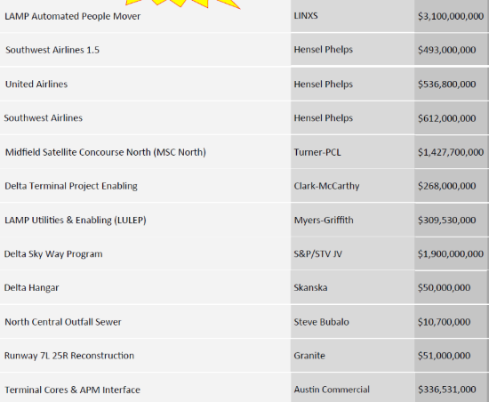
LAX: OPPORTUNITIES- ACTIVE PROJECTS
PROJECT
LAMP BUSINESS INCLUSION REQUIREMENTS
PROJECT NAME | DEVELOPER or PRIME | APPROX. PROJECT VALUE
APM
PHASE | SBE | LBE | LSBE | DVBE
DESIGN | 22% | 8% | 3% | 3%
BUILD | 18% | 7% | 5% | 3%
O & M | 17% | 10% | 5% | 3%
CONRAC
PHASE | SBE | LBE | LSBE | DVBE
DESIGN | 18% | 50% | 10% | 3%
BUILD | 22% | 20% | 5% | 5%
O & M | 20% | 7% | 5% | 3%
ITF-W
PHASE | SBE | LBE | LSBE | DVBE
DESIGN & BUILD | 20% | 10% | 5% | 3%
 | Plus all firms named in the proposal
LULEP
(contract
precedes
DVBE ordinance)
PHASE | SBE | LBE | LSBE | DVBE
DESIGN & BUILD | 19.63% | 12.5% | 7.49% | N/A

Slide 34
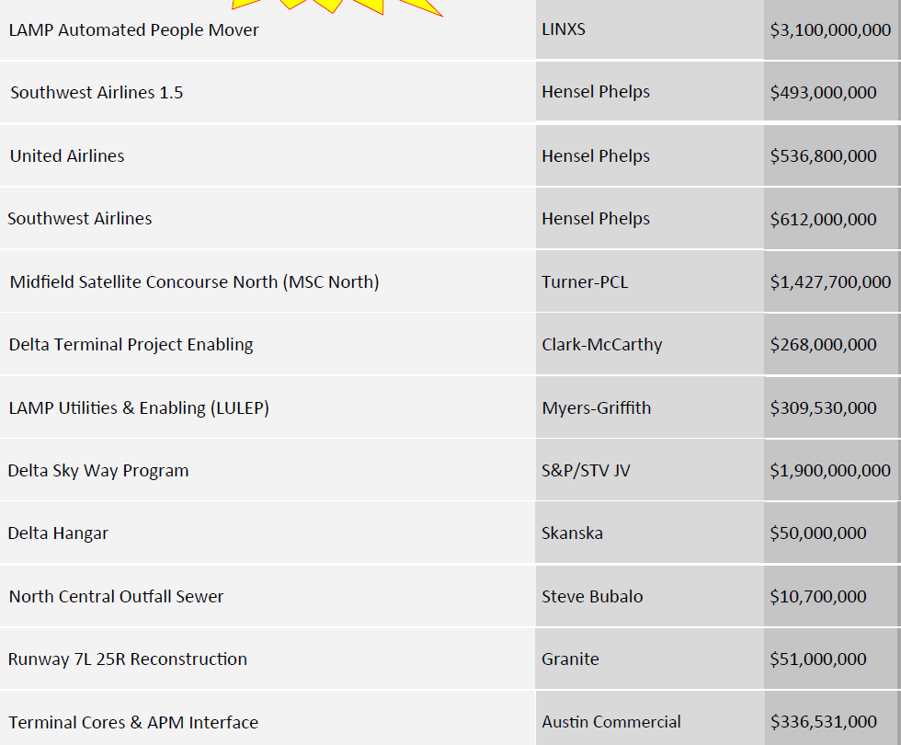
LAX: OPPORTUNITIES- ACTIVE PROJECTS
PROJECT
LAMP BUSINESS INCLUSION REQUIREMENTS
PROJECT NAME | DEVELOPER or PRIME | APPROX. PROJECT VALUE
APM
PHASE | SBE | LBE | LSBE | DVBE
DESIGN | 22% | 8% | 3% | 3%
BUILD | 18% | 7% | 5% | 3%
O & M | 17% | 10% | 5% | 3%
CONRAC
PHASE | SBE | LBE | LSBE | DVBE
DESIGN | 18% | 50% | 10% | 3%
BUILD | 22% | 20% | 5% | 5%
O & M | 20% | 7% | 5% | 3%
ITF-W
PHASE | SBE | LBE | LSBE | DVBE
DESIGN & BUILD | 20% | 10% | 5% | 3%
 | Plus all firms named in the proposal

Slide 35
LAX: WHAT YOU SHOULD KNOW
BE PREPARED
The doors of opportunity are open.
Prepare to walk through.
KNOW YOUR AGENCY
Do your Research
Understand opportunities & priorities
Understand administrative requirements
Develop relationships with agency staff
Register with BAVN
Attend workshops hosted by agency
STAY READY
Get (STAY) certified
Focus your business- do one thing & do it well
Build your capacity- look for training and mentor opportunities
Understand your finances- understand bonding, cash flow, insurance, taxes, credit
Network
Use the Project Labor Agreement to you Advantage
KNOW YOUR CUSTOMER
Understand the project: design, procurement and bid package schedule
Understand your contract
Plan for “the gap”
Develop relationships with your prime
Be careful about your bid- Bid to make a PROFIT

Slide 36

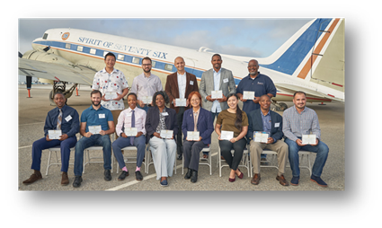


LAX: SMALL BUSINESS POLICIES & SUPPORT
ESTABLISH LAWA CONTRACTOR RECRUITMENT PIPELINE PARTNERSHIPS
Build a pipeline of firms at various levels of readiness
LAX BUSINESS NAVIGATION & SUPPORT OFFICE
Help small, local, diverse firms navigate LAWA and connect to resources
NEW!
BUILDLAX- THE LAWA CONTRACTOR DEVELOPMENT ACADEMY
Provides small contractors support and preparation to address the challenges they may encounter accessing contract opportunities on LAWA projects.
http://www.lawa.org - > About LAWA - > Business Opportunities - > Administrative Requirements

Slide 37
BUSINESS, JOBS & SOCIAL RESPONSIBILITY
For more information please contact:
Chamberlain Duru
CDURU@lawa.org |(424) 646-5374
For general inquires, contact the Business Jobs and
Social Responsibility Division at BusinessandJobs@lawa.org or (424) 646 -7300.

Slide 38


First Source Hiring Program
Business, Jobs & Social Responsibility Division (BJSR)
JobsatLAX.org
Business, Jobs & Social Responsibility (BJSR)

Slide 39
Program Description
The First Source Hiring Program (FSHP) is a valuable resource to connect LAX employers with job seekers.
The program requires employers and their sub-contractors to participate by posting and promoting their jobs on www.jobsatlax.org.
Applicants can apply directly on the company’s website or directly on the www.jobsatlax.org website.
Contractors can post their jobs manually and communicate with job seekers directly.
Currently the website has 100,000+ active job seeker accounts and 50,000+ searchable resumes.
JobsatLAX.org
Business, Jobs & Social Responsibility (BJSR)

Slide 40
Next Steps for Selected Contractors
Contact FSHP to register once a LAX contract has started by reaching Clarence Espinosa at cespinosa@lawa.org for guidance and technical assistance needs.
Complete the “FSHP Company Profile Form” located under the “Employment” tab on www.JobsatLAX.org
Designate a liaison to work with FSHP (i.e. Manager, Human Resources personnel, etc.).
Work with the FSHP team to post jobs online and utilize the features of the system to hire prospective employees.
JobsatLAX.org
Business, Jobs & Social Responsibility (BJSR)

Slide 41
Los Angeles World Airports
For more information, please contact:
Business, Jobs & Social Responsibility
First Source Hiring Program
6053 W. Century Blvd., Suite 300
Los Angeles, CA 90045
Phone: (424) 646-7300
Websites: www.jobsatlax.org
Email: cespinosa@lawa.org
JobsatLAX.org
Business, Jobs & Social Responsibility (BJSR)

Slide 42
Contractor Development and Bonding Program
Robert Lowery

Slide 43
CONTRACTOR DEVELOPMENT AND BONDING PROGRAM
LAWA helps certified firms with gaining access to supportive services in the areas of bonding and insurance.
The City of Los Angeles’ Contractor Development and Bonding Program (CDABP) is available to all small local contractors planning to bid on city contracts and subcontracts through a partnership with Merriwether & Williams Insurance Services www.imwis.com

Slide 44
CONTRACTOR DEVELOPMENT AND BONDING PROGRAM
CDABP Services
  Bond guarantees up to 40% to a maximum of $250,000 (whichever is less)
  Accounting cost subsidy up to $3,200 for financial statements
  Funds Administration payment of fees 1% of contract price
  Contractor Development: Development Plan and Marketing Profile, Self-Assessment
  Training: individual counseling and group workshops on bonding, financing and business management

Slide 45
CONTRACTOR DEVELOPMENT AND BONDING PROGRAM
Measuring Program Success…
City of Los Angeles
$162,557,255 in Bid Bonds
$37,721,894 in Bid Bonds for LAWA
$64,606,661 in Final Bonds
$19,521,894 in Final Bonds For LAWA
For more information, please contact:
Robert Lowery, Field Support Project Manager
(213) 270-0282
rlowery@imwis.com

Slide 46
GETTING CERTIFIED
Small Business Enterprise (SBE-Proprietary)
Small Local Business (SLB)
Local Business Enterprise (LBE)
Disabled Veterans Business Enterprise (DVBE)(LAWA)
Certification Recognition
Local Small Business Enterprise (LSBE)
Federal Programs Certification
Disadvantaged Business Enterprise (DBE)
Airport Concessions DBE (ACDBE)

Slide 47
SBE (Proprietary) Certification
Requirements:
  Firm is independently owned and operated
  Firm meets small business criteria set forth by the Small Business Administration (8a) Business Development Program or State DGS Small Business Program, whichever standard is higher
Advantage:
  Certification provides additional opportunities in competing against non-certified subcontractors for procurements opportunities calling for SBE (proprietary)-certified firms
Process:
  If certified by one of the agencies on the following chart, provide copy of the certification; OR if not, submit SBE (Proprietary) Application for processing.
  Certification is good for two years.
Applying:
  Go to https://bca.lacity.org/Uploads/cca/SBE%20%28Proprietary%29%20Application.pdf
Types of Projects: Construction, professional and non-professional projects valued over $150,000.

Slide 48
SBE (Proprietary) Certification
If your firm is currently certified with one of the following agencies you do NOT need to go through the Certification process, simply submit a copy of your certification to a Certification analyst or with your bid/proposal.
City of Los Angeles
City of Los Angeles
CERTIFYING AGENCY | CERTIFICATION | ACCEPTED BY LAWA FOR SBE (PROPRIETARY)?
Federal Small Business Administration (SBA) | SBA 8(a) Business Devpt. Program | Yes
State of California Department of General Services (DGS) | SB, SB-Public Works, SB (micro) | Yes
California Department of Transportation (CALTRANS) | SMBE, SWBE, DBE | Yes
L.A. County Metropolitan Transportation Authority (METRO) | SBE, DBE | Yes
California Unified Certification Program (CUCP) Agencies: • California Department of Transportation (CALTRANS) City of Fresno • City of Los Angeles L.A. County Metropolitan Transportation Authority (METRO) • San Diego County Regional Airport Authority (SAN) • San Francisco Bay Area Rapid Transit District (BART) • San Francisco International Airport (SFO) • San Francisco Municipal Transportation Agency (SFMTA) • San Mateo County Transit District (SAMTRANS) • Santa Clara Valley Transportation Authority (VTA) | DBE | Yes
US Women’s Chamber of Commerce (USWCC) | WOSB, EDWOSB | Yes
Women’s Business Enterprise Council West (WBEC-WEST) | WOSB | Yes
National Women Business Owners Corporation (NWBOC) | WOSB, EDWOSB | Yes
City of Los Angeles | SBE, SLB | Yes
County of Los Angeles | LSBE | Yes

Slide 49
Small Local Business (SLB) Certification
Requirements:
  Principal office located in the County of Los Angeles
  Gross receipts (including affiliates) for the previous fiscal year must be less than $3 million
  City of Los Angeles Business Tax Registration Certificate
Advantage:
  Certified SLB responsible bidders on procurement contracts under $100,000 given a 10% deduction on their bid amount
Process:
  Submit hard copies of one page application or via email, copy of current taxes, and BTRC
  Certification process is simple and good for two years
Applying:
  Go to https://bca.lacity.org/Uploads/cca/SLBApplication.pdf
Type of Contracts: Mostly goods and commodities.

Slide 50
LBE Certification
Requirements:
  Must have business workspace within the County of Los Angeles:
    Headquartered (physically conducts and manages all operations) in the County; OR
    at least 50 of its full-time employees perform work within the boundaries of the County at least 60 percent of their total hours worked on annual basis; OR
    at least half of its full-time employees work within the boundaries of the County at a minimum of 60 percent of their total regular hours worked on annual basis.
  City of Los Angeles Business Tax Registration Certificate
  Current on all City & County taxes
Advantage:
  Certified LBEs on procurement contracts over $150,000 are given an 8% deduction on the bid amount or 8 points toward the proposal score
Process (on-line):
  Affidavit of Eligibility completed by Local Business
  Affidavit posted by Local Business on LABAVN (Mayor’s website) & verified by BCA/LAWA
  Certification valid for five years.

Slide 51
LBE Certification
Applying:
  After registering on LABAVN, download an LBE Affidavit and apply on-line
Example: Any type of business, the major eligibility criteria is business workspace/headquarters located within LA County boundaries
NOTE: LAWA does not accept Harbor’s LBE or LA County LSBE certification. LBE
Certification does not apply to contracts that involve the expenditure of funds that are not entirely within LAWA’s control; i.e., grants, federal funds, etc.

Slide 52
DVBE (LAWA) Certification
Requirements:
Must be certified by any one of three agencies, two Federal, one State of
California (see following slide) and
  Must also have business workspace within the State of California:
    Headquartered (physically conducts and manages all operations) in the State; OR
    at least 50 of its full-time employees perform work within the boundaries of the State at least 60 percent of their total hours worked on annual basis; OR
    at least half of its full-time employees work within the boundaries of the State at a minimum of 60 percent of their total regular hours worked on annual basis.
  City of Los Angeles Business Tax Registration Certificate
  Current on all City, County, & State taxes
Advantage:
  Certified DVBE(LAWA)s on procurement contracts over $150,000 are given an 8% deduction on the bid amount or 8 points toward the proposal score

Slide 53
Recognized for DVBE (LAWA) Certification
CERTIFYING AGENCY | CERTIFICATION | ACCEPTED BY LAWA AS DVBE (LAWA)?
U.S. Department of Veterans Affairs* | Service-Disabled Veteran-Owned Small Business (SDVOSB) | Yes
U.S. Small Business Administration* | Service-Disabled Veteran-Owned Small Business (SDVOSB) | Yes
State of California | Disabled Veteran Business Enterprise (DVBE) | Yes
*The Federal SDVOSB must be headquartered or have employees working at a business workspace in California in order to be certified as
a DVBE (LAWA)
If a firm is verified as being certified by one of the Federal agencies as an SDVOSB and is also verified as certified as a City of Los Angeles LBE, that firm will be granted DVBE (LAWA) certification..

Slide 54
DVBE (LAWA) Certification
Process (on-line):
  Affidavit of Eligibility completed by Disabled Veterans Business firm
  Affidavit posted by Local Business on LABAVN (Mayor’s website) & verified by BCA/LAWA
  Certification valid for five years.
  An optional site visit may be conducted to verify State of California location.
  Applying:
  After registering on LABAVN, download a DVBE(LAWA) Affidavit and apply online
Example: Any type of business
NOTE: DVBE (LAWA)Certification does not apply to contracts that involve the
expenditure of funds that are not entirely within LAWA’s control; i.e., grants,
federal funds, etc.

Slide 55
LAWA’s Local Small Business Enterprise (LSBE) Certification Recognition
There is no separate LSBE certification process with the City of Los Angeles or with LAWA. In order to qualify as a LAWA LSBE, a firm must be certified as an SBE and LBE
What happens if I have LSBE certification from the County of Los Angeles?
  Your firm will be recognized as an SBE (Proprietary) by LAWA.
  However, you must submit a LBE Affidavit of Eligibility with the City of Los Angeles.
  If your firm meets the City of Los Angeles’ LBE criteria and consequently obtains LBE certification, your firm will then be recognized as both an LBE and LSBE by LAWA.

Slide 56
LAWA’s Local Small Business Enterprise (LSBE) Certification Recognition
Advantage: Certification provides additional opportunities in competing against non-certified subcontractors for procurements opportunities calling for LSBE (LAWA)-recognized firms
Example: Any type of business
NOTE: As mentioned previously, LAWA does not accept LA County LSBE Certification for Local Business Enterprise Certification Recognition.

Slide 57
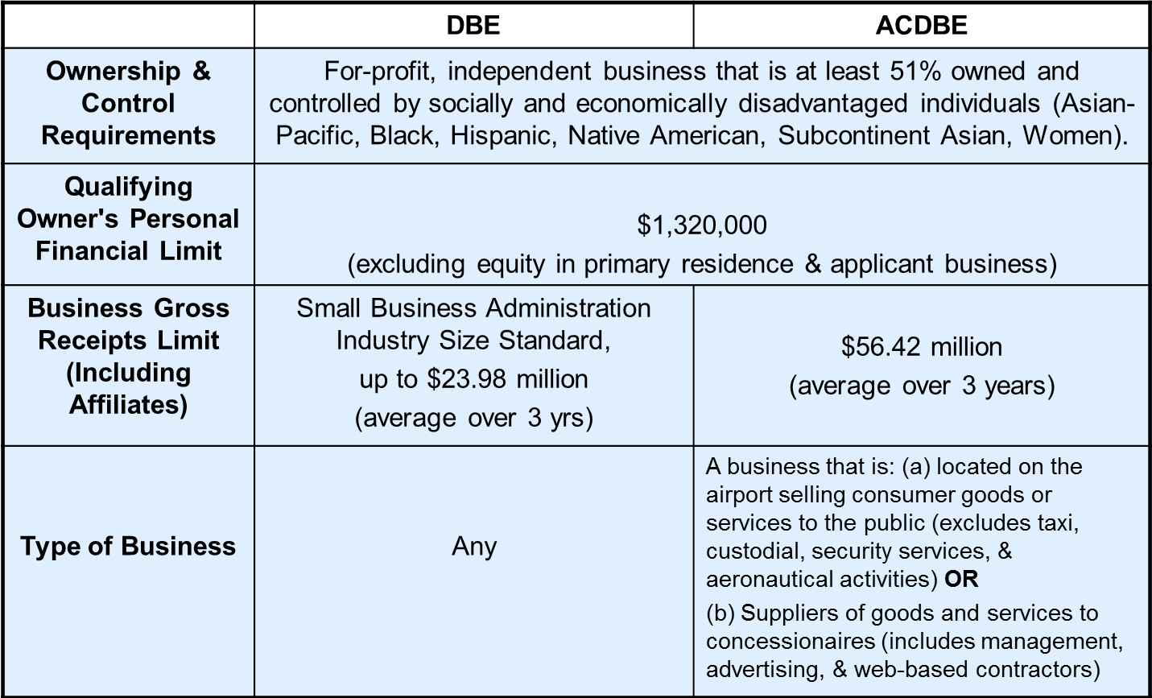
DBE/ACDBE Certification Requirements

Slide 58
DBE / ACDBE Certification
Applying for DBE or ACDBE Certification:
  Go to www.bca.lacity.org/Uploads/cca/DBE_ACDBE_Application.pdf
Advantage:
  Certification provides additional opportunities in competing against non-certified subcontractors
  Marketing exposure through nationwide, statewide, and citywide databases
  One stop shop – the City’s DBE/ACDBE certifications are honored throughout CA (CUCP includes CALTRANS, Metro, etc.)
  DBE certification is good until or unless removed for cause; e.g., change in ownership or control, exceeds size standards or net worth or failure to cooperate.
ACDBE Examples:
  On-line and hard copy airport magazine publisher
  On-line digital advertising vendor
  Vehicle Service and Maintenance Provider off the LAWA campus who performs CHP-standard vehicle inspections and services. Staff also repairs, services, and maintains tour buses and shuttle vans that transport travelers to and from LAX.

Slide 59
DBE/ACDBE Certification Process
1. Preliminary Intake Review:
Submitted documents are checked for completeness
2. Desk Audit:
Supporting documents are reviewed to determine eligibility for certification, additional information may be requested
3. Mandatory Site Visit:
Interview applicant at the business location; physical verification that business exists
4. Final Review for Approval/Denial

Slide 60
Getting Certified
For more information:
http://bca.lacity.org
  Certification Helpline
  (213) 847-2684
  bca.certifications@lacity.org
Shaun Shimoda-Kobayashi, LAWA Certification Manager
(213) 847-2650
shaun.shimoda-kobayashi@lacity.org
Elaine Luong-Huynh, LAWA Certification Analyst
(213) 847-2667
elaine.luong@lacity.org
Dana Tominaga, LAWA Certification Analyst
(213) 847-2375
dana.tominaga@lacity.org
Directories of Certified Firms:
CUCP: https://dot.ca.gov/programs/business-and-economic-opportunity/dbe-search> Directory City of LA: http://bca.lacity.org -> Certification Listings -> Click on DBE/MBE/WBE Directory

Slide 61
ADMINISTRATIVE REQUIREMENTS

Slide 62
Administrative Requirements
Due with bid/proposal
Affidavit of Non-Collusion (Form: Notary signature)
Bid Bond (Form, project specific)*
Bidder Contribution Limits (Form CEC 55, >$100,000)
Contractor Responsibility Program (Form, Board approval)
Equal Benefits Ordinance (Form, project specific)*
Municipal Lobbying Ordinance (Form CEC 50, > $25,000)
Vendor Identification Form
Subcontractor Participation Plan
Iran Contracting Act of 2010
Insurance (pricing only), if greater than $1 million…requirements…

Slide 63
Administrative Requirements
Selected Bidder/ Proposer Requirements
Affirmative Action Plan (Language)
Assignment of Anti-Trust Claims (Language)
Child Support Obligations (Language)
First Source Hiring Program (LAX only)
Labor Peace Agreement (Language, concessions only)
Living Wage Ordinance/Service Contractor Worker Retention Ordinance (Language; if applicable, complete the Correct Exemption Form)*
Insurance (Form)

Slide 64
Administrative Requirements
Administrative Requirements Website:
http://www.lawa.org - > About LAWA - >
Business Opportunities - > Administrative Requirements

Slide 65
Next Steps…
1. Check the products and services that LAWA needs on www.lawa.org -> Business
Opportunities -> What LAWA Buys as well as the LAWA Construction
Forecast Report. Additionally, reach out to Prime Contractor and
potential business partners.
2. Research applicable CERTIFICATION Programs and APPLY.
3. Register on Los Angeles Business Assistance Virtual Network –
LABAVN at www.labavn.org
4. Check the Expiring Contracts Report at https://www.lawa.org/en/lawa-businesses/lawa-current-opportunities for contracts that are about to expire.

Slide 66
Next Steps…
5. Contact Business Jobs & Social Responsibility Division for upcoming Outreach
Events.
6. Attend any relevant pre-bid/proposal meetings (refer to RFB/P)
7. Research LAWA’s Contractor Development & Bonding Program for technical
assistance.
8. Research LAWA’s First Source Hiring Program for any employee needs.
9. If applying, contact the Contract Administrators of the RFB/P regarding
questions on the scope of work.

Slide 67
Next Steps… (cont.)
10. Contact Procurement Services Division (Contract Services Unit) regarding
Administrative Requirements at (424) 646-5380 or go to www.lawa.org
- > About LAWA - > Business Opportunities - >
Administrative Requirements

Slide 68
Contact Information
LAWA Business, Jobs & Social Responsibility | (424) 646-7300 |  | http://www.lawa.org/bjrc
LAWA Procurement Services Division | PSD Main Line: (424) 646-5380 | Purchasing: (424) 646-7392 | https://www.lawa.org/en/groups-and-divisions/procurement
City of Los Angeles Contractor Development and Bonding Program (Rosa Osorio, Senior Account Manager) | (424) 646-7300 |  | rosa@imwis.com
LAWA First Source Hiring Program | (424) 646-7300 |  | gcarter@agile1.com
LAWA Risk Management Insurance Compliance Section | (424) 646-5480
Department of Public Works, Bureau of Contract Admin. | bca.certifications@lacity.org
LA Business Assistance Virtual Network | http://www.labavn.org

Slide 69

DOING BUSINESS with
Los Angeles World Airports

