Slide 1

LAWA Commercial Development Group
Regulatory Compliance:
Los Angeles Fire Code & Notice of Violations
Guest Speakers
Los Angeles Fire Department
Asst. Chief N. Brodowy
Inspector S. Habersham

Slide 2
OVERVIEW
I. The Target
II. Introduction
III. Preventive Maintenance
IV. Responsiveness
V. Hitting the Target
VI. Conclusion
VII. Questions

Slide 3

THE TARGET
Preventive Maintenance & Responsiveness
Preventive Maintenance:
Maintain properties to City of Los Angeles Fire Code at all times to ensure safety of staff
Responsiveness:
Resolve Notice of Violation (NOV) violations within 30 days

Slide 4
INTRODUCTION
Partners in Compliance
Tenants
LAFD
  Assistant Chief: N. Brodowy
  LAX Inspector: S. Habersham
  Temp. Inspectors: G. Durant and W. Sutton
LAWA
  Commercial Development Group
    Business Relationship Managers (BRM)
    Tenant Preventive Maintenance: Vimal Patel, Bonnie Soong, Hector Lara
  Facilities Maintenance and Utilities Group (FMUG)
    Regulatory Compliance – Silvia Mejia, Renee Fletcher, Vijai Seeram

Slide 5
INTRODUCTION
Purpose of the Fire Code
Fire Code Section 101.3 Intent (extract)
The purpose of this [LA City Fire] code is to establish the minimum requirements consistent with nationally recognized good practice for
  providing a reasonable level of life safety and property protection from the hazards of fire, explosion, panic, or dangerous conditions in new and existing buildings...
  and to provide a reasonable level of safety to fire fighters and emergency responders during emergency operations.

Slide 6
INTRODUCTION
Typical Lease/Agreement Language
Lessee shall be solely responsible for fully complying with any and all applicable present and/or future rules, regulations, restrictions, ordinances, statutes, laws, policies and/or orders of any federal, state, and/or local government authority (“Applicable Laws”).
Lessee shall be solely responsible for any and all civil and/or criminal penalties assessed as a result of its failure to comply with any of these rules, regulations, restrictions, restrictions, ordinances, statutes, laws, orders, directives and or conditions.
Current Status
LAFD: Many facilities non-compliant with Fire Code at this time
Increased number of inspections → Increased number of NOVs

Slide 7
PREVENTIVE MAINTENANCE
Maintain Facilities to Fire Code - Always
  Regulation 4 Testing & Compliance (Reg. 4)
    Testing and maintenance of building fire protection equipment and systems
  Annual Site Inspections
    Fire Code compliance inspection
    Informal guides:
      Pre-Inspection Checklist
Notes:
LAWA’s responsibility: Any buildings/structures on LAWA land are LAWA’s resp.
LAWA leases/agreements: Tenant must comply with all Fed/State/Local laws/ordinances/regulations, which includes the Code.
CDG: Ensures tenant compliance: CDG ensures tenants comply with leases/agreements, therefore we are for ensuring tenants comply with Code.

Slide 8
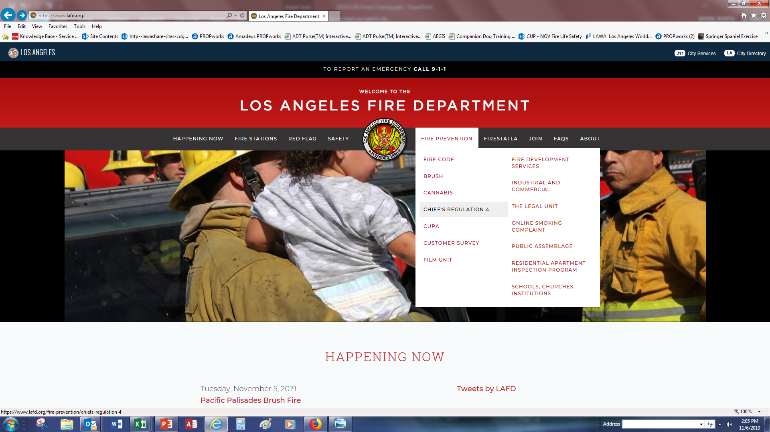
PREVENTIVE MAINTENANCE
1. Reg. 4 Testing & Compliance
Tenant Compliance Requirements:
Periodic Testing (1yr/5yr) by a LAFD Certified Tester
Deficiencies – Repair by a Licensed Contractor, Re-Test
Reference: LAFD.org → Fire Prevention → Chief’s Regulation 4
Notes:
LAWA’s responsibility: Any buildings/structures on LAWA land are LAWA’s resp.
LAWA leases/agreements: Tenant must comply with all Fed/State/Local laws/ordinances/regulations, which includes the Code.
CDG: Ensures tenant compliance: CDG ensures tenants comply with leases/agreements, therefore we are for ensuring tenants comply with Code.

Slide 9
PREVENTIVE MAINTENANCE
1. Reg. 4 Testing & Compliance
  Building Equipment/Systems List and Test Frequency
  Every Year:
    Basic Fire Warning Systems
    Complex Fire Warning Systems
    Central Station Signaling Systems
    Elevators, Automatic
    Emergency Generator and Lighting Systems: All Occupancies
    Fire Doors: All Types/All Occupancies
    Fire Escapes
    Fire Pumps
    Pre-action, Deluge, and Dry Pipe Systems – Pressure Reducing Valves (PRVs) and Partial Flow
    Smoke Management Systems
  Every 5 Years:
    All Standpipe Systems
    Automatic Fire Sprinkler Systems
    Pre-action, Deluge, and Dry Pipe Systems – Full Flow
Notes:
LAWA’s responsibility: Any buildings/structures on LAWA land are LAWA’s resp.
LAWA leases/agreements: Tenant must comply with all Fed/State/Local laws/ordinances/regulations, which includes the Code.
CDG: Ensures tenant compliance: CDG ensures tenants comply with leases/agreements, therefore we are for ensuring tenants comply with Code.

Slide 10
PREVENTIVE MAINTENANCE
1. Reg. 4 Testing & Compliance
The Compliance Engine (“Brycer”)
Web-based Reg. 4 Test Tracking and Compliance Reporting Tool
Certified Testers submit reports directly into Brycer
Launched 4 years ago
Properties whose systems/equipment testing are more than 4 years past due have no record in Brycer
Notes:
LAWA’s responsibility: Any buildings/structures on LAWA land are LAWA’s resp.
LAWA leases/agreements: Tenant must comply with all Fed/State/Local laws/ordinances/regulations, which includes the Code.
CDG: Ensures tenant compliance: CDG ensures tenants comply with leases/agreements, therefore we are for ensuring tenants comply with Code.

Slide 11
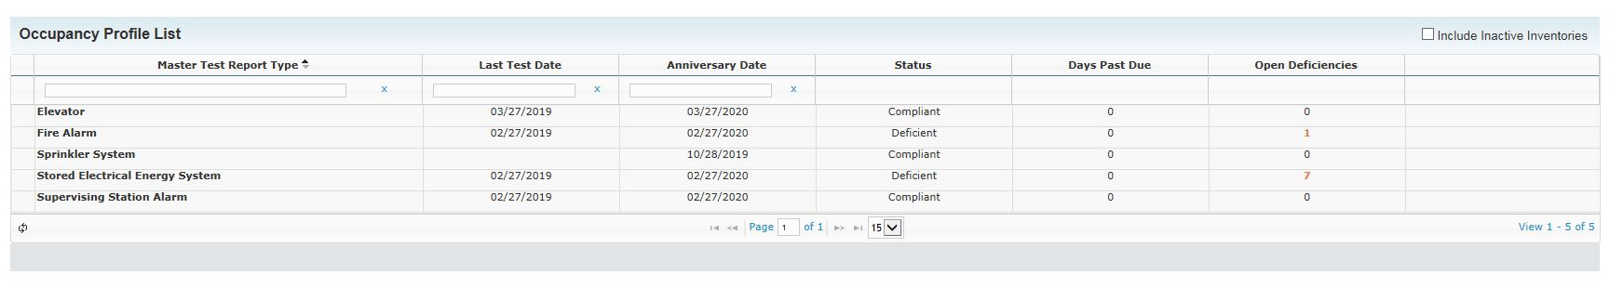
PREVENTIVE MAINTENANCE
1. Reg. 4 Testing & Compliance
  The Compliance Engine (“Brycer”) – Sample Report
    Occupancy Profile List
Notes:
LAWA’s responsibility: Any buildings/structures on LAWA land are LAWA’s resp.
LAWA leases/agreements: Tenant must comply with all Fed/State/Local laws/ordinances/regulations, which includes the Code.
CDG: Ensures tenant compliance: CDG ensures tenants comply with leases/agreements, therefore we are for ensuring tenants comply with Code.

Slide 12
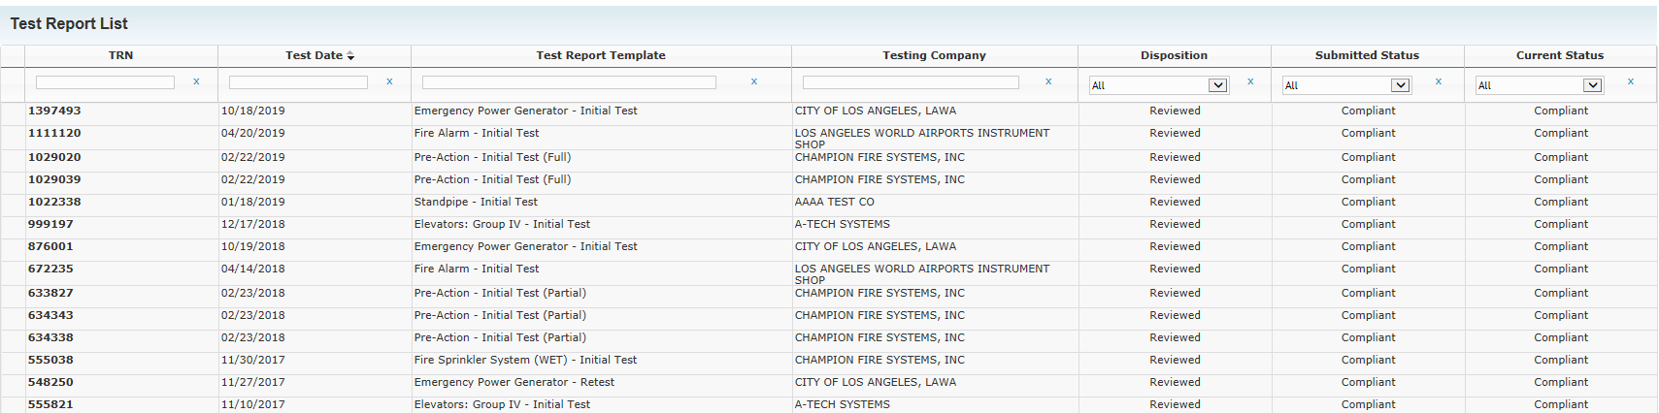
PREVENTIVE MAINTENANCE
1. Reg. 4 Testing & Compliance
  The Compliance Engine (“Brycer”) – Sample Report
    Test Report List
Notes:
LAWA’s responsibility: Any buildings/structures on LAWA land are LAWA’s resp.
LAWA leases/agreements: Tenant must comply with all Fed/State/Local laws/ordinances/regulations, which includes the Code.
CDG: Ensures tenant compliance: CDG ensures tenants comply with leases/agreements, therefore we are for ensuring tenants comply with Code.

Slide 13
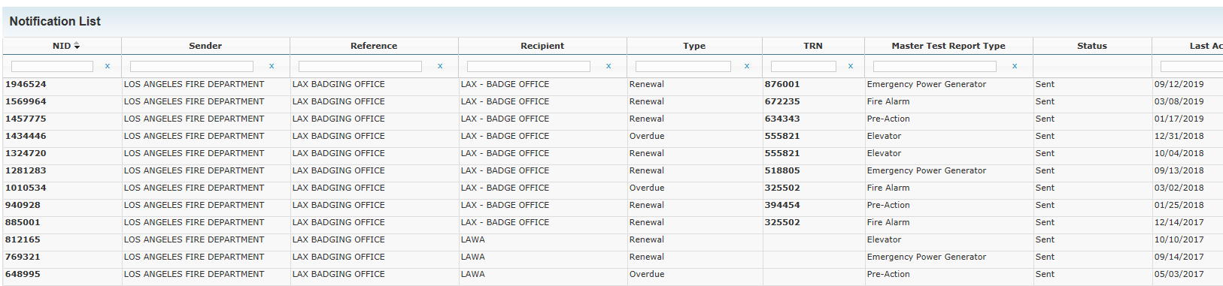
PREVENTIVE MAINTENANCE
1. Reg. 4 Testing & Compliance
  The Compliance Engine (“Brycer”) – Sample Report
    Notification List
Notes:
LAWA’s responsibility: Any buildings/structures on LAWA land are LAWA’s resp.
LAWA leases/agreements: Tenant must comply with all Fed/State/Local laws/ordinances/regulations, which includes the Code.
CDG: Ensures tenant compliance: CDG ensures tenants comply with leases/agreements, therefore we are for ensuring tenants comply with Code.

Slide 14
PREVENTIVE MAINTENANCE
1. Reg. 4 Testing & Compliance
  Action Plan – TODAY
  Tenants will soon receive Brycer property reports and instructions to immediately address any “past due” or “deficient” systems/equipment using certified testers and licensed contractors.
  For properties not listed in Brycer, tenants must first identify the Reg. 4 systems within their facility and then get them tested/repaired immediately.
  Tenants must keep a current set of Reg. 4 test reports on-site for LAFD inspector.
Notes:
LAWA’s responsibility: Any buildings/structures on LAWA land are LAWA’s resp.
LAWA leases/agreements: Tenant must comply with all Fed/State/Local laws/ordinances/regulations, which includes the Code.
CDG: Ensures tenant compliance: CDG ensures tenants comply with leases/agreements, therefore we are for ensuring tenants comply with Code.

Slide 15
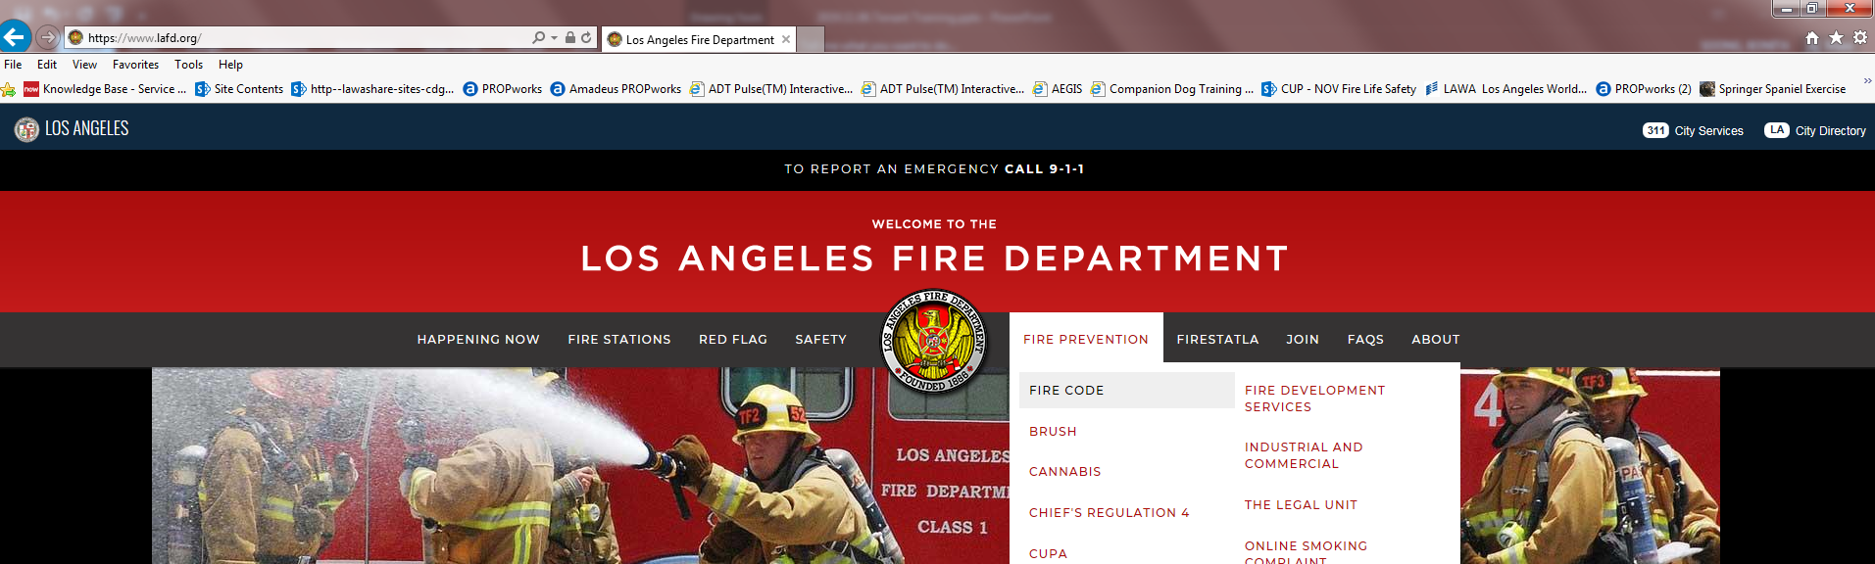
PREVENTIVE MAINTENANCE
2. Annual Site Inspections
Fire Code compliance inspection – LAFD Inspector and Vijai Seeram
Code violations written-up in a Notice of Violation (NOV)
30-day deadline from NOV “Notice Date” to address violation
Reference: LAFD.org → Fire Prevention → Fire Code
Notes:
LAWA’s responsibility: Any buildings/structures on LAWA land are LAWA’s resp.
LAWA leases/agreements: Tenant must comply with all Fed/State/Local laws/ordinances/regulations, which includes the Code.
CDG: Ensures tenant compliance: CDG ensures tenants comply with leases/agreements, therefore we are for ensuring tenants comply with Code.

Slide 16
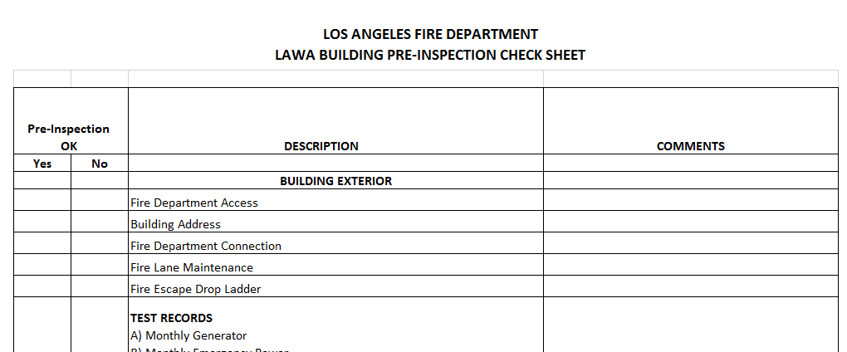
PREVENTIVE MAINTENANCE
2. Annual Site Inspections
    Informal guide: Pre-Inspection Check Sheet
    Note: The most common observed violations are marked with asterisk.
Notes:
LAWA’s responsibility: Any buildings/structures on LAWA land are LAWA’s resp.
LAWA leases/agreements: Tenant must comply with all Fed/State/Local laws/ordinances/regulations, which includes the Code.
CDG: Ensures tenant compliance: CDG ensures tenants comply with leases/agreements, therefore we are for ensuring tenants comply with Code.

Slide 17
PREVENTIVE MAINTENANCE
2. Annual Site Inspections
  Action Plan – TODAY
  Allocate resources/Designate persons to address Fire Code issues – SME
  Conduct periodic Fire Code site walks – use informal guides to identify and address any violations.
  Vijai Seeram – Available to do a site walk prior to annual site inspection walk.
  Contact Inspector Habersham (via mobile phone) with Fire Code questions.
  Contact your BRM to develop a Fire Code preventive maintenance strategy.
GOAL: Maintain facility to Fire Code at all times → No violations found during inspection
Notes:
LAWA’s responsibility: Any buildings/structures on LAWA land are LAWA’s resp.
LAWA leases/agreements: Tenant must comply with all Fed/State/Local laws/ordinances/regulations, which includes the Code.
CDG: Ensures tenant compliance: CDG ensures tenants comply with leases/agreements, therefore we are for ensuring tenants comply with Code.

Slide 18
RESPONSIVENESS
Resolve NOV violations within 30 days
LAFD Inspector issues a Notice of Violation (NOV) for any Fire Code violations identified during annual site walk.
NOV will also include any outstanding Reg. 4 violations.
NOV provides 30 calendar days to address violations.
  “FORTHWITH” requires immediate remediation
LAFD may require Tenant provide 24/7 immediate Fire Watch for any critical Reg. 4 violation in order to ensure safety of people and structure until Reg. 4 violation is properly addressed.
Notes:
LAWA’s responsibility: Any buildings/structures on LAWA land are LAWA’s resp.
LAWA leases/agreements: Tenant must comply with all Fed/State/Local laws/ordinances/regulations, which includes the Code.
CDG: Ensures tenant compliance: CDG ensures tenants comply with leases/agreements, therefore we are for ensuring tenants comply with Code.

Slide 19
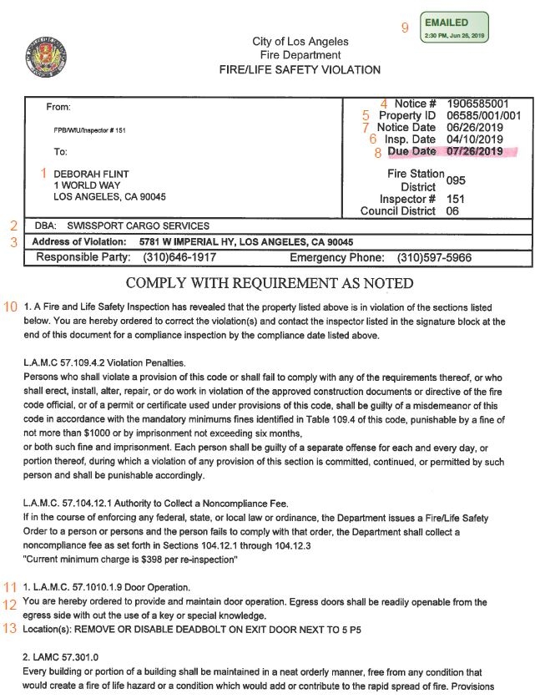
RESPONSIVENESS
NOV Contents – Sample
Recipient (LAWA CEO)
Company Name
Address of Violation
Notice #
Property ID (LA County Assessor’s)
Inspection Date
Notice Date
Due Date (30 Days from Notice Date)
“Emailed To LAWA” Date
Standard Notice Language
Violation Number and Applicable Code Section
Applicable Code Section Language – “Forthwith”
Location of Violation and Instructions to Comply
Note: Photos may be attached at end of NOV
Notes:
LAWA’s responsibility: Any buildings/structures on LAWA land are LAWA’s resp.
LAWA leases/agreements: Tenant must comply with all Fed/State/Local laws/ordinances/regulations, which includes the Code.
CDG: Ensures tenant compliance: CDG ensures tenants comply with leases/agreements, therefore we are for ensuring tenants comply with Code.

Slide 20
RESPONSIVENESS
Roles and Responsibilities
LAWA
  Receives NOV from LAFD
  Tracks NOV resolution status
  BRM requests/receives weekly status updates from Tenant
    Weekly - For each assigned violation: 1) Action Plan, 2) Estim. Date of Completion
  BRM ensures tenants address violations in a timely manner
Tenants
  Receives NOV from LAWA
  Works directly with LAFD inspector, LAWA FMUG (Vijai Seeram), and BRM
  Contact vendors as needed
  Extensive corrective action may require LAWA’s Tenant Improvement Approval Process (TIAP)
  Provide weekly status updates to BRM – each TUESDAY
    For each assigned violation: a) Action Plan, b) Estimated Date of Completion

Slide 21
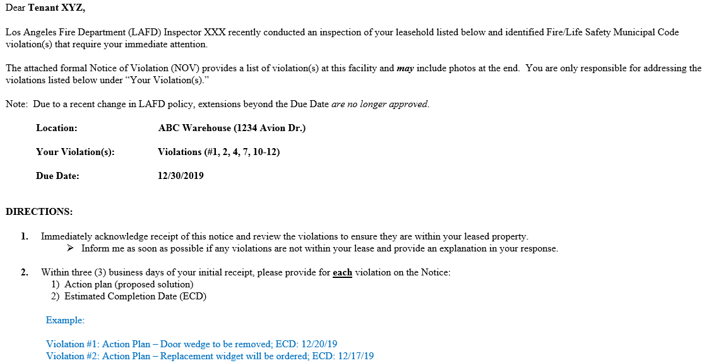
RESPONSIVENESS
Example: NOV notification

Slide 22

RESPONSIVENESS
NOV Response Timeline – 30 days
Every TUE. – by close of business
Tenant emails update for each violation on NOV (action plan, ECD) →
to BRM
LAWA/BRM forwards to Tenant – requests ack (1 bus. day)
Tenant emails ack to BRM
Wk 3: Tenant 1) updates violations and 2) highlights if any violations will extend past Due Date
If so: Provide documentation
(PO, etc.) to BRM to demonstrate due diligence.
Remaining violations:
Tenant sends last-minute updates to BRM
Wk 1:
Tenant provides to BRM for
each violation:
1) Action plan (proposed solution)
2) Estim. completion date
LAFD sends Notice (NOV) to LAWA
CLOCK STARTS
Day 1
Day 2-4
Week 1
TUE
Week 2
TUE
Week 3
TUE
Due Date minus 2 bus. days
DUE DATE
Day 30

Slide 23

RESPONSIVENESS
Tenants are the *Key*
30-day timeline
When things go wrong
-and they will:
  Vacation
  Emergency leave
  Vendor disappears
  Important to have a back-up
We depend on your
resourcefulness
to keep us on track.

Slide 24
HITTING THE TARGET
Preventive Maintenance & Responsiveness
Bring our properties up to Fire Code – TODAY
  Brycer tests completed and keep reports on-site
  Regular site inspections using Pre-Inspection Check Sheet as guide
  Important resources: Inspector Habersham and Vijai Seeram
Resolve NOV violations in 30 days
  Timeline:
    Receive LAFD Notice of Violation
    Acknowledge receipt – within 1 business day
    Baseline – 3 business days after receipt of NOV
      For each violation: 1) Action plan and 2) Est. Completion Date
    EVERY TUESDAY – update each violation
      1st Tuesday Baseline is sufficient
      2nd Tuesday Update all violations
      3rd Tuesday Update all violations – add assessment (miss Due Date w/supporting docs)

Slide 25

CONCLUSION
Contacts
  Inspector S. Habersham (LAFD)
    (323) 459-3234
    sir.habersham@lacity.org
  Vijai Seeram (LAWA FMUG)
    vseeram@lawa.org
Questions: Email to TPMP@LAWA.org
Thank you very much in advance!
TAKE NO PRISONERS!!!

Slide 26
QUESTIONS
Please speak into the remote microphone.
Thank you

