Slide 1

Facility Maintenance
Guest Experience Partners Council
February 14, 2018
Michael Christensen
Deputy Executive Director
Facilities Maintenance & Utilities Group

Slide 2
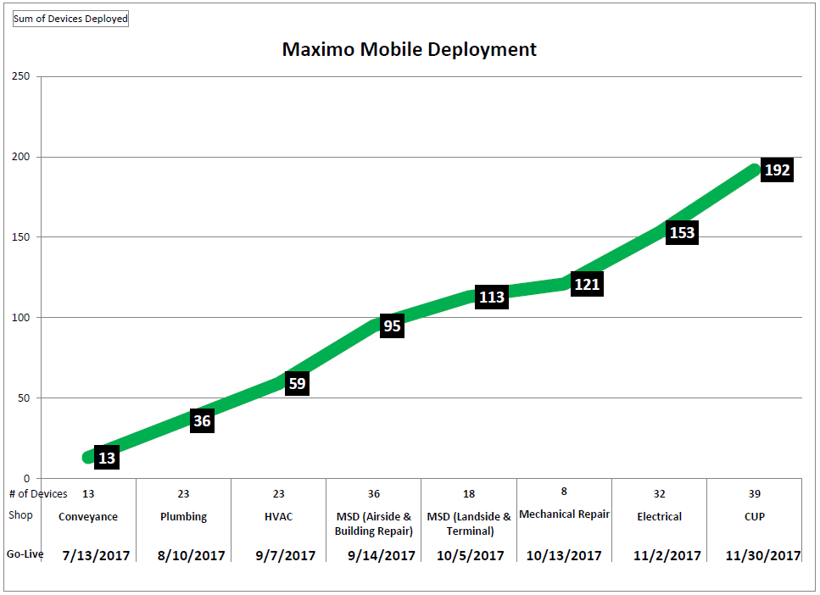
*202 Total Devices. 10 allocated to IMTG & AMD for support.
Notes:
FTSD 100 (1 assigned to Michael Johnson for special projects/restroom inspections).
MSD 54
CUP 39
IMTG 5
AMD 4
Grand Total 202
Phased Roll out Training – 2 days/4 sessions (3 hours each) to capture all staff. IMTG Vendor/Contractor provided training. Training from July – Nov 2017.
Refresher Training – FMUG Asset Management Division is currently providing refresher training courses to all shops. Training began January 2018 and continuing until all shops are covered. 2 hour sessions.
Mobile Refreshers Schedule:
Trained Elevator Shop on Wed 1/17/18
Electrical Shop 1/31 (7-9am & 2-4pm)
MSD Landside Services – 2/1 (7-9am & 4-6pm)
AC Shop 2/7 (7-9am & 2-4pm)
Plumbing Shop 2/15 (7-9am & 3-5pm)
Mechanical Repair 2/21 (7-9am)
CUP & MSD Airside/Building Repair/Terminal groups pending scheduling

Slide 3
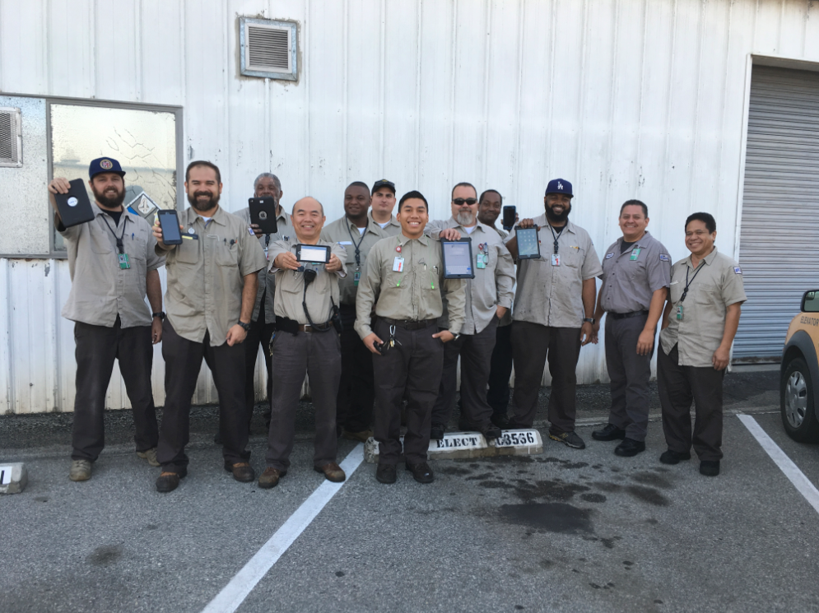
LAWA Elevator Shop

Slide 4
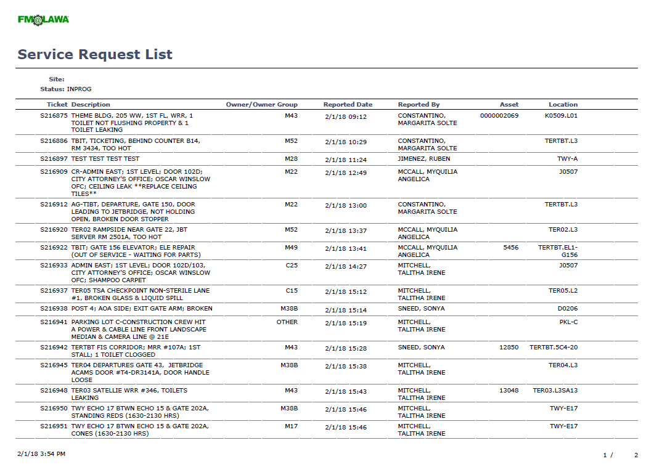
Notes:
ARCC Daily Shift Service Request Report

Slide 5
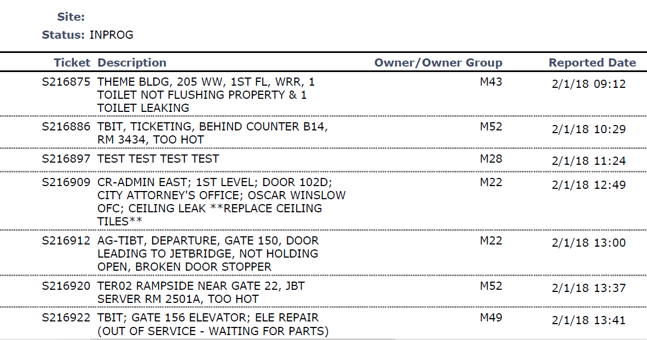
Notes:
ARCC Daily Shift Service Request Report

Slide 6
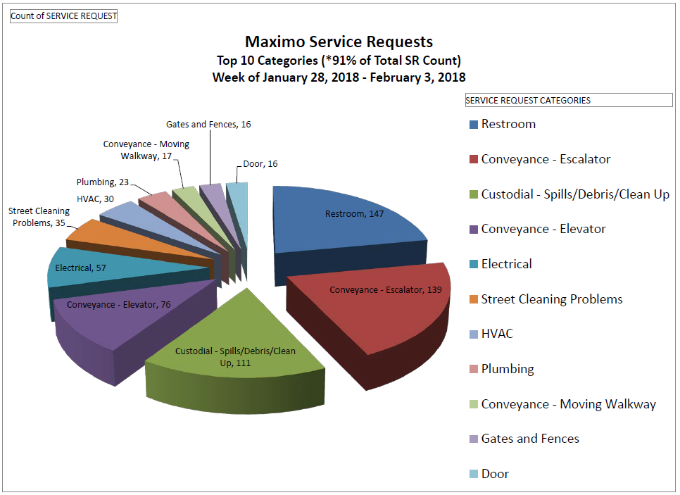

Slide 7
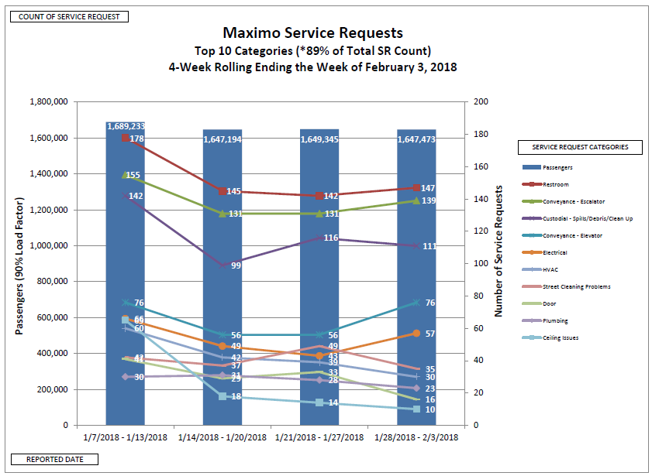

Slide 8
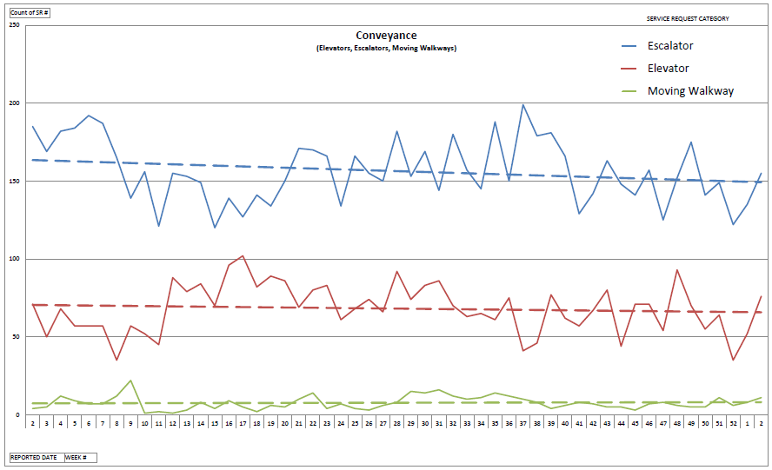
Notes:
Reporting period: Jan 11, 2017 – Jan 13, 2018

Slide 9
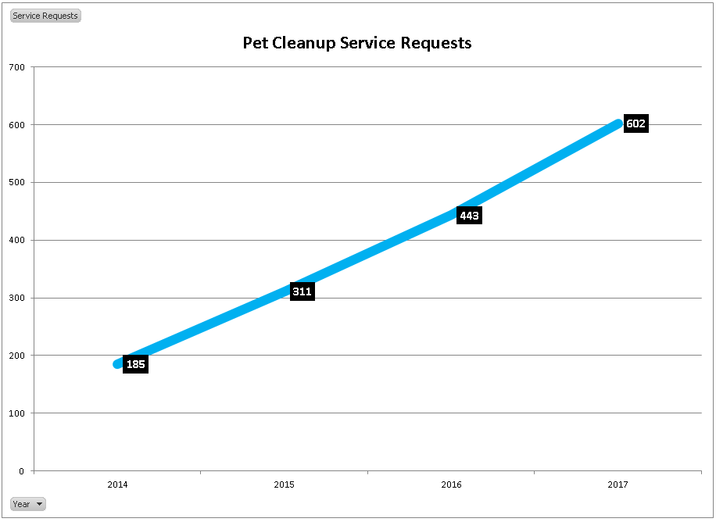

Slide 10
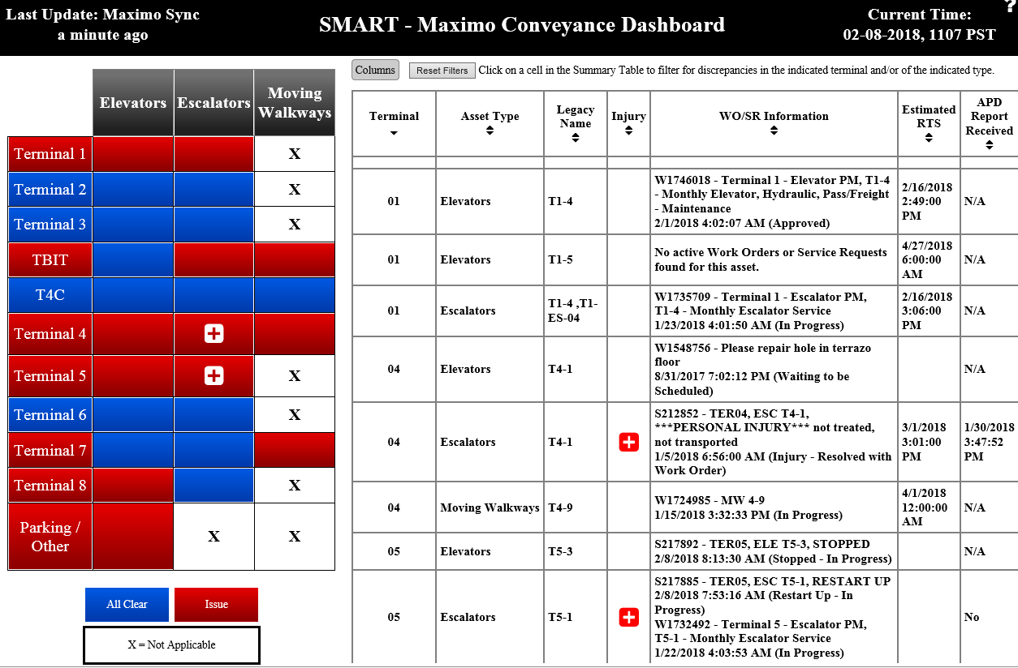
http://insidelawa/homepage.aspx

