Slide 1
LAXceptional Xperience

Slide 2
LAXceptional Xperience!

Slide 3
Objectives
Showcase our LAX brand statement and address LAX mission/vision
Highlight investment in physical improvements ($14 billion capital program)
Highlight human investment - share iCARE standards
Engage in demonstrating iCARE behaviors through fun and games!

Slide 4
LAX Airport
We are the world’s 5th busiest airport!
We are the 2nd largest city!
We have 65 different airport brands!
We connect our guests to the world!

Slide 5
World Class Airport

Slide 6
LAX MODERNIZATION

Slide 7
NEW INTERNATIONAL CONCOURSE

Slide 8
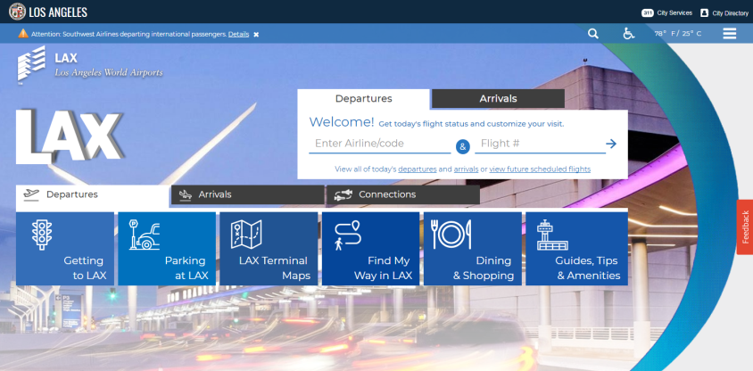
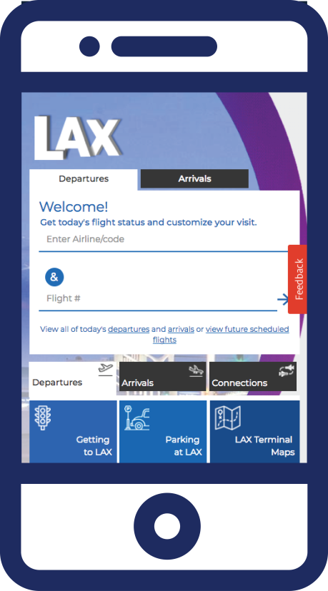
LAX on the Move!
News & Updates:
https://www.flylax.com/

Slide 9
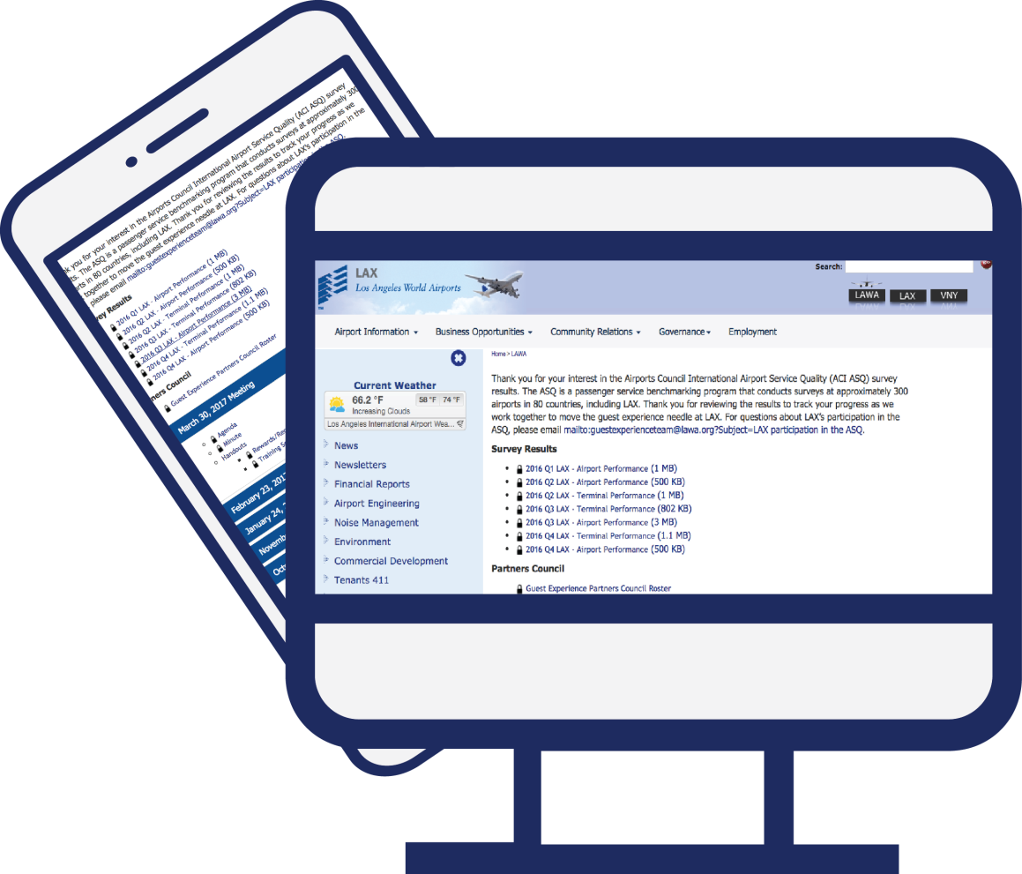
Weekly Construction Updates
http://www.lawa.org/en/lawa-tenants-411/guest-experience

Slide 10
Notes:
Barbara will speak to the group on the Brand Statement.
Question to pose to the group:
How does our brand statement connect with you so you can live it everyday?
Easel responses

Slide 11
One Word
Notes:
Jingle
Draw a Picture
Social Media Post
Tell a Story

Slide 12
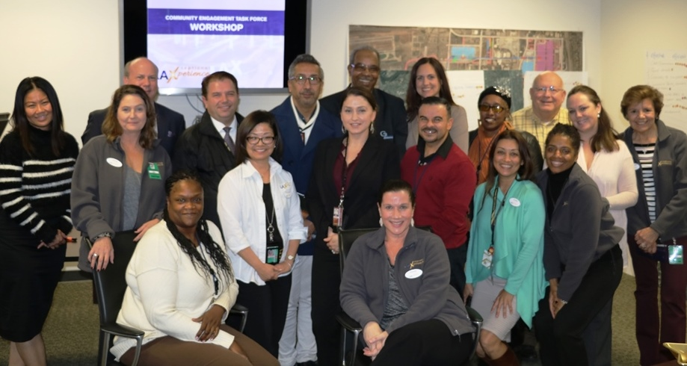
By Employees & For Employees

Slide 13
LAXceptional Xperience Standards
iCARE LAX
Informative
Showcasing all things LAX - its people, its facilities, its services and amenities
Courteous
Exuding excitement and the warmth of L.A.
Approachable
Creating exceptional memorable moments.
Responsive
Demonstrating integrity and empathy.
Efficient & Effective
Respecting our guests’ time and experiences.

Slide 14
LAXceptional Xperience Behaviors
informative – showcasing all things LAX
Be knowledgeable & informed
Be present and alert
Be proactive
Seek out answers and be accountable
Courteous – exuding excitement and the warmth of LA
Smile and be friendly, energetic and sincere
Be respectful and culturally sensitive
Make good eye contact and be attentive
Be patient with words, intent and feelings
Approachable – creating exceptional memorable moments
Be accessible and visible
Demonstrate positive body language
Be professional in appearance and actions
Demonstrate a “can do” attitude
Responsive – demonstrating integrity & empathy
Empathize with a sense of urgency
Actively listen
Anticipate guests’ needs
Be thoughtful and provide accurate and meaningful responses
Be aware of safety and security risks and call (424) 646-7911 if warranted
Help ensure clean facilities
Efficient & Effective – Respecting our guests’ time and experiences
Clearly communicate
Be resourceful
Help ensure consistent processes and communications
Take ownership of situations and handle with confidence

Slide 15
iCARE Video

Slide 16
GOLD STAR REWARD PROGRAM

Slide 17
LAXceptional Pursuit
Game Rules:
Roll the dice
Move game pawn according to the dots on the dice
Select a color coded card on the color space you landed
One player reads the question for the team to answer
Correct answer is highlighted on card
If answer is correct – fill in that section of the STAR
Next player rolls the dice
When all sections of the STAR are completed your team wins!

Slide 18
One Community
“You can design and create and build the most wonderful place in the world. But it takes people to make the dream a reality.” Walt Disney

Slide 19
Notes:
Distribute thank you gifts with LAX branded name
Feedback Forms

