Slide 1
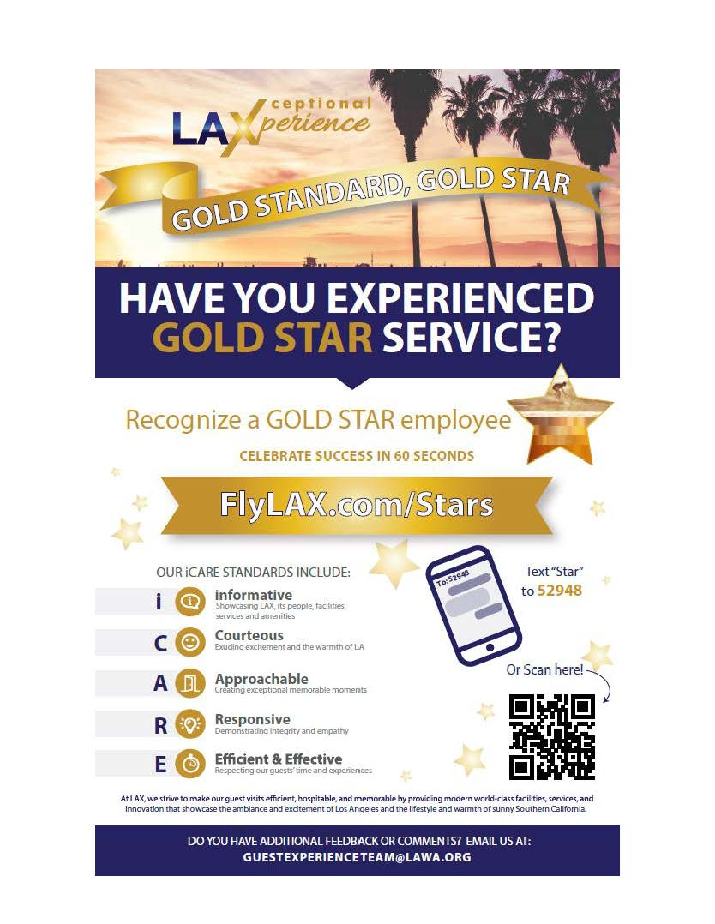
FlyLAX.com/Stars
Notes:
The last week of January, we had a soft launch of our rewards and recognition program called “LAX Gold Stars”. We’ll have an official kick-off next month, but you can start recognizing employees today! Wanted to do a quick demo for you. And we are now ready for you to share this with your employees.
There are number of ways to recognize someone:
1. www.laxfly.com/stars (you can get there through flylax.com or lawa.org)
(Demo on web)
I am a guest
I am an employee
Complete form and submit
2. Text – you can also get to this website on your phone by texting STAR to 52948
3. QR – Or you can use this QR code that will be on a number of promotional materials
So that’s how you can recognize and employee digitally on website and mobile.

Slide 2
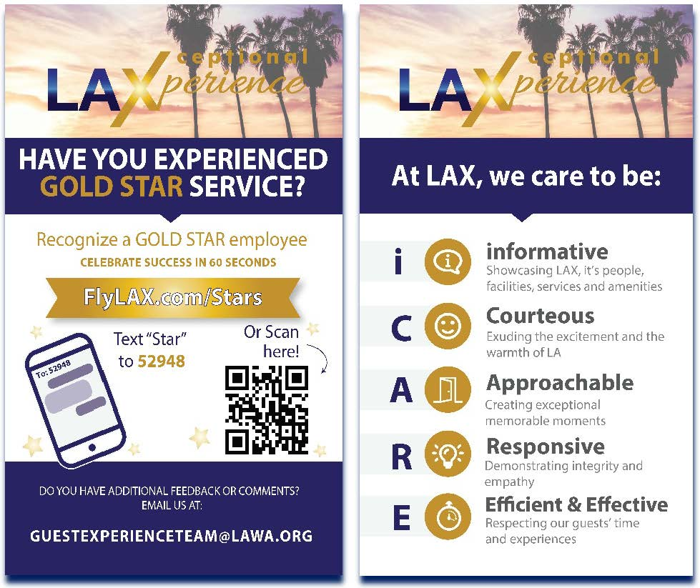
Notes:
But there are other options the “old school” way:
Business cards – Sometimes people will say, “You did such an awesome job, I want to let your boss know. How can I do that?” So now the employee can just hand this business card to the guest with all the info.

Slide 3
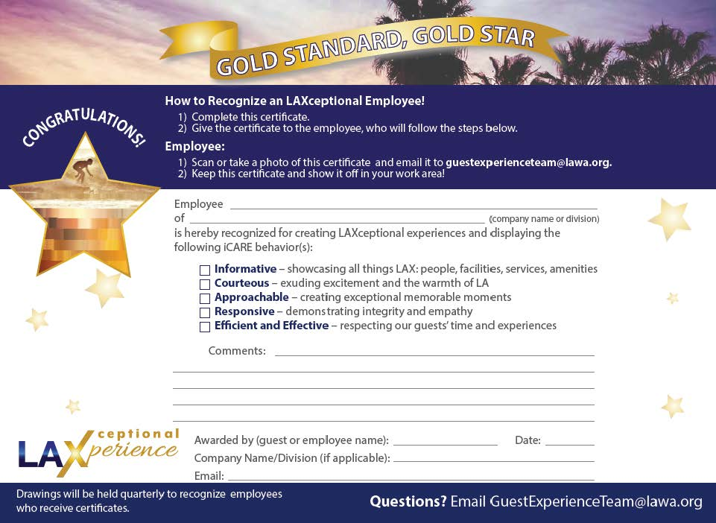
Notes:
Paper certificates – There will also be paper certificates that can be completed by guests or employees. These will be at the info desks in all terminals on the arrivals levels and we will make these available for those of you who have public counters or want to have stack to hand out as needed.

Slide 4
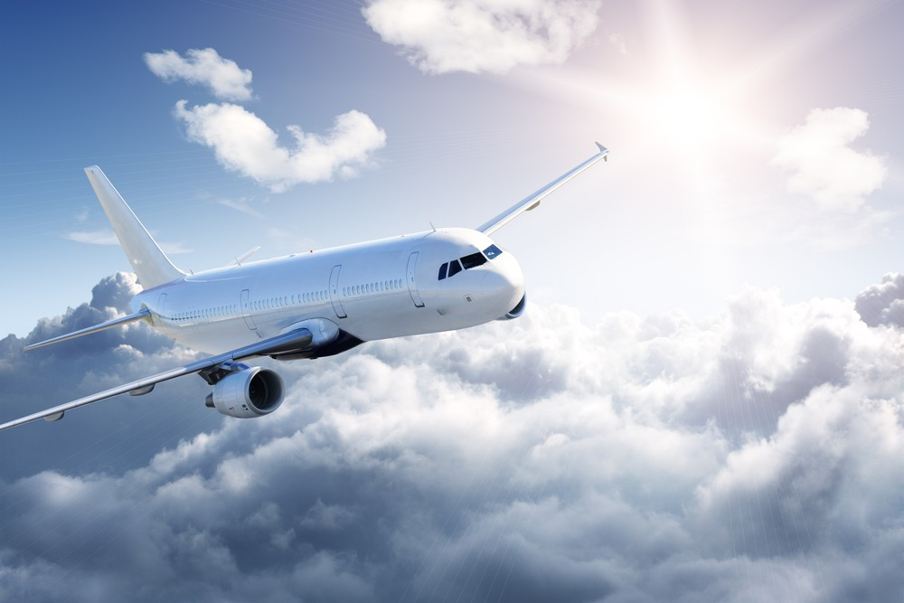
Monthly:
Certificates
Quarterly:
Random Drawing
3 from each terminal
10 airport-wide
“Wall of Fame”
What happens after recognition is sent in?
FlyLAX.com/Stars
Notes:
What happens after recognition is sent in?
Monthly
Certificates -- Every month, we’ll get a list of all the employees that have been recognized and we’ll email certificates to division managers (PC) to present to their employees in whatever manner they choose i.e. staff meeting, tailgate, etc.
Quarterly – Will take all the names from the quarter and randomly draw winners:
3 from each terminal
10 airport-wide
Those winners will be posted on a virtual Wall of Fame on our website.
Annually – Awards banquet

Slide 5
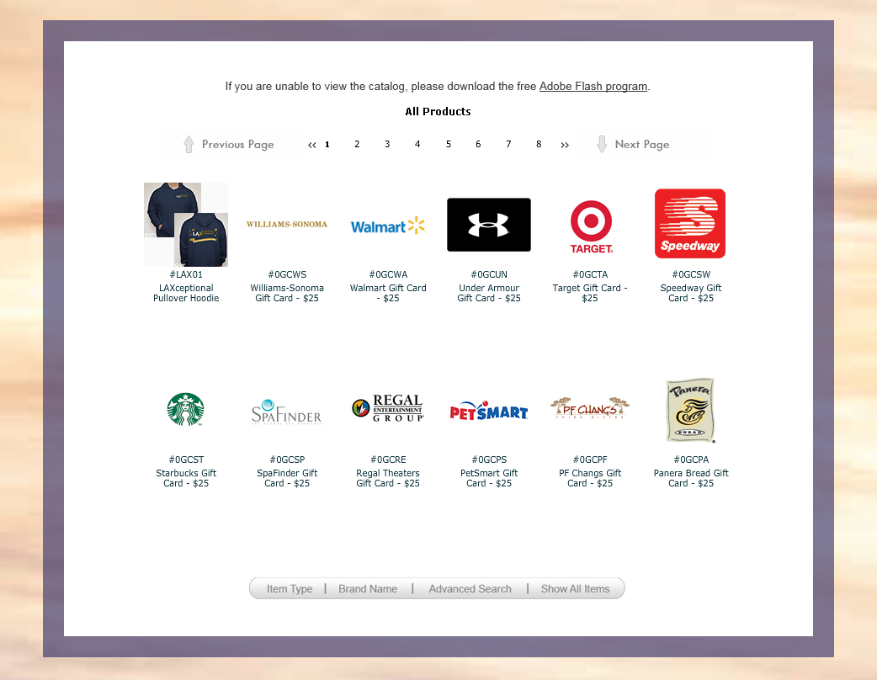
FlyLAX.com/Stars
Notes:
Those drawn will receive a special code to go on the website to select some pretty cool prizes
Demo on website
170 prizes to choose from
(75) $25 gift cards
Assortment of products from electronics to kitchen supplies to jewelry

Slide 6

Quarterly Awards
Mystery Shop Scores
Best Overall Terminal
Most Improved Terminal
Best Performers
ASQ
Best Overall Terminal
Most Improved Terminal
Friendliest Terminal (courtesy scores)
Highest Satisfaction – Check-in, Security Process, Restrooms
Best Rated Airline
Most Improved Airline
LAXtra Mile
Employees who go the extra mile, above and beyond their normal course of duties
Notes:
In addition, every quarter, we’ll have an informal celebration to recognize our best performers based on ASQ and mystery shop scores.
The award categories are listed here.
And then the big celebration will be an annual awards ceremony next year.

Slide 7
LAXtra Mile
Quarterly – Selection committee of LAWA and Partners Council
Cross section of airlines, concessionaires, TSA, CBP, ground transportation and LAWA
Notes:
LAXtra Mile – For all nominations submitted, GET will determine if the nomination should be considered for an LAXtra Mile award which recognizes employees who take exceptional service to the next level.
We would like to put together a selection committee made up of LAWA and Partners council members to vet those employees considered for an LAXtra Mile award. If any of you are interested in being on that selection committee, please let me know.

Slide 8


Communications Tools
Posters for employee lunch and break rooms
Tabletop posters for public counters (Badging, HR, Permits, ABM Parking Office, etc.)
Tent cards for concessions, airline check-in desks and other areas
Freestanding signage at info booths
Digital Display Boards – (JC Decaux available space in concourse and other areas)
Flight Information Displays – Available panels used as
placeholders for emergency messaging
Placards in shuttle buses
Business cards
Buttons for employees to wear to increase awareness
LAX maps
Notes:
Although you are able to use the website and recognize employees today, we will be doing a more official launch next month. The communications tools will include all of these things listed here from digital displays which are in our terminals now to posters to tent cards to digital displays to buttons. Maps – that were so popular during the Delta move – are also being reprinted to include the rewards info.
Today, we have some fliers for you to share with your employees and we will also send it to you electronically. Will also post on lawa.org.
We also be out in the terminals to get the word out to our guests as well as employees and would like to coordinate this with you.

Slide 9




How you can help!
Help us identify your employees (monthly, beginning in April)
Present certificates to your Gold Stars
Spread the word to your team!
Provide us with a contact person to coordinate promotional materials/activities
Invite us to your staff meeting/employee forum
Take the iCARE training by June 2018
Open classroom sessions
Targeted group sessions
Train-the-Trainer workshops
Training Modules (10-minute “chunked” learning)
Computer Based Training (Coming Soon!)
Notes:
We have a number of specific asks of you.
1. Monthly (beginning April 2018), Guest Experience Team will send you a list of employees who were recognized. You may be asked to help verify the employees' names in cases where the information provided is incomplete.
2. Once names are verified, we will send you certificates to present to your employees in a forum of your choice (staff meeting, shift briefings, tailgates, etc.) on a monthly basis.
Love you to help spread the word in your existing employee communications tools whether it’s an email, newsletter, video.
We will provide you with a number of communications tools.
Please provide us with a contact name of the person you want us to coordinate with to provide posters, tent cards, etc as well as any in-terminal promotional activities. Sign-up sheet going around
You can also invite us to one of your employee meetings and we’ll be happy to brief them on the program and generate awareness and excitement.
In order to ensure that your employees have a good chance and being recognized, we also need you to get them to take the iCARE training. The deadline is fast approaching – which is the end of February -- for divisions with less than 100 employees to complete the training and we are almost there! I’ve reached out to those of you who are almost at the finish line to help you get there.
NEW TRAINING OPTION! Modules – Took the classroom training and broke it into three modules, each 10 to 15 minutes long. Includes discussion points. Can deliver this during staff meetings, etc. as you see fit. Once you’ve completed all three modules, please send us a list of all the employees that participated.
Modules are posted on Tenants 411.
Working on CBT – 30-minute training broken into six modules with videos and interactive activities. Will have first draft in March and final delivery in April.

