Slide 1
Airline Engagement
November 14, 2017
Notes:
Background
Findings
Recommendations

Slide 2
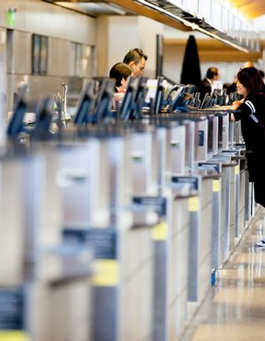
Background
Airline liaison role
Airline relationship
Airline engagement
  Alaska Airlines, Mike Stanley & Rick Jeffrey
  Delta, Daryl Elsberg
  JetBlue, Paula Minniti
  Hawaiian Airlines, Lisa Halvorson
  Southwest Airlines, Toni Wilson
  United Airlines, Jim Trabuco & Jim Hanselman
Notes:
AvAirPros role – single point of contact for airlines and lawa. Serving LAX since 2007.
Airline relationship governed by the Lease and Use Agreement. Relationship steered by Corporate Real-estate (Airport Affairs), interface primarily with CDG. Legacy airline operations work autonomously – responsible for improvements, janitorial and maintenance in leased space. Includes ticket counter, bag claim and holdrooms. Excl. public corridors and restrooms. Different than common use facilities -100% reliant on LAWA.
Engagement limited and inconsistent, so we went to them and this is what we learned…..

Slide 3

What We Learned
Airlines acknowledge and appreciate LAWA’s focus on the guest experience
Facility functionality is a basic need
i-CARE training is difficult to deliver
Case studies
  Alaska
  JetBlue
  Southwest
  United
Notes:
When asked about guest experience two primary theme – fix the facility and improve OT
Unaware of how to escalate issues
Didn’t really understand that the Guest Experience included them – it is something LAWA is doing
Challenged to incorporate i-CARE and support corporate initiatives
Alaska – active customer response program at headquarters (all employees) and local. Daily metrics reviewed. Working on VX integration. Willing to test training with mgt employees.
JetBlue – all employees recently participated in a 2 day soft skill training, leadership 3 day. Going forward will be rolled into initial and recurrent. Willing to incorporate
Southwest – Q1 and Q2 annual training. Accountability and recognition actively managed w/ customers. Surprise and delight – Fuzzy dice.
United - Like WN no shift briefings, 170 start times
Similar company training exists
Programs are corporate driven and measured – additional initiatives not funded or supported
Do pass through material via email

Slide 4

Partners Council
Commitment to improve attendance
Suggestion to focus on pain points
Metrics provide some value
Communication is shared
Notes:
Published calendar in advance would be helpful
Would like to use partners council to improve relationships, if necessary escalate pain points
Metrics are some value – terminal specific, but get similar information internally
Communication is shared –pdf and word
Employees are less interested in what is going to happen, they want to know how to manage through construction
Construction updates very helpful

Slide 5
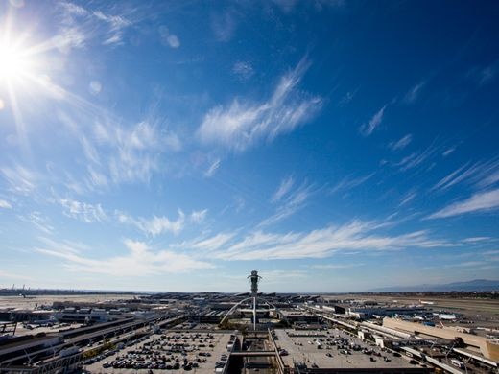
Focus Areas
Facilities & Cleanliness
Restrooms cleanliness and provisioning
Out of service vertical circulation
“Things just look messy”
Connectivity & IT
Guest become disconnected at the airport
Airlines unsuccessfully introduce automation
Basic elements don’t work
Notes:
Consistent with passenger feedback….
Things look messy – trash cans overflowing, dirty
Wi-fi a huge issue. Airlines offer Onboard entertainment, but customers cant download app
Affects operation: bag scanning, irr ops mgt, employee communication
PA systems don’t work

Slide 6
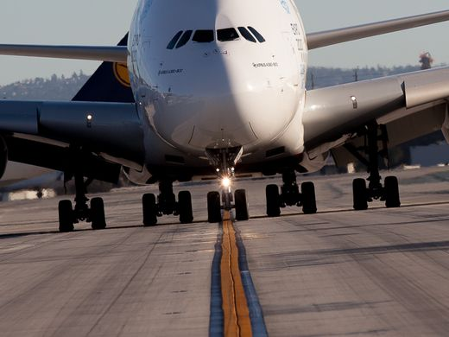
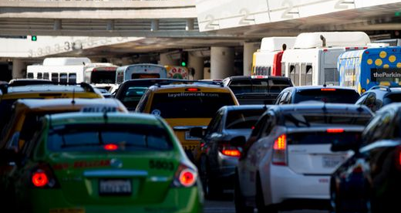
Focus Areas
Airfield & Taxiway Congestion
Long taxi-times and gate holds
On-time directly tied to guest experience
Traffic Congestion
Impacts employees and guests
Notes:
LAX is facing increasing OT problems, some likely construction related others may be attributed to growth.
Discuss ASMS and including education in next Partners Council
Traffic congestion impact

Slide 7
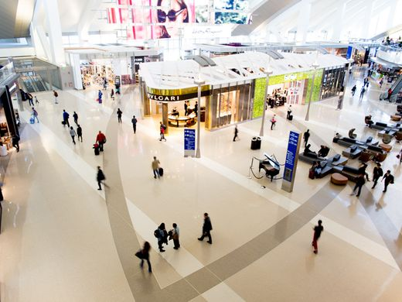
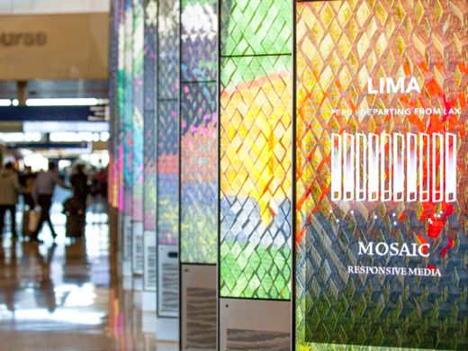
Focus Areas
Wayfinding & Services
Signage needs refreshing
Technology has a role
Concession availability and variety
Additional services
Notes:
Additional Services – red coats and busing

Slide 8
Recommendations
Partners Council
  Highlight best practices at Partners Council
  Highlight pain points
Develop terminal action plans
  Focus on cleanliness and maintenance
  24/7 services
Work with airlines who can support i-CARE training
Escalate cellular delivery
Explore Wi-Fi Improvements
Analyze and problem solve for airfield congestion

