Slide 1
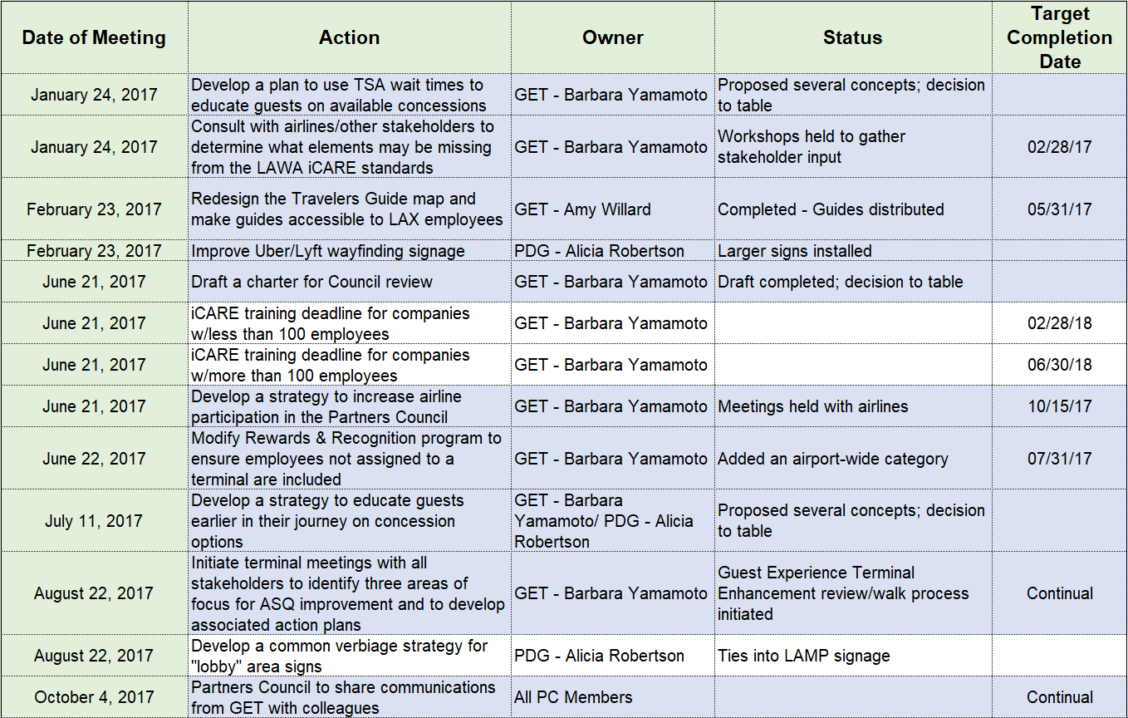
Partners council action plan
Shaded lines indicate closed/ complete

Slide 2
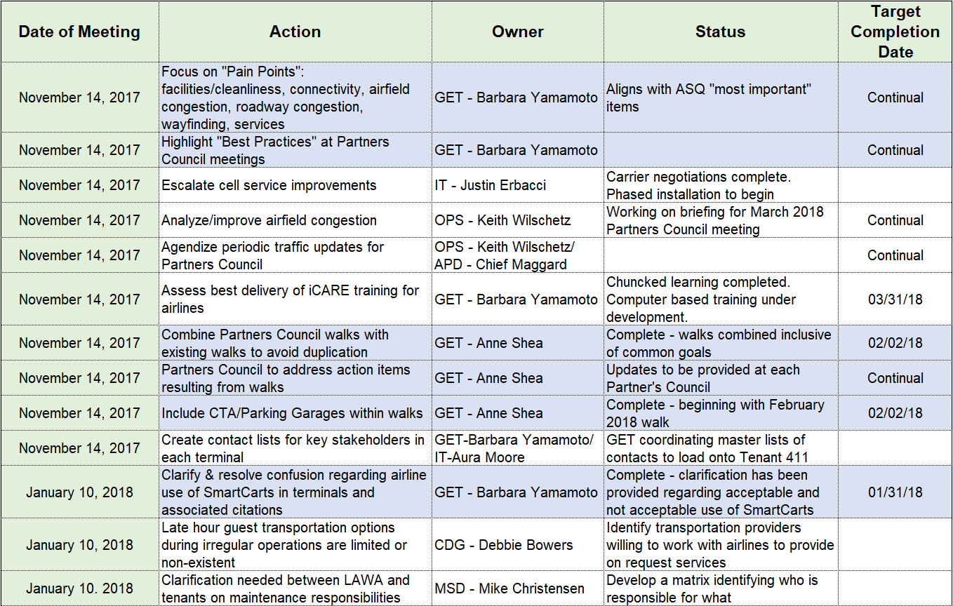
Partners council action plan
Shaded lines indicate closed/ complete

